Slide 1
SquarePie
Giri Narasimhan
Programming Team
Sep 1, 2016

Slide 2
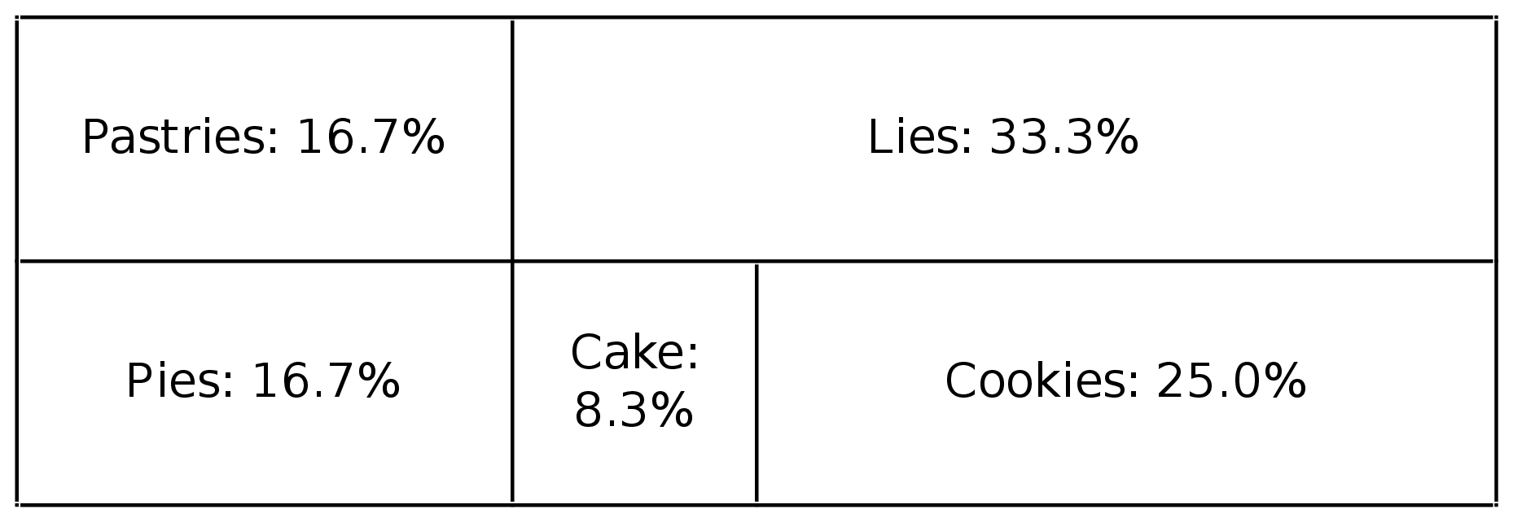
Square Pie Chart
Given a square pie chart as a collection of horiz and vertical line segments, goal is to list sizes of regions in decreasing order
8
6 2 0 2
0 0 6 0
0 2 0 0
2 2 2 1
3 1 3 0
0 1 6 1
6 0 6 2
2 1 2 0

Slide 3
Approach
Identify the rectangular regions
Find their areas, sort the list of areas, and report the list

Slide 4
Challenge
To identify the regions because …
Regions are not given as rectangles
Given as a collection of line segments
Line segments are not given in any order
As a simple subproblem
How do we identify first, i.e., largest rectangle?
Observation
Line segments given as created, not after segmenting
Although outer segments broken later, they are whole

Slide 5
Simple idea
Sort segments by length
Step 1 (perform once):
Find 2 horizontal & 2 vertical segments that are longest
If more than two, then pick “outermost” to construct rectangle and insert into list of surviving rectangles
Step 2 (repeat until no more segments):
Longest vert/horiz seg must partition a rectangle
Remove rectangle, partition it and insert the two newly created rectangle into surviving rectangles list
Step 3: Report areas of all surviving rects

