Slide 1
Chapter 10
ASP.NET AJAX

Slide 2
Objectives
Using the UpdatePanel control to avoid page flicker
Understanding the ScriptManager control that enables the Ajax functionality
Using the UpdateProgress control to notify users about progress of an Ajax operation
Creating WCF services that are accessible by your client-side script

Slide 3
Introducing AJAX
Ajax stands for Asynchronous Javascript and XML and enables web pages to exchange data without having to send the entire page over to the server.
Ajax used to use XML to transfer data over to the server but it now mostly uses JSON (Javascript Object Notation) because it is more lightweight.
Normally, when a postback to the server from an application, the entire contents of the page are sent back to the server.
This is because of the HTTP protocols’ stateless nature.
Ideally however, if a control needs to retrieve data from the server during the interaction you would like send only what changes.

Slide 4
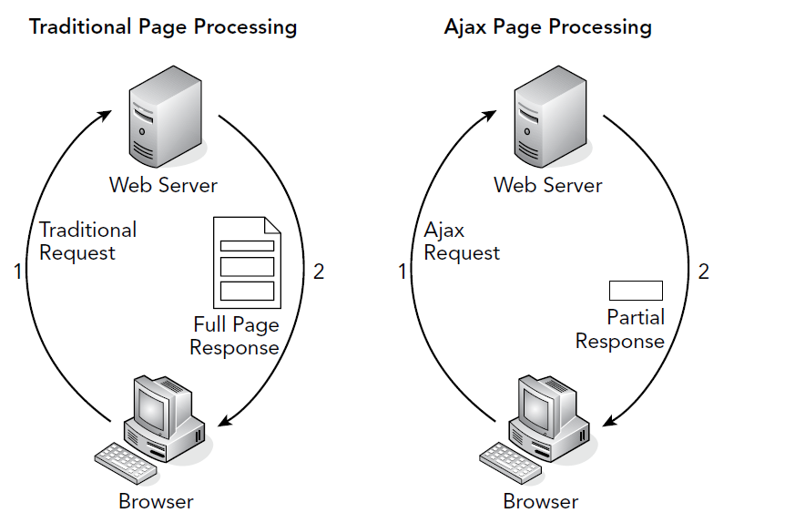
Full Response vs. Partial Response

Slide 5
Flicker-Free
Now consider how the browser has to render the page.
The other problem from a user experience standpoint, is that the since all the existing controls are discarded and reloaded, the user experiences a “flicker” as the loading occurs.
This flicker causes an unattractive user experience.
The Ajax architecture addresses this problem as well, by quickly loading a subset of the controls on an as-needed basis.

Slide 6
ASP.NET Ajax
An earlier form of Ajax available was the XMLHttpRequest Object that enabled calls to be made to the server from the client using XML to send and receive data.
With ASP.NET Ajax, you can:
  Create flicker-free pages that enable you to refresh portions of the page without a full reload and without affecting other parts of the page
  Provide feedback to your users during these page refreshes
  Update sections of a page and call server-side code on a scheduled basis using a timer
  Access server-side WCF and other services and work with the data they return

Slide 7
Using ASP.NET Ajax
Each new ASP.NET 4.5.1 web project you create in VS is already Ajax-enabled.
Toolbox contains an AJAX Extensions category with a number of Ajax-related controls that you can use in your pages.
Controls:
  UpdatePanel
  ScriptManager
  UpdateProgress
  Timer
  ScriptManagerProxy

Slide 8
The UpdatePanel Control
This control is wrapped around the content that you want to update and works alongside the ScriptManager.
If one of the controls within the UpdatePanel causes a postback to the server, only the content within that UpdatePanel is refreshed.
Consider the UpdatePanel to be a special type of container.
Suppose you were to add an UpdatePanel and then add a label and a button inside the UpdatePanel.

Slide 9
The UpdatePanel Control
The following would be your markup
<asp:UpdatePanel runat="server">
<ContentTemplate>
<asp:Label ID="Label1" runat="server"></asp:Label>
<asp:Button ID="Button1" runat="server" Text="Button" />
</ContentTemplate>
</asp:UpdatePanel>
In addition, you need to add a ScriptManager control
<asp:Content ID="Content2" ContentPlaceHolderID="cpMainContent" runat="Server">
<asp:ScriptManager ID="ScriptManager1" runat="server"></asp:ScriptManager>
<asp:UpdatePanel runat="server">

Slide 10
The UpdatePanel Control
When the button gets clicked since it is part of the UpdatePanel, a postback occurs and only the controls within the UpdatePanel get updated.
You can go ahead and change the text in the label by adding the following to the Page_Load method.
  protected void Page_Load(object sender, EventArgs e)
  {
  Label1.Text = System.DateTime.Now.ToString();
  }
You would see the label’s text getting updated with a partial postback due to the UpdatePanel.

Slide 11
The UpdatePanel and ScriptManager
The ScriptManager — that you placed in UpdatePanel.aspx directly in this exercise — is a requirement for most Ajax functionality in an ASPX page to operate correctly.
It serves as the bridge between the client page and the Microsoft ASP.NET AJAX Framework and takes care of things like registering the correct JavaScript files that are used in the browser.
The default behavior of an UpdatePanel is that only its inner contents are refreshed by other server controls defined within the <ContentTemplate> element.

Slide 12
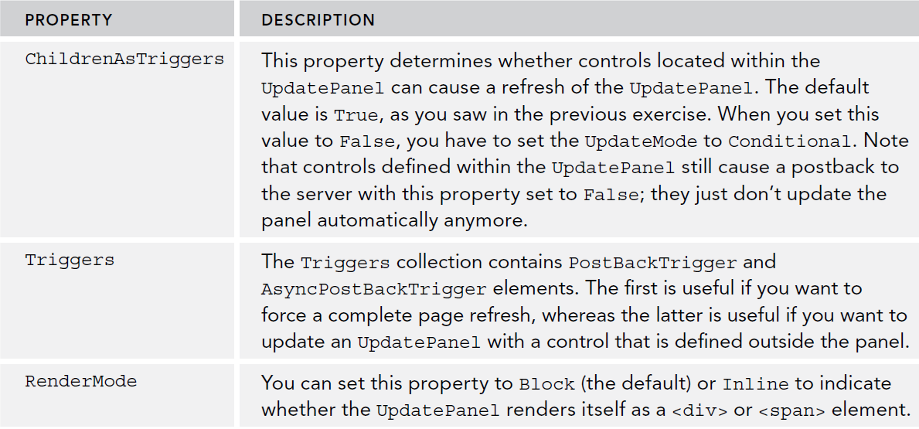
Common UpdatePanel properties

Slide 13
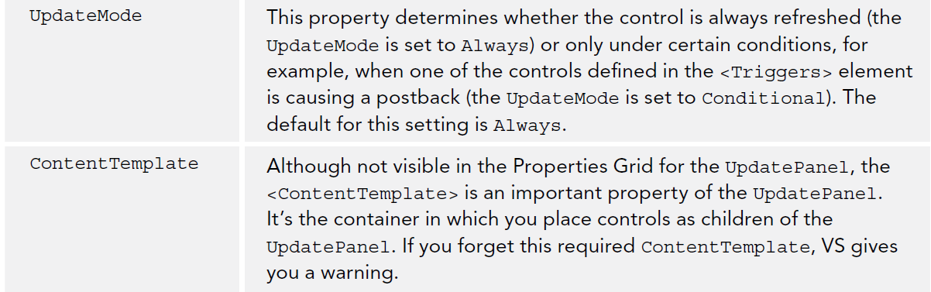
Common UpdatePanel Properties

Slide 14
Things to Remember: UpdatePanel
The entire page (and all of its form data) is still posted back to the server. At the server, the page still goes through its normal life cycle and then sends back the HTML that is needed to update the page.
The data contains some overhead data (required by ASP.NET AJAX to understand how to interpret it).
This means that the UpdatePanel carries some overhead in terms of form posts, page processing, and network traffic.

Slide 15
ScriptManager Control
This control serves as the bridge between the client page and the server.
It manages script resources (the JavaScript files used at the client), takes care of partial-page updates, and handles interaction with your website for things like WCF services.
You can place it in the aspx page if it will only be used in several pages, or you can place it on the Master page.
For simple use with UpdatePanel, there is no modification needed, but it does support other attrivutes.

Slide 16
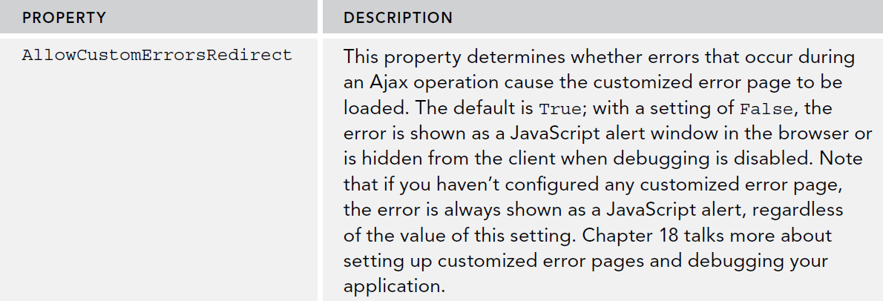
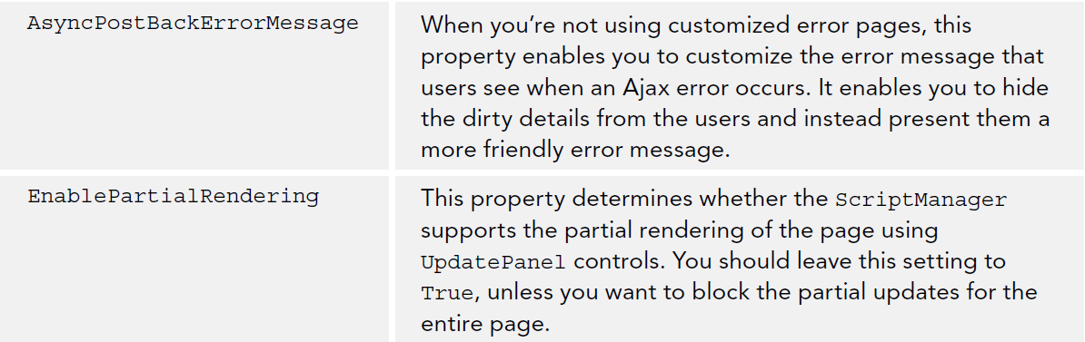
ScriptManager Properties

Slide 17
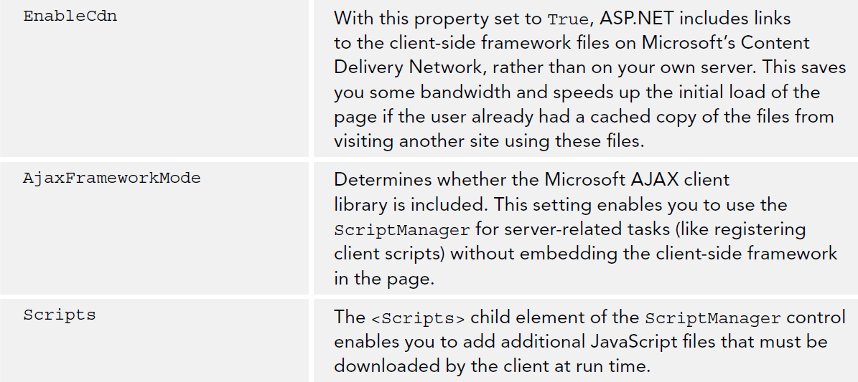
ScriptManager Properties

Slide 18
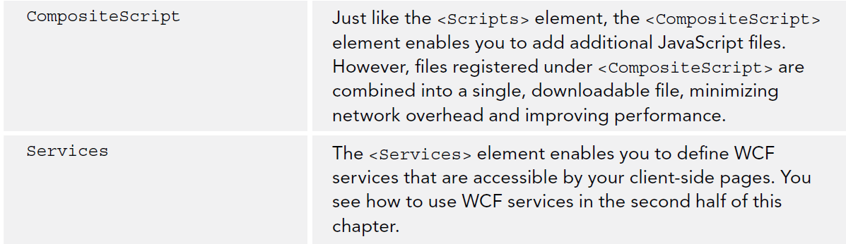
ScriptManager Properties

Slide 19
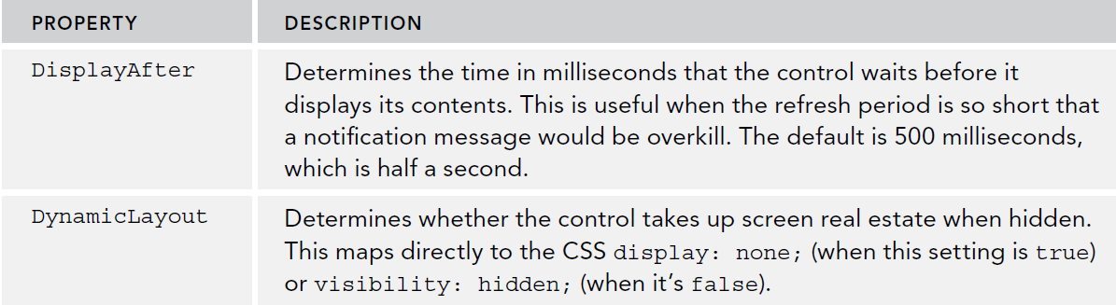
UpdateProgress Control
Used for providing feedback to the user.
Is connected to the Update Panel by the AssociatedUpdatePanelID property.
Defines a <ProgressTemplate> element whose contents are showing while the UpdatePanel is refreshing.
In addition, has the following properties:

Slide 20
UpdateProgress Control
You can use a GIF or Text to display the progress, and combine CSS rules.
Example Code:
    <asp:UpdateProgress ID="UpdateProgress1" runat="server“ AssociatedUpdatePanelID="UpdatePanel1">
    <ProgressTemplate>
    <div class="PleaseWait">
    Please Wait...
    </div>
    </ProgressTemplate>
    </asp:UpdateProgress>
You can always set a minimum time to process by using the Sleep method in C#
      System.Threading.Thread.Sleep(5000); //5 second wait
The CSS can contain the refresh image that gets displayed.

Slide 21
UpdateProgress Control
The class “PleaseWait” is defined in the CSS as
.PleaseWait
{
height: 32px;
width: 500px;
background-image: url(Images/PleaseWait.gif);
background-repeat: no-repeat;
padding-left: 40px;
line-height: 32px;
}
The Result is:

Slide 22
Timer Control
The Time Control can be used to refresh an area of a page on a given interval.
At the given interval, the control fires its “Tick” event.
You can add your code to the event handler to perform a server side call and update any content on a page.
Must be used with a page or Master page that has the Script Manager control.

Slide 23
Timer Control
Example:
  <asp:UpdatePanel ID="UpdatePanel1" runat="server">
  <ContentTemplate>
  <asp:Label ID="Label1" runat="server"></asp:Label>
  <asp:Timer ID="Timer1" runat="server" Interval="5000" OnTick="Timer1_Tick" />
  </ContentTemplate>
  </asp:UpdatePanel>
We can program to respond to the OnTick event as follows:
protected void Timer1_Tick(object sender, EventArgs e)
{
Label1.Text = System.DateTime.Now.ToString();
}
You can also add your own button to call this method to force a refresh.

Slide 24
Web Services in AJAX Websites
Web Services is a an agreed upon standard to call methods over the web.
They are framework agnostic, so other frameworks such as Java and PHP also support web services.
The Windows Communication Foundation (WCF) is Microsoft Platform for Service Oriented Architecture.
In previous versions of ASP.NET you could also make use of so-called ASMX web services, but these have now been deprecated in favor of WCF.
To build a WCF web service, you add a WCF service (with an .svc extension) to your project.

Slide 25
Web Services in AJAX Websites
Inside a .svc service file (the NameService class) you define a Service Contract and an Operation Contract.
The Service Contract defines the overall service.
The Operation Contract defines the various methods that are available on the service.
  [ServiceContract(Namespace = "")]
  [AspNetCompatibilityRequirements(
  RequirementsMode = AspNetCompatibilityRequirementsMode.Allowed)]
  public class NameService
  {
  [OperationContract]
  public string HelloWorld(string name)
  {
  return string.Format("Hello {0}", name);
  }
  }

Slide 26
Web Services in AJAX Websites
The [ServiceContract] is an attributes (attributes use brackets) and mark this method as a special method.
With this attribute you signal to the .NET runtime that you want to expose this class as a WCF Service.
The ASPNetCompatibilityRequirments.Allowed means this is compatible with the older .Asmx services.
To expose your method in the we service, we have the OperationContract attribute. This enables you to create other methods which add functionality but are not exposed by default.

Slide 27
Web Service in AJAX Websites.
To expose a WCF service to the client-side script in your application, you need to register it in the Web.config file.
In addition, you need to apply the correct attributes to the service class. Both actions are carried out for you when you add an WCF Service (Ajax-enabled) to your project.
Web.config should have the following once you add a WCF Service
    <services>
    <service name="NameService">
    <endpoint address="“ behaviorConfiguration="NameServiceAspNetAjaxBehavior"
    binding="webHttpBinding" contract="NameService" />
    </service>
    </services>

Slide 28
Calling the service from the Client Side
We can have the client call the web service in the same project, but in practice we can create two separate projects (one which is just a web service and the other which is the website).
Given the NameService class (.svc) we configure a client call as following:
  <asp:ScriptManager ID="ScriptManager1" runat="server">
  <Services>
  <asp:ServiceReference Path="~/WebServices/NameService.svc" />
  </Services>
  </asp:ScriptManager>

Slide 29
Calling the service from the Client Side
You can call the service from the Client side. By using plain HTML elements and not ASP.NET Server Controls, you can see that the code you are going to write really executes at the client.
For example, you can call it on a button click if on an HTML button on the markup
<input id="SayHello" type="button" value="Say Hello" onclick="helloWorld();" />
Then on the Javascript client side, call the web service
  function helloWorld()
  {
  var yourName = document.getElementById('YourName').value;
  NameService.HelloWorld(yourName, helloWorldCallback);
  }

Slide 30
Calling the service from the Client Side
Once this service has been configured in your page with the ScriptManager, we can make the call to the method in javascript:
      NameService.HelloWorld('Imar', helloWorldCallback);
      function helloWorldCallback(result)
      {
      alert(result);
      }
The HelloWorld web service method can be called from anywhere in your javascript, but the second parameter “hellowWorldCallback” is a Javascript function which receives the result after the web service method is called.
This is known as a callback function and receives a “result” or output from the web service method.

Slide 31
Calling the service from the Client Side
The web service method can have the following parameters:
  Method parameters: Parameters defined in C# method
  success callback function: will receive control after the web service method is executed.
  fail callback function: Will receive control if the web service method failes to be executed.
  User context: useful if you need additional context data to correctly process the success callback

Slide 32
Exchanging Complex Objects in Web Services
Suppose we have a method that returns a List of a complex Object, for example:
    [ServiceContract(Namespace = "")]
    [AspNetCompatibilityRequirements(
    RequirementsMode = AspNetCompatibilityRequirementsMode.Allowed)]
    public class ReviewsService
    {
      [OperationContract]
      public List<Review> GetLatestReviews()
      {
      List<Review> temp = new List<Review>()
      {
      new Review() {Id = 1, Title = "21st Century Breakdown by Green Day"},
      new Review() {Id = 2, Title = "Sonic Youth: Daydream Nation live in Roundhouse, London"}
      };
      return temp;
      }
    }
    public class Review
    {
    public int Id { get; set; }
    public string Title { get; set; }
    }

Slide 33
Exchanging Complex Objects in Web Services
This method will return a List of type Review.
On the client side javascript we can use a for loop and refer to each item in the list by an index.
function getLatestReviewsCallback(result)
{
var listItems = '';
for (i = 0; i < result.length; i++)
{
listItems += '<li>' + result[i].Title + '</li>';
}
document.getElementById('Reviews').innerHTML = listItems;
}
To get the object to the client, WCF serializes the collection of reviews into JavaScript Object Notation (JSON) — a string representation of your objects that can be used directly in your JavaScript code.

Slide 34
Exchanging Complex Objects in Web Services
The JSON representation of the data coming over from the previous method would be:
{"d":[{"__type":"Review:#","Id":1,"Title":"21st Century Breakdown
by Green Day"},{"__type":"Review:#","Id":2,"Title":
"Sonic Youth: Daydream Nation live in Roundhouse, London"}]}

Slide 35
JSON in Web Services
JSON is a lightweight, extremely popular format to pass Objects in the wbe service standard.
W3Schools JSON Info http://www.w3schools.com/json/
Format looks like the following:
  {"employees":[
  {"firstName":"John", "lastName":"Doe"},
  {"firstName":"Anna", "lastName":"Smith"},
  {"firstName":"Peter", "lastName":"Jones"}
  ]}
This represents a list of Employee Objects with the attributes firstName and lastName.

Slide 36
Creating a Web Service
Add a new item of Template type “WCF Service Ajax –enabled”

Slide 37
Creating a Web Service
Open the service you added an add your method to the codebehind
public class NameService
{
  ...
  [OperationContract]
  public string HelloWorld(string name)
  {
  return string.Format("Hello {0}", name);
  }
}

Slide 38
Creating a Web Service
You can review if your web service is available by browsing the URL.
WCF services don’t expose their metadata. This means they don’t tell the outside world how they work and how to call them.

Slide 39
Configuring the ScriptManager
You can add a ScriptManager to an individual page or to the master page so it becomes available throughout your site.
When using web services, you also need to tell the ScriptManager that you want to expose your web service to client script. You have two ways to do this:
  In the ScriptManager in the master page
  In a content page that uses the web service, using the ScriptManagerProxy class
For example, to make the NameService.svc service you created available in all
pages in your site, you’d add the following highlighted code to the master page:
    <asp:ScriptManager ID="ScriptManager1" runat="server">
    <Services>
    <asp:ServiceReference Path="~/WebServices/NameService.svc" />
    </Services>
    </asp:ScriptManager>

Slide 40
Configuring the ScriptManager
If the Master page already contains a ScriptManager and you want to add services on a specific page, you need to use ScriptManagerByProxy in the content page.
<asp:ScriptManagerProxy ID="ScriptManagerProxy1" runat="server">
<Services>
<asp:ServiceReference Path="~/WebServices/AnotherNameService.svc" />
</Services>
</asp:ScriptManagerProxy>
You should place your common web services in the Master page, so all pages inherit them, but you can create specifc services for specific service on by using ScriptManagerProxy.

Slide 41
Handling an error from the Web Service
In addition to this success callback, you could add another callback method that is triggered when the web service somehow fails; for example, because the network connection is down or because the service threw an exception.
In that case, the call to HelloWorld would look like this:
NameService.HelloWorld(yourName, helloWorldCallback, helloWorldErrorCallback);
The helloWorldErrorCallback function could then look like this:
function helloWorldErrorCallback(error)
{
alert(error.get_message());
}
NOTE: When debugging a web service, alert() is a great way to see what is being sent back.

Slide 42
Summary
In this chapter we covered:
  Learned how to use the UpdatePanel control to avoid page flicker
  Understood the ScriptManager control that enables the Ajax functionality
  Learned how to use the UpdateProgress control to notify users about progress of an Ajax operation
  Created WCF services that are accessible by your client-side script

