Slide 1
Chapter 12
Introducing Databases

Slide 2
Objectives
What a database is and which databases are typically used with ASP.NET pages
What SQL is, how it looks, and how you use it to manipulate data
What database relationships are and why they are important
Which tools you have available to manage database objects (such as tables) and how to use them

Slide 3
Databases
A database is a collection of data that can usually by accessed and queried.
The most popular databases are relational databases, in which data is arranged in tables which store rows of data across columns.
You can query the data using SQL (Structured Query Language) statements.
Other types exist, including flat-file, NoSQL, object-relational, and object-oriented databases, but these are less common in Internet applications.

Slide 4
Relational Databases
Information is stored across tables, which are composed of columns.

Slide 5
Relational Databases
You can use many different kinds of databases in your ASP.NET projects, including Microsoft Access, SQL Server, Oracle, SQLite, and MySQL. However, the most commonly used database in ASP.NET websites is probably Microsoft SQL Server.
ASP.NET can directly plug into a database to be able to save your data from your web forms.

Slide 6
SQL Express
SQL Express is Microsoft’s free version of the database that can be installed locally.
SQL Server 2016 link https://www.microsoft.com/en-us/download/details.aspx?id=52679
After you install the database, you can connect to the DB server with your windows account

Slide 7
SQL Express
Once you have logged in, create a database by right clicking on the Databases tab and choose “New Database”.

Slide 8
SQL Express
Change the Database name to whatever you want to call your database.

Slide 9
SQL Express
You can now expand the Databases tab and you should see your new database created.
You can click on File -> New Query and a Query Window will open

Slide 10
Retrieving and Manipulating Data with SQL
Most of the Data operation performed by the website are known as C.R.U.D.
  Create
  Read
  Update
  Delete
To Select data, you use the select statement to retrieve a rowset (rows)
SELECT ColumnName [, OtherColumnNames] FROM TableName
You can filter your data by using the WHERE clause
SELECT Id FROM Genre WHERE Name = 'Grunge'

Slide 11
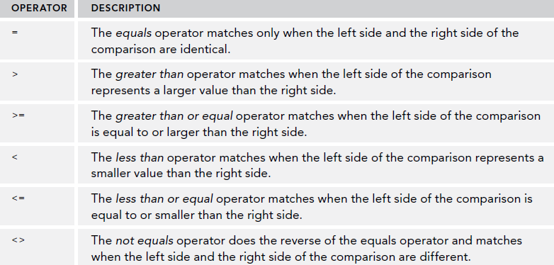
Retrieving and Manipulating Data with SQL
WHERE clause operators

Slide 12
Retrieving and Manipulating Data with SQL
You can ORDER your result set by using ORDER BY
  SELECT Id, Name FROM Genre ORDER BY Name
Because ascending is the default order, you don’t need to specify the ASC keyword explicitly, although you could if you wanted to. The next example is functionally equivalent to the preceding
example:
  SELECT Id, Name FROM Genre ORDER BY Name ASC
If you wanted to return the same rows but sort them in reverse order on their Name column, you use this syntax:
  SELECT Id, Name FROM Genre ORDER BY Name DESC

Slide 13
Joining Data
To bring in data from two tables, you need to join them by a particular column.
The basic syntax for a JOIN looks like the following bolded code:
SELECT
SomeColumn
FROM
LeftTable
INNER JOIN RightTable ON LeftTable.SomeColumn = RightTable.SomeColumn
An inner join will bring in the records that can join by the join columns. Anything that doesn’t join by that column would be discarded.

Slide 14
Joining Data: Outer Join
The OUTER JOIN enables you to retrieve rows from one table regardless of whether they have a matching row in another table. The following example returns a list with all the genres in the system together with the reviews in each genre:
SELECT
Genre.Id, Genre.Name, Review.Title
FROM
Genre
LEFT OUTER JOIN Review ON Genre.Id = Review.GenreId

Slide 15
Creating Data
To create data, first you must create a table to hold the data. You msut specify the columns and the data types.
To insert data into the table, you use the Insert statement.
INSERT INTO TableName (Column1 [, Column2]) VALUES (Value1 [, Value2])
If we wanted to insert data into the Genre table, the command would be as follows:
INSERT INTO Genre (Name, SortOrder) VALUES ('Tribal House', 20)

Slide 16
Updating Data
To update data in a table, you use the UPDATE statement:
UPDATE TableName SET Column1 = NewValue1 [, Column2 = NewValue2] WHERE
Column3 = Value3
With the UPDATE statement, you use Column = Value constructs to indicate the new value of the specified column. You can have as many of these constructs as you want, with a maximum of one per column in the table.
To limit the number of items that get updated, you use the WHERE clause, just as with selecting data as you saw earlier. Without a WHERE clause, all rows will be affected which is usually not what you want.
UPDATE Genre SET Name = 'Trance', SortOrder = 5 WHERE Id = 13

Slide 17
Delete Data
To Delete Data, use the Delete statement
  DELETE FROM Genre WHERE Id = 13
This statement delete rows of information. There is no need to choose columns.
Leaving out the WHERE clause will delete all the rows.

Slide 18
Creating Tables
Your can create tables using the Table Designer.
In management studio, you can click on the Tables folder in your database and choose “New Table”
You can fill out the table and specify
Each column’s name, data type and if
It allows null.

Slide 19
Creating Tables
Create a table with the designer.

Slide 20
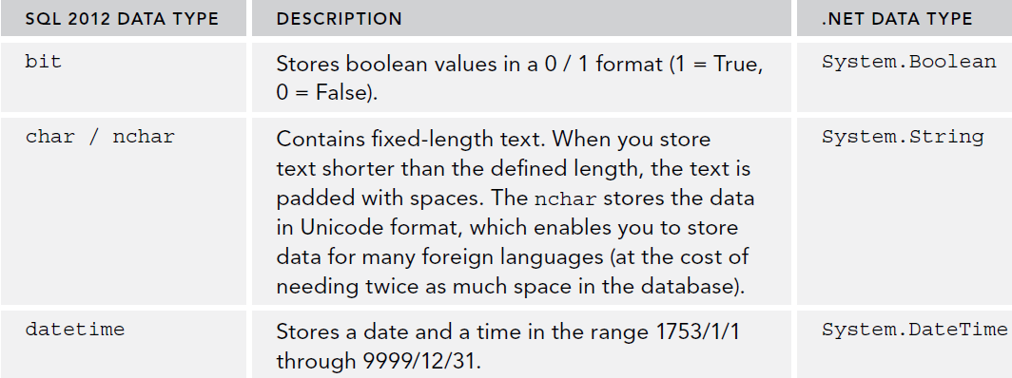
Data Types for Columns

Slide 21
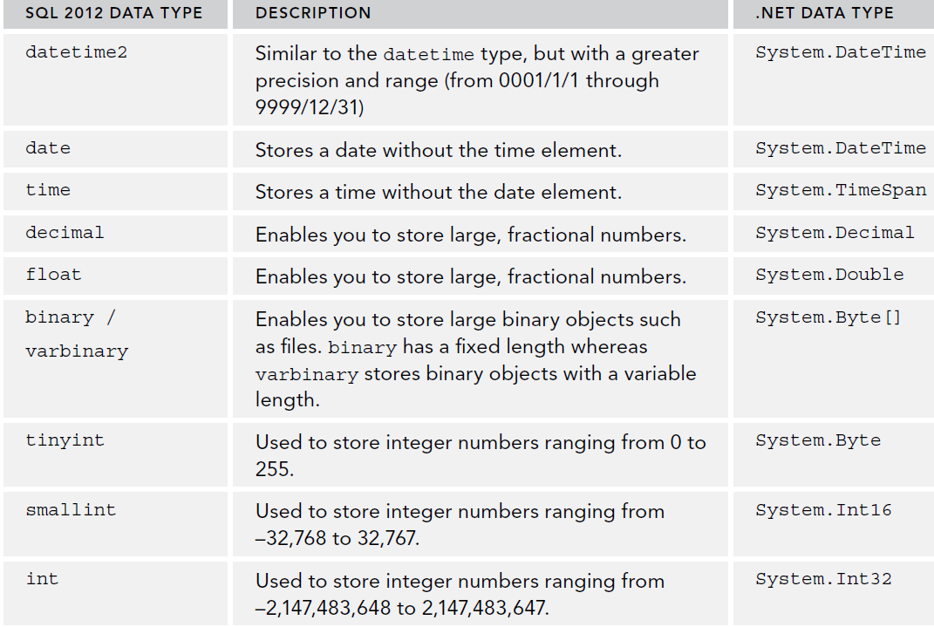
Data Types for Columns

Slide 22
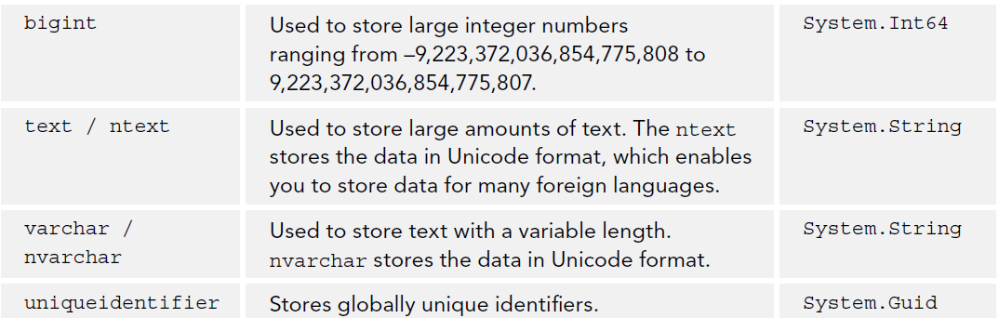
Data Types for Columns

Slide 23
Primary Keys and Identities
A primary key is a column that uniquely identifies the row.
An identity column is a numeric column whose sequential values are generated automatically whenever a new row is inserted. They are often used as the primary key for a table.

Slide 24
Creating Relationships between tables
You can create relationships between the primary key of one table and a column in another table. This relationship, known as a foreign key, This will protect records from being deleted if they are related to existing records in the referring table.
On the table designer, you can go to relationships and click Add.

Slide 25
Creating Relationships between tables
You can specify the table that form the Foreign Key relationship here.

Slide 26
Creating Relationships between tables
When you create a relationship between two tables, the database will enforce this relationship when you try to insert, update, or delete data.
For example:
  rows in the Review table have a genre that exists in the Genre table. When you try to delete a row from the Genre table, the database sees that the genre is used by a row in the Review table and cancels the delete operation.

Slide 27
Summary
In this chapter we covered:
  Learned what a database is and which databases are typically used with ASP.NET pages
  Learned SQL is, how it looks, and how you use it to manipulate data
  Learned what database relationships are and why they are important
  Which tools you have available to manage database objects (such as tables) and how to use them

