Slide 1
Chapter 13
Displaying and Updating Data

Slide 2
Objectives
How to display, insert, edit, and delete data using controls such as GridView, DetailsView, and SqlDataSource
How to create a rich interface that enables a user to insert and edit data while maintaining data integrity with the ASP.NET validation controls
The best way to store your connection strings in your application so they are easily updatable.
Learn about ADO.NET and how to use it.

Slide 3
Data Bound Controls
You use them to display and edit data on web pages.
List Controls: Gridview, DataList and repeater are able to display multiple rows.
Single Item controls: DetailsView and FormView can only display one row at a time.
Datapager adds paging capabilities to list controls.
The data source controls are used to retrieve data from a data source, like a database or an XML file, and then offer this data to the data-bound controls.

Slide 4
List Control: Gridview
Supports automated paging, rows are spread out among multiple pages.
Supports sorting, editing, deleting and selecting.
Does not allow you to insert data into the underlying data source directly.

Slide 5
List Control: ListView, Repeater
The DataList control enables you to present data not only in rows as with the GridView, but it is deprecated and replaced with the ListView.
The Repeater gives you the greatest flexibility in terms of the HTML that you output to the browser because the control by itself does not add any HTML to the page output. No capabilities to page, sort or modify data.
The ListView control supports editing, deleting, and paging of data, similar to the GridView. It supports multi-column and multi-row layouts like the DataList offers, and it enables you to completely control the markup generated by the control, just as the Repeater does.

Slide 6
Single Item Controls: DetailsView and FormView
DetailsView uses a built-in tabular format to display the data.
FormView uses templates to let you define the look and feel of your data.
For example, DetailsView can look like:
FormView control has a RenderOuterTable property which doesn’t generate an outer wrapping HTML table when set to false.

Slide 7
Paging Controls: DataPager
DataPager is a control that enables page on the ListView control.
Without this control, paging cannot occur.
Paging

Slide 8
Data Source Controls
Our controls have to be bound to a data source, whether it’s a database or an XML file.
The XmlDataSource and SiteMapDataSource controls are used to bind hierarchical, XML-based data.
The ObjectDataSource control enables you to connect your data-bound controls to separate objects in your application.
SQLDataSource is used to connect to a relational database.
LinqDataSource is used to connect to LINQ to SQL datasource.
EntityDataSource is used to connect to Microsoft’s Entity Framework.

Slide 9
SQLDataSource and Gridview
Can be used to connect to a SQL data source to support C.R.U.D. operations without writing much code.
Can connect to not only SQL server, but Oracle or MySQL.
You can connect your database to the Server Explorer in Visual studio.
Drag the desired table into an asp:Content tag in the design view, Visual Studio will create a Gridview and SQLDatasource.
You can click on the Gridview control and ask for it to “Show Smart Tag”
Also, you can Drag a SqlDataSource into the Design and connect it to a database.

Slide 10
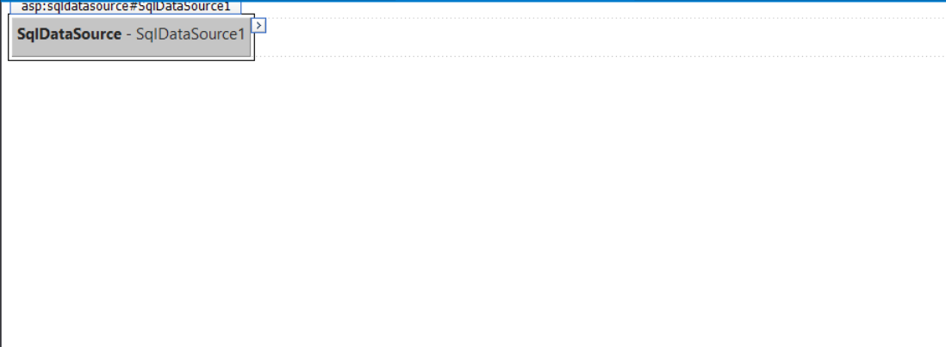
SQLDataSource and Gridview
Drag a SQLDataSource and configure the Data Source.
Allows you to configure Data Source

Slide 11
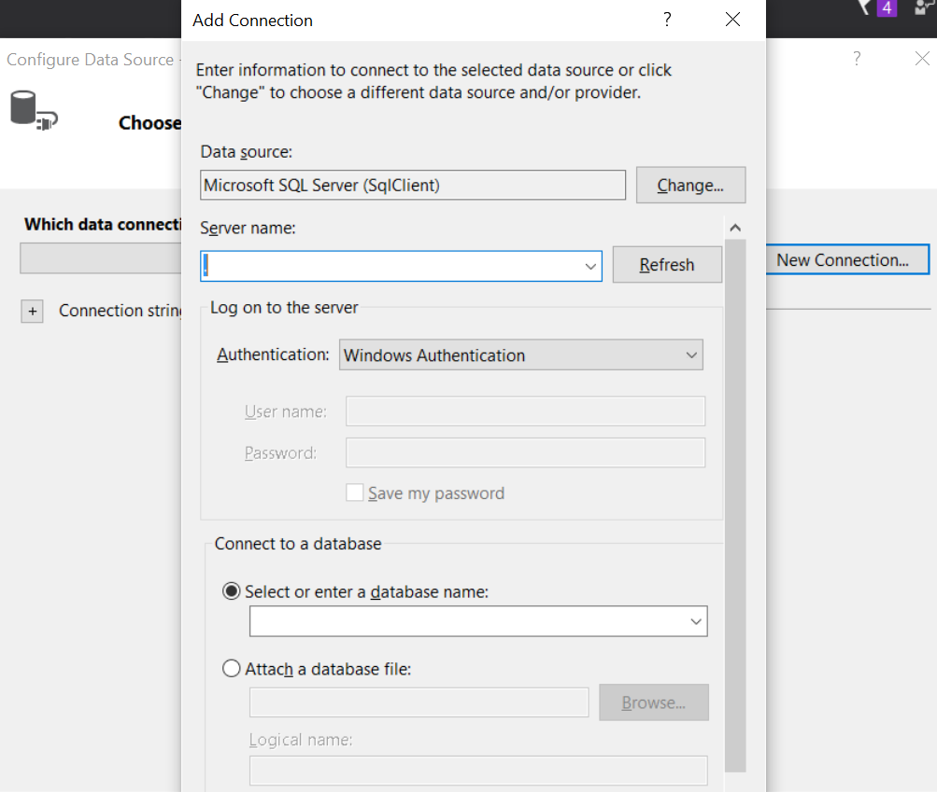
SQLDataSource and Gridview
You can choose a “New Connection” and find your database server. Hint: using “.” will find the DB in your local machine.
Use “.” for local server

Slide 12
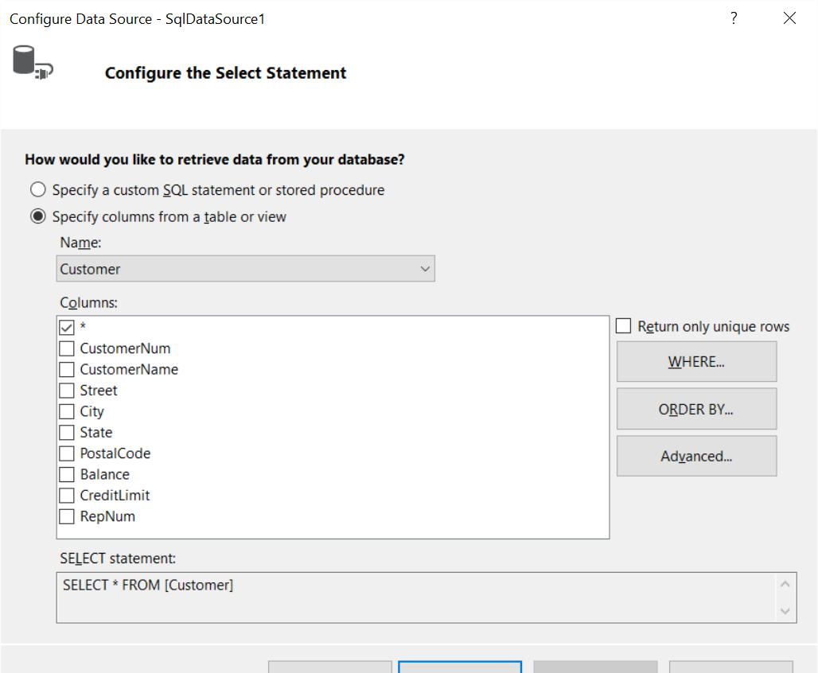
SQLDataSource and Gridview
Choose Table or SP. You can always change this later.

Slide 13
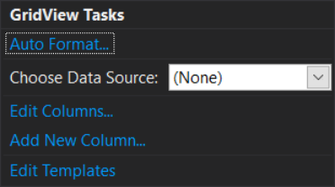
SQLDataSource and Gridview
Once you have a defined SQLDataSource on your screen, you can now add another control to bind it to.
Once you add that control, say a Gridview, you can choose the data source.
You can always go to the markup and make modifications to these controls as needed.
Bind to Data Source

Slide 14
SqlDataSource and Gridview
On the smart tag, you can enable paging, sorting, editing, deletion and selection.

Slide 15
SqlDataSource
Sample SqlDataSource tag:
<asp:SqlDataSource ID="SqlDataSource1" runat="server"
ConnectionString="<%$ ConnectionStrings:PlanetWroxConnectionString1 %>"
ProviderName="<%$ ConnectionStrings:PlanetWroxConnectionString1.ProviderName %>"
DeleteCommand="DELETE FROM [Genre] WHERE [Id] = @Id"
InsertCommand="INSERT INTO [Genre] ([Name], [SortOrder]) VALUES (@Name,
@SortOrder)"
SelectCommand="SELECT [Id], [Name], [SortOrder] FROM [Genre]"
UpdateCommand="UPDATE [Genre] SET [Name] = @Name, [SortOrder] = @SortOrder
WHERE [Id] = @Id">
<DeleteParameters>
<asp:Parameter Name="Id" Type="Int32" />
</DeleteParameters>
<InsertParameters>
<asp:Parameter Name="Name" Type="String" />
<asp:Parameter Name="SortOrder" Type="Int32" />
</InsertParameters>
<UpdateParameters>
<asp:Parameter Name="Name" Type="String" />
<asp:Parameter Name="SortOrder" Type="Int32" />
<asp:Parameter Name="Id" Type="Int32" />
</UpdateParameters>
</asp:SqlDataSource>

Slide 16
SqlDataSource
The connectionstring and providedername are auto generated for youand configured for you in the web.config file.
The INSERT, UPDATE, and DELETE commands contain parameters, identified by the at symbol (@) prefix. At run time, when the control is asked to perform the relevant data operation, these parameters are substituted by runtime values.
For example, take a look at the Id parameter:
<DeleteParameters>
<asp:Parameter Name="Id" Type="Int32" />
</DeleteParameters>
And the command:
DeleteCommand="DELETE FROM [Genre] WHERE [Id] = @Id"

Slide 17
GridView
The GridView code generated looks like this:
<asp:GridView ID="GridView1" runat="server" AllowPaging="True" AllowSorting="True"
AutoGenerateColumns="False" DataKeyNames="Id" DataSourceID="SqlDataSource1"
EmptyDataText="There are no data records to display.">
<Columns>
<asp:CommandField ShowDeleteButton="True" ShowEditButton="True“ ShowSelectButton="True" />
<asp:BoundField DataField="Id" HeaderText="Id" ReadOnly="True“ SortExpression="Id" />
<asp:BoundField DataField="Name" HeaderText="Name" SortExpression="Name" />
<asp:BoundField DataField="SortOrder" HeaderText="SortOrder“ SortExpression="SortOrder" />
</Columns>
</asp:GridView>

Slide 18
GridView attributes
DataKeyNames: Contains the Primary Key of the row. This is needed to uniquely identify the rows in the grid.
DataSourceId: Points to the Data Source definition being used.
Allowpage: Flag to allow paging.
Allowsorting: Flag to allow sorting.
CommandField : a column in the GridView that enables a user to execute one or more actions for the row to which the CommandField applies. It ends up in the browser as one or more text links or buttons. Clicking on these commands will generate a command executed server side.

Slide 19
Gridview Layout
The following Gridview is rendered:
Sorting
CommandField Attributes
Paging

Slide 20
Gridview CommandField and Bound Fields
To render button instead of links, change the ButtonType
<asp:CommandField ShowDeleteButton="True" ShowEditButton="True"
ShowSelectButton="True" ButtonType="Button"></asp:CommandField>
Bound Fields:
  These fields map directly to the columns of the table.
  <asp:BoundField DataField="Name" HeaderText="Name" SortExpression="Name" />
  Attributes:
    DataField: The name of the column in the database.
    HeaderText: The Text that gets displayed on the Grid itself.
    SortExpression: The column that is used to sort by when the sort header is clicked. Normally matches the DataField.

Slide 21
Gridview Lifecycle
1. Request is made and page begins lifecycle.
2. The GridView knows it is set up to retrieve and display data because it has a DataSourceID attribute that points to a SqlDataSource control. The SqlDataSource in turn connects to the database and then fires its SelectCommand, the SQL statement that selects the Id, Name, and SortOrder from the Genre table in the database:
SelectCommand="SELECT [Id], [Name], [SortOrder] FROM [Genre]“
3. SQLDataSource receives the rows from the database and the Gridview renders the bound fields based on the <column> elements.
4. When “Edit” is clicked, the page performs a postback. The row’s ID is retrieved from the Viewstate. The SQLDataSource fires its SelectCommand to get the latest row and places it in edit mode.

Slide 22
Gridview Lifecycle
4. When the Update link is pressed, the Gridview obtains the new values and contacts SqlDataSource again.
5. For each of the parameters in the <UpdateParameters> element of the SqlDataSource, the GridView supplies a value. It retrieves the Id of the table from the selected row, and then retrieves the new column values from the TextBox controls in the page.
6.The UpdateCommand is then executed against the database. For example:
UpdateCommand="UPDATE [Genre] SET [Name] = @Name,
[SortOrder] = @SortOrder WHERE [Id] = @Id“
Each of the parameters prefixed with the at symbol (@) is filled with the values that the GridView supplied.
7. Finally, the GridView refreshes the data on the page by once again asking the SqlDataSource to execute its SelectCommand. This way, the GridView now displays the latest data with the update you made.

Slide 23

DetailView Control Inserting Data
You can add a DetailsView from the toolbox and then open the control’s smart task panel. Make sure you bind it to the same SqlDataSource as the Gridview. In addition Enable Inserting Item and set the DefaultMode to Insert.
<asp:DetailsView ID="DetailsView1" runat="server" AutoGenerateRows="False"
DataKeyNames="Id" DataSourceID="SqlDataSource1" DefaultMode="Insert"
Height="50px" Width="125px">
<Fields>
<asp:BoundField DataField="Id" HeaderText="Id" InsertVisible="False"
ReadOnly="True" SortExpression="Id" />
<asp:BoundField DataField="Name" HeaderText="Name" SortExpression="Name" />
<asp:BoundField DataField="SortOrder" HeaderText="SortOrder"
SortExpression="SortOrder" />
<asp:CommandField ShowInsertButton="True" />
</Fields>
</asp:DetailsView>

Slide 24
DetailView Control
DetailView Control can have the following views: read-only, insert, and edit
By linking it up to the SqlDataSource it can use the DataKeyNames to find the Id and does not expose it to as a field.
The DetailsView collects the relevant information from the page’s controls and forwards them to the SqlDataSource.
This SqlDataSource control in turn pushes the new values in the parameters for the INSERT statement and then sends the command off to the database, which inserts the new row in the table.

Slide 25
Storing Connection Strings in Web.config
When the was added to your page, Visual Studio also created a connection string in the Web.config file under the <connectionStrings> element and pointed the SqlDataSource to this connection string.
The setting in Web.config looks like this:
<connectionStrings>
<add name="PlanetWroxConnectionString1" connectionString="Data Source=
(localdb)\v11.0;AttachDbFilename=|DataDirectory|\PlanetWrox.mdf;
Integrated Security=True"
providerName="System.Data.SqlClient" />
</connectionStrings>
The SQLDataSource then accesses this connection by name
<asp:SqlDataSource ID="SqlDataSource1" runat="server“ ConnectionString="<%$ConnectionStrings:PlanetWroxConnectionString1 %>”

Slide 26
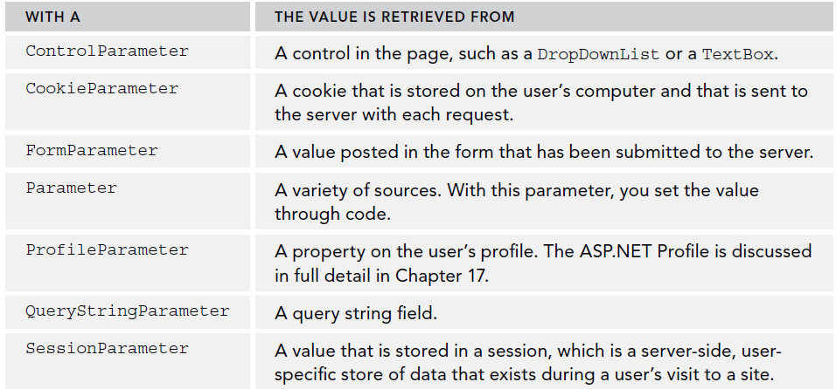
Filtering Data
To filter data, you need to create a where clause in your statements and SQLDataSource control has a <SelectParameters> element that enables runtime values to be supplied. This can come from:

Slide 27
Filtering Data
Adding a dropdown list control creates the following
<asp:DropDownList ID="DropDownList1" runat="server" DataSourceID="SqlDataSource1"
DataTextField="Name" DataValueField="Id" AppendDataBoundItems="true"
AutoPostBack="True">
<asp:ListItem Value="">Make a selection</asp:ListItem>
</asp:DropDownList>
When adding a SQLDataSource and you are dragging the tables, you can defined the WHERE clause.

Slide 28
Filtering Data
Once the where clause has been defined, we can see the Where clause be defined in the markup:
<asp:SqlDataSource ID="SqlDataSource2" runat="server"
ConnectionString="<%$ ConnectionStrings:PlanetWroxConnectionString1 %>"
SelectCommand="SELECT * FROM [Review] WHERE ([GenreId] = @GenreId)">
<SelectParameters>
<asp:ControlParameter ControlID="DropDownList1" Name="GenreId"
PropertyName="SelectedValue" Type="Int32" />
</SelectParameters>
</asp:SqlDataSource>

Slide 29
Filtering Data
That means that the SQL statement returns rows from the table only for a specific genre. At run time, the value for this parameter is retrieved from the control defined in the ControlParameter element. In this example, the code is set up to get the value from the DropDownList1 control.
With this code set up, the GridView asks the SqlDataSource for its data. This data source in turn asks the DropDownList for the item that the user has selected in the list.
This value is inserted in the SQL statement, which is sent to the database. The results that are returned from the database are sent back through the data source to the GridView, which uses them to create the HTML table in the browser.

Slide 30
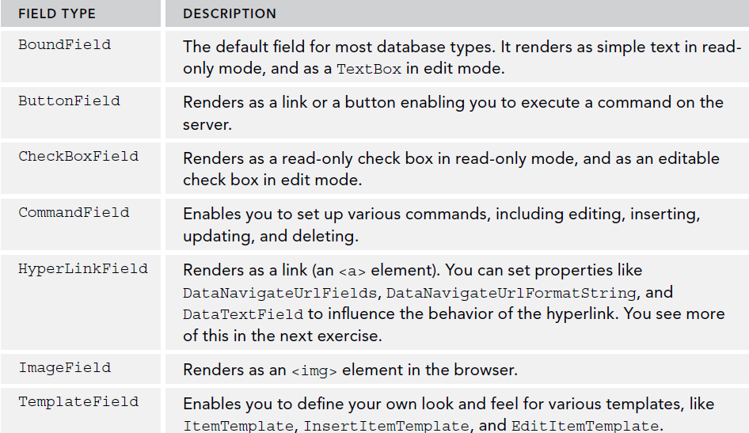
Configuring Columns or Fields of Data Bound Controls
Within the <Columns> or <Fields> you can add the following types of fields.

Slide 31
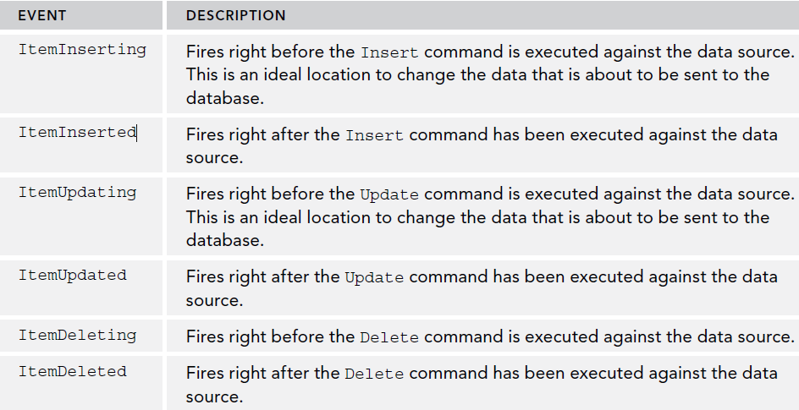
Update and Insert Data with DetailsView
Events fired by DetailsView, FormView, and ListView

Slide 32
Working with ADO.NET Data Provider
ADO.NET is an object-oriented set of libraries that allows you to interact with data sources. Uses System.Data and System.Data.SqlClient namespaces.
It allows you to save to data in the C# source by leveraging SQL code.
Requires a connection string and a data provider for your database.
Connections are made to database with the “using” statement and the SqlConnection object to ensure the DB connection is closed when exiting.
    using (SqlConnection connection = new SqlConnection(
    connectionString))
    {
    SqlCommand command = new SqlCommand(queryString, connection);
    command.Connection.Open();
    command.ExecuteNonQuery();
    }

Slide 33
Working with ADO.NET Data Provider
Providers are used to access the data sources:
  ODBC Data Provider: Interacts with ODBC Databases.
  OleDB Data Provider: Interacts with OleDB (Access / Excel).
  Oracle Data Provider: Interacts with Oracle Databases.
  SQL Data Provider: Interacts with SQL server.
SqlCommand Object: This is an Object where the SQL commands are added to be executed on the database.
SqlParameter Object: This is an Object that is used to set the parameters of a query. Replaces the “@param” in the query.
SqlDataReader Object: This is an Object that is used to read the data that comes back from a query.

Slide 34
Working with ADO.NET Data Provider
//Uses System.Data and Systen.Data.SqlClient namespaces
conn.ConnectionString = "Server=[server_name];Database=[database_name];Trusted_Connection=true";
conn.Open();
SqlCommand command = new SqlCommand("SELECT * FROM TableName WHERE FirstColumn = @param1", conn);
command.Parameters.Add(new SqlParameter("param1", 1));
using (SqlDataReader reader = command.ExecuteReader())
{
while (reader.Read())
{
String myFirstColumnValue = reader[0];
String mySecondColumnValue = reader[1];
}
} //exits and closes connection

Slide 35
Working with ADO.NET Data Provider
Inserting records can be done with SQLCommand’s ExecuteNonQuery method.
conn.Open();
SqlCommand insertCommand = new SqlCommand("INSERT INTO TableName "
+" (FirstColumn, SecondColumn) VALUES (@param1, @param2)", conn);
insertCommand.Parameters.Add(new SqlParameter("@param1", "Value1"));
insertCommand.Parameters.Add(new SqlParameter("@param2", "Value2));
Int32 recordsAffected = insertCommand.ExecuteNonQuery();
This can also be done with an update statement.
Always use SqlParameters to protect against SQL Injection.

Slide 36
Working with ADO.NET Data Provider
Using a Stored Procedure to add data.
// Assumes connection is a valid SqlConnection.
SqlCommand command = new SqlCommand("myStoredProc", connection);
command.CommandType = CommandType.StoredProcedure;
SqlParameter parameter = command.Parameters.Add("@param1", SqlDbType.NChar,25);
SqlParameter parameter = command.Parameters.Add("@param2", SqlDbType.NChar, 25);
command.Parameters["@param1"].Value = "SP Param1 Value";
command.Parameters["@param2"].Value = "SP Param2 Value";
try {
command.ExecuteNonQuery();
} catch (SqlException error)
{
//Catch any SQL Errors
}
//SP Executed

Slide 37
Working with ADO.NET Data Provider
ADO.NET is really useful for making data reads or modifications.
Always use parameters to send values to queries / procedures.
Always use the using statement to recycle SQL connections.
Further reading:
  https://msdn.microsoft.com/en-us/library/ms254937(v=vs.110).aspx

Slide 38
Summary
In this chapter we covered:
  Learned how to display, insert, edit, and delete data using controls such as GridView, DetailsView, and SqlDataSource
  Learned how to create a rich interface that enables a user to insert and edit data while maintaining data integrity with the ASP.NET validation controls
  Learned The best way to store your connection strings in your application so they are easily updatable.
  Learned about ADO.NET and how to use it.

