Slide 1
Chapter 16
Securing your ASP.NET
Website

Slide 2
Objectives
Important terminology you’ll encounter when dealing with security
The ASP.NET application services that drive the security model of ASP.NET
How you can let users sign up for an account for your site
How users can reset their passwords or request new ones
How you can manage the users and roles in your database at development time
How you can present different content to different users based on their access rights in the system

Slide 3
Security
Security aims to answer the following:
  Identity: Who are you?
  Authentication: How can you prove who you are?
  Authorization: What are you allowed to do here?
    Permissions: based on the username and roles.
    Authorization rules: rules for a resource that the user is trying to access
ASP.NET 4.5.1 contains the following application services to implement security:
  Membership — Enables you to manage and work with user accounts in your system.
  Roles — Enables you to manage the roles to which your users can be assigned.
  Profile — Enables you to store user-specific data in a back-end database.

Slide 4
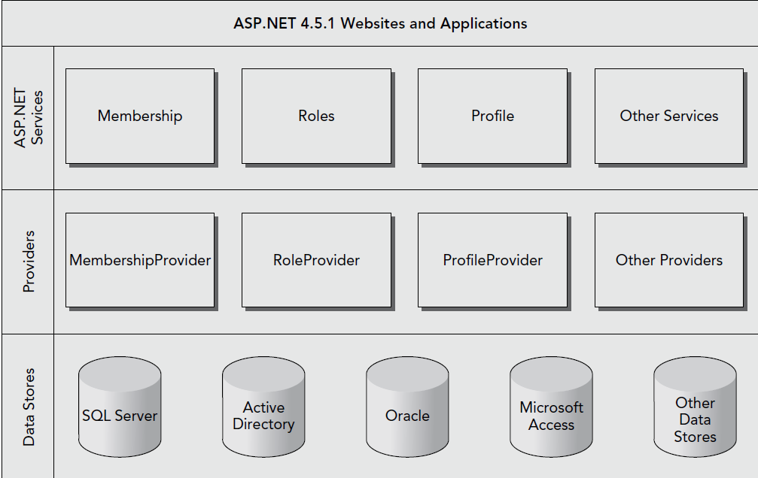
ASP.NET Security

Slide 5
ASP.NET Security
For flexibility, services talk to a provider who then talks to the data store.
Microsoft released the Universal Providers that work the same as the SQL Server providers, but can be used to target all editions of SQL Server, including SQL Server Compact and SQL Azure.
You can change providers through configuration and not code.
Each provider needs a data store to operate correctly.
Ideally, you don’t deal with these providers directly. Under normal circumstances, the various providers are configured for your website at a central location.
ASP.NET built-in login controls access the services directly.

Slide 6
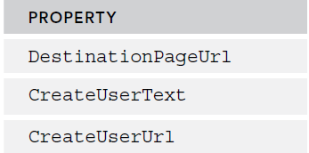
ASP.NET Security
If the providers are not installed (you should see System.Web.Providers.dll in you Bin folder), then you can installed them directl from Nu.
  Install-Package Microsoft.AspNet.Providers
Drag a Login control into a page.
The Login control has the following attributes:

Slide 7
ASP.NET Security
DestinationURL: This is where you will go if authentication is successful.
CreateUserText: This is the Text that is shown to the user so that they can create a new account
CreateUserURL: The web page where the user will be created if they need to be.

Slide 8
ASP.NET Security
Modify the Web.config to enable Forms authentication
  <system.web>
  <authentication mode="Forms" />
  ...
  </system.web>
Also, specify the database conntection string to store the provider’s data:
<membership defaultProvider="DefaultMembershipProvider">
<providers>
<add name="DefaultMembershipProvider"
... Other attributes here
connectionStringName="PlanetWroxConnectionString1"
enablePasswordRetrieval="false" enablePasswordReset="true"
.. Other attributes here
/>
</providers>
</membership>

Slide 9
ASP.NET Security
The Login Control is now configured to operate:

Slide 10
ASP.NET Security
ASP.NET controls talk to the configured application service providers; a software layer that sits between the login controls and the SQL Server database that keeps track of the users.
If the database from the connection string doesn’t exist, or it doesn’t contain the necessary tables, .NET executes a SQL script to prepare the database for you.
New tables are:
  Memberships, Profiles, Roles,
  Applications,Users, UserInRoles

Slide 11
ASP.NET Security
You can configure the forms timeout to allow the user to keep a cookie that allows them to reauthenticate.
<authentication mode="Forms">
<forms timeout="1440" />
</authentication>
This means that if the user checked off “Remember Me” they will not need to login again unless they exceed the timeout time without login in.

Slide 12
The Login Controls
ASP.NET contains 7 login controls.
  Login Control
  LoginView Control
  LoginStatus Control
  LoginName Control
  CreteUserWizard Control
  PasswordRecovery Control
  ChangePassword Control

Slide 13
Login Control
Login control enables the user to log in to the website.
The control talks to the configured Membership provider through the application services to see if the username and password represent a valid user in the system.
If the user is validated, a cookie is issued that is sent to the user’s browser.
On future requests, the browser resubmits the cookie to the server so the system knows it’s still dealing with a valid user.
  <asp:Login ID="Login1" runat="server" />

Slide 14
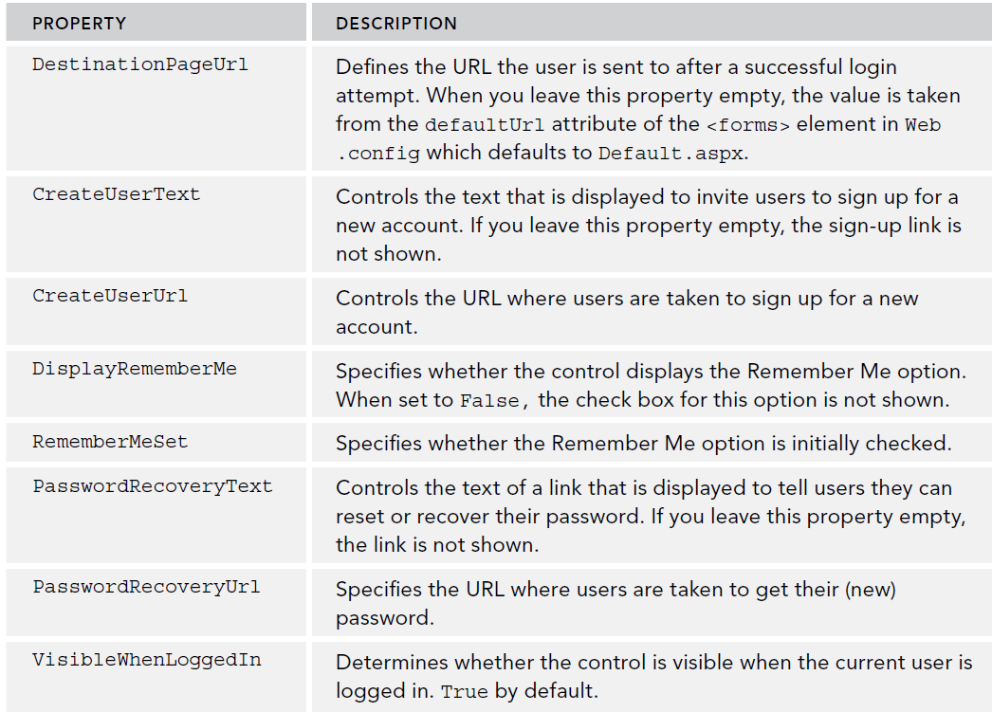
Login Control
Also has the following:

Slide 15
Login Control
Authentication in .NET assumes that Login.aspx is the default login page. To change this, modify the forms tag in web.config.
    <authentication mode="Forms">
    <forms loginUrl="~/Account/MyLoginPage.aspx" />
    </authentication>
The control supports styling if there needs to be any, and you can move the styling to CSS.
After a user logs in, the event Logged fires. This is a good place to intercept a logged in user and transfer them to a page.

Slide 16
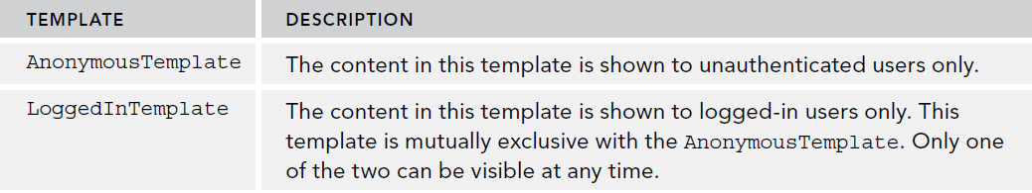
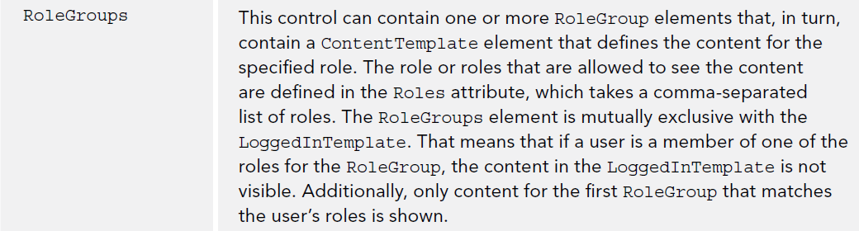
LoginView Control
LoginView lets you display different data to different users. It is a template driven control.

Slide 17
LoginView Control
You add markup to this control to provide messages in the templates.
<asp:LoginView ID="LoginView1" runat="server">
<AnonymousTemplate>
Hi there visitor. Would you be interested in signing up for an account?
</AnonymousTemplate>
<LoggedInTemplate>
Hi there visitor and welcome back to PlanetWrox.com.
</LoggedInTemplate>
<RoleGroups>
<asp:RoleGroup Roles="Managers">
<ContentTemplate>
Hi there manager. You can proceed to the Management section.
</ContentTemplate>
</asp:RoleGroup>
</RoleGroups>
</asp:LoginView>

Slide 18
LoginStatus Control
LoginStatus control provides information about the current status of the user. It provides a Login link when the user is not authenticated and a Logout link when the user is already logged in.
Text being displayed can be controlled by LoginText and LogoutText properties.
LoginImageURL and LogoutImageURL can be used to display images instead.
LogOutAction determines if the current page is refreshed or taken to another page as defined by LogoutPageUrl.
This control raises the events LogginOut (right before loggin out) and LoggedOut (right after logging out).

Slide 19
LoginName Control
Displays the logged in user. You can format with an existing string using a string format {0}.
<asp:LoginName ID="LoginName1" runat="server" FormatString="Logged in as {0}" />
Example of a full implementation:
<asp:LoginView ID="LoginView1" runat="server">
<AnonymousTemplate>
<asp:Login ID="Login1" runat="server" CreateUserUrl="SignUp.aspx"
DestinationPageUrl="~/Default.aspx"
CreateUserText="Sign Up for a New Account at Planet Wrox">
</asp:Login>
</AnonymousTemplate>
<LoggedInTemplate>
You are already logged in.
</LoggedInTemplate>
</asp:LoginView>

Slide 20
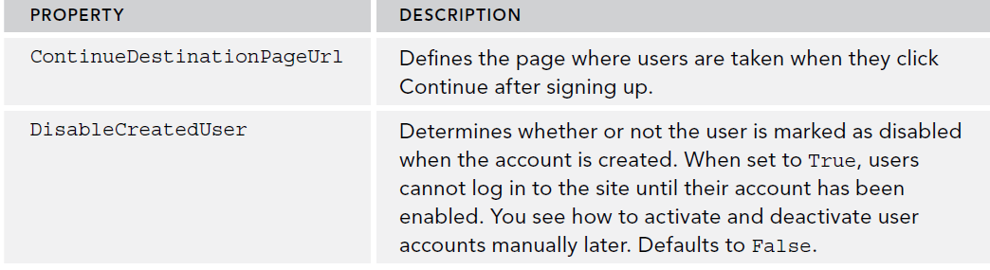
CreateUserWizard Control
Helps create a user through the respective provider.
Has properties that can change the Text properties, such as CancelButtonText, CompleteSucessText, UserNameLabelText and CreateUserButtonText.

Slide 21
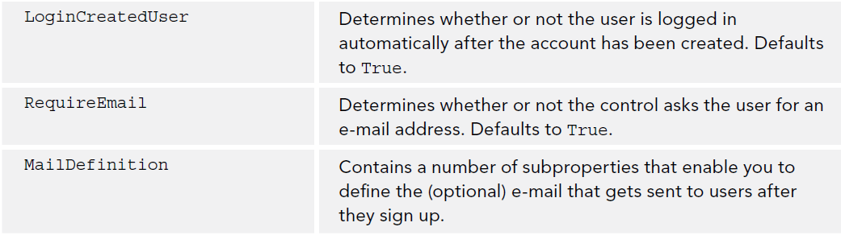
CreateUserWizard Control
Other properties

Slide 22
PasswordRecovery Control
Enables users to retrieve their existing passwords or gets a new auto-generated password to be sent to the email address for the user.
Properties:
  GeneralFailureText: Shows when password cannot be recovered.
  SuccessText: Shows when password is received.
  ButtonType, ButtonText, ButtonImageUrl:Change the look and behavior of the action buttons of the control.
  SuccessPageUrl: Goes to another site if the recovery succeeds.

Slide 23
ChangePassword Control
Enables logged in and existing users to change their password.
<asp:Content ID="Content2" ContentPlaceHolderID="cpMainContent" runat="Server">
<h1>My Profile</h1>
<p>The My Profile page allows you to make changes to your personal profile.
For now, all you can do is change your password below.</p>
<asp:ChangePassword ID="ChangePassword1" runat="server"></asp:ChangePassword>

Slide 24
Changing a password
By default, your passwords are stored in a hashed format in the database, which means they cannot be retrieved. Hashing is an irreversible process that creates a unique fingerprint of your data.
When you log in, the password you enter is also hashed and then the two hashes are compared to see if you are allowed to enter.
Because the original password cannot be retrieved, the PasswordRecovery control generates a new password for you. It then sends this password to the e-mail address that is associated with the username you entered.

Slide 25
Configuring the Security of your Web App
Inside the web.config, you can change the attributes of your membership provider.
<membership defaultProvider="DefaultMembershipProvider">
<providers>
<add name="DefaultMembershipProvider"
type="System.Web.Providers.DefaultMembershipProvider,
System.Web.Providers, Version=2.0.0.0, Culture=neutral,
PublicKeyToken=31bf3856ad364e35"
connectionStringName="PlanetWroxConnectionString1"
enablePasswordRetrieval="false" enablePasswordReset="true"
requiresQuestionAndAnswer="false" requiresUniqueEmail="false"
maxInvalidPasswordAttempts="5" minRequiredPasswordLength="6"
minRequiredNonalphanumericCharacters="0" passwordAttemptWindow="10“
applicationName="/"
/>
</providers>
</membership>

Slide 26
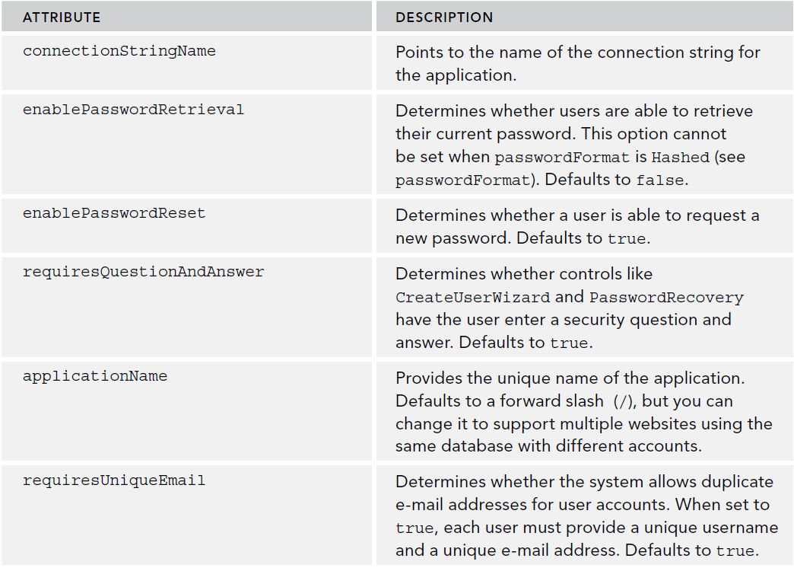
Configuring the Security of your Web App

Slide 27
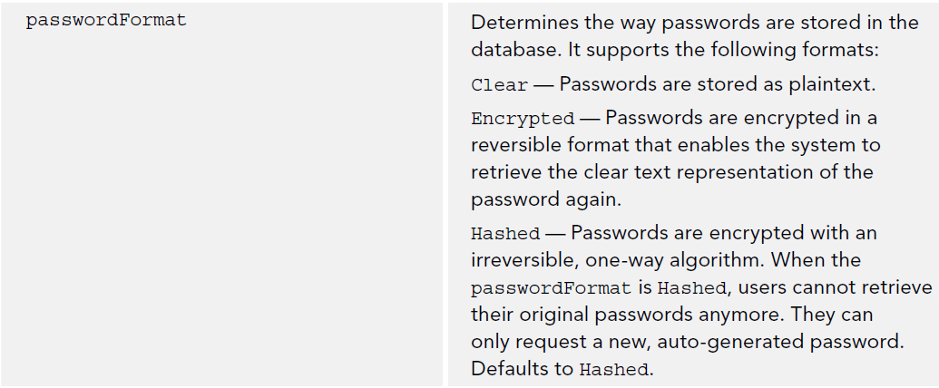
Configuring the Security of your Web App

Slide 28
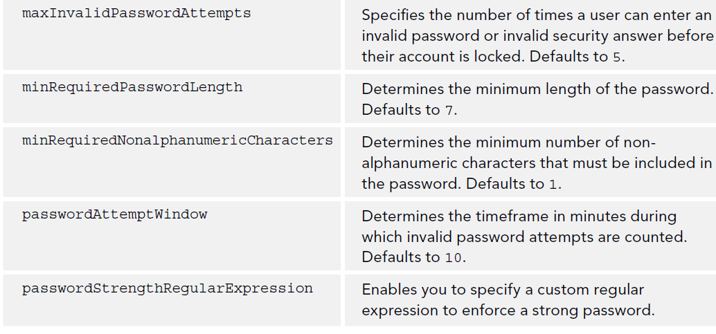
Configuring the Security of your Web App

Slide 29
Configuring the Security of your Web App
The CreateUserWizard uses the configured Membership provider under the hood to validate the data and create the user.
The provider in turn consults the Web.config file for the configuration information such as the minimum password length.
When you try to create the user, the provider enforces the rules set in Web.config and cancels the user creation process as soon as one of the rules is not fulfilled.

Slide 30
Role Manager
The Role Manager is available to manager security through Roles.
Roles is a functional grouping of the users so that you can apply security rights to the role instead of the user.
Role Management has to be enabled through the DefaultRoleProvider.
<roleManager defaultProvider="DefaultRoleProvider">
<providers>
<add name="DefaultRoleProvider"
type="System.Web.Providers.DefaultRoleProvider, System.Web.Providers,
Version=2.0.0.0, Culture=neutral, PublicKeyToken=31bf3856ad364e35"
connectionStringName="PlanetWroxConnectionString1"
applicationName="/"
/>
</providers>
</roleManager>

Slide 31
Role Manager
The Role Manager is not enabled by default, and to enable it, you need to add an enabled="true“ attribute to the <roleManager /> element.
With the Membership and Role Manager providers configured and the database created, it’s time to manage the users and roles in your system. You have a few ways to accomplish that:
  Using the Web Site Administration Tool, generally referred to as the WSAT
  Using IIS (the Windows web server) on recent Windows editions (you see more about this in Chapter 19)
  Programmatically, using the Role Manager API (application programming interface)

Slide 32
Managing Users with WSAT
The Web Site Administration Tool is used for the following tasks:
  Managing users
  Managing roles
  Managing access rules — for example, to determine what user can access which files and folders
  Configuring application, mail, and debug settings
  Taking the site offline so users can’t request any pages and get a friendly error message instead
It is only available from your local machine to initially setup users, but its not usable for a production environment.

Slide 33
Managing Users with WSAT
The WSAT:

Slide 34
Managing Users with WSAT
Managing Users, Roles and Access Rules

Slide 35
Configuring Web Applications to Work with Roles
The Access Rules allow you to configure the users or roles that have (or do not) have access to folders or files.
The security settings are stored in web.config.
For example, limit access to the “Management” folder
<location path="Management">
<system.web>
<authorization>
<allow roles="Managers" />
<deny users="*" />
</authorization>
</system.web>
</location>

Slide 36
Configuring Web Applications to Work with Roles
The security model works inside out, it starts by scanning the Web.config file (if present) in the folder that contains the requested page and then works its way up hierarchically to the root.
If it doesn’t find the file there or it doesn’t contain settings that block or grant access, it goes up in the folder hierarchy searching for configuration files with authorization elements.
The “?” can be used to denote unauthenticated users.
<location path="Reviews">
<system.web>
<authorization>
<deny users="?" />
</authorization>
</system.web>
</location>

Slide 37
Programmatically Checking Roles
LoginView control is used to change the content a user is allowed to see at run time, but sometimes this needs to be done programmatically.
You can use IsInRole from the User object
if (User.IsInRole("Managers"))
{
// This code runs for Managers only
}
Or you can use the Roles objects.
if (Roles.IsUserInRole("Managers"))
{
// This code runs for Managers only
}
The IsUserInRole method returns a boolean that indicates whether the current user is a manager.

Slide 38
Summary
In this chapter we covered:
  Learned important terminology you’ll encounter when dealing with security
  Learned the ASP.NET application services that drive the security model of ASP.NET
  Reviewed how you can let users sign up for an account for your site
  Reviewed How users can reset their passwords or request new ones
  Learned How you can manage the users and roles in your database at development time
  Learned how you can present different content to different users based on their access rights in the system

