Slide 1
Chapter 3
Designing Your Web Pages

Slide 2
Objectives
What is CSS and Why it is needed
How CSS looks and how to write it
The different ways to add CSS code to your ASP.NET pages and external files
The numerous tools that VS offers you to quickly write CSS

Slide 3
CSS (Cascading Style Sheets)
CSS is a language used for styling and design your web pages.
CSS can be used to quickly change the appearance of your web pages.
It is supported by all browsers, so it is not specific to .NET
Very popular with designers of web pages.
Used not just in enterprise applications, but heavily used in content delivery. mediums such as Blogs.
CSS “rules” can be chained together for efficiency (more on that later).

Slide 4
But why is CSS needed?
Before CSS, all the formatting was done with HTML tags and their attributes, which mixed both the data content that you wanted to display and how it should be displayed (presentation).
For example:
<p><font face="Arial" color="red" size="+1">
This is red text in an arial type face and slightly larger than the default text.
</font></p>
What can be the problem here?

Slide 5
HTML shortcomings
<p><font face="Arial" color="red" size="+1">
This is red text in an arial type face and slightly larger than the default text.
</font></p>
Consider these problems:
If we had this paragraph in multiple changes, any time we wanted to change th color we would have to do it in each instance.
We can't dynamically change this formatting depending on a given scenario (i.e. colorblindness, visually impaired, etc.)
Required duplication of formatting tags gives the page more data to load each time.

Slide 6
CSS to the rescue
CSS addresses these problems by separating the data from the presentation.
The html files will continue to be your data (content) but now they will refer to CSS files which dictated how the presentation should be handled.
In addition, you can centralize your styling into a centralized CSS file, which means multiple HTML pages will use the presentation formatting from a central place and wont have to duplicate HTML presentation tags such as <FONT>, <B>, <EM>, etc. You can also embed CSS into your HTML element tags if needed.
CSS is understood by all major browsers and it is the language you want to understand to design pages.

Slide 7
Intro to CSS
Create a file named CssDemo.aspx
In the markup, add the following after the closing <title> tag
<style>
h1
{
font-size: 20px;
color: Green;
}
p
{
color: #0000FF
font-style: italic;
}
.RightAligned
{
text-align: right;
}
</style>

Slide 8
Intro to CSS
Inside the <div> tag, add the following
<h1>Welcome to this CSS Demo page</h1>
<p>CSS makes it super easy to style your pages.</p>
<p class="RightAligned">
With very little code, you can quickly change the looks of a page.
</p>
The CSS style gets applied to the appropriate elements.

Slide 9
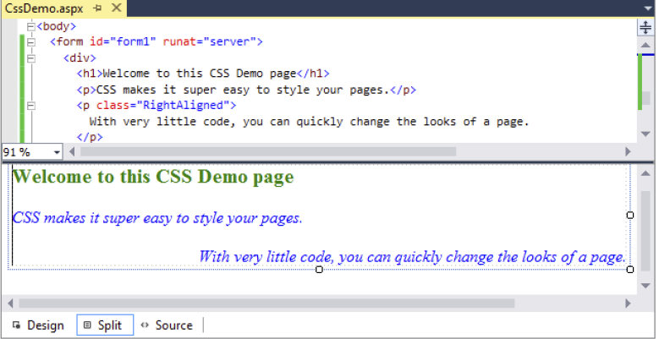
Intro to CSS
Output:

Slide 10
How does it work?
The code block between the <style> tags is called a rule or a rule set.
A rule dictates how the elements affected by this rule set will behave.
The elements are chosen by selectors. There are various different kinds of selectors.
Inside each rule set are properties and values
Selector -> h1
Rule Set Begins -> {
property and value assigned-> font-size: 20px;
color: Green;
Rule Set End-> }

Slide 11
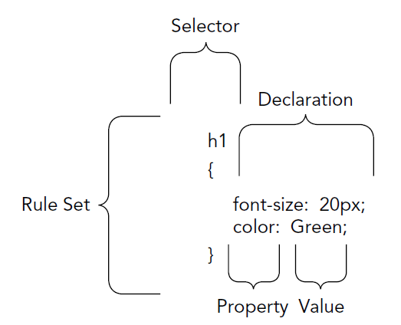
How does it work?
For the above example, the selector affects all H1 elements
The rule set affects those elements by changing the property “font-size” to a value of “20px”.
Why is this useful from an organizational and efficiency perspective?

Slide 12
CSS – The language
A CSS is a collection of rules.
A rule a combination of a selector and one or more declarations.
Each declaration is composed of a property and a value.
To declare these rules, you create a style sheet which is placed
either in between the <style></style> tags in a markup file (.html, aspx.) – this is known as the inline way
In a separate file that is then referred to by your markup (more on this later)

Slide 13
CSS – The language
To be able to style an element on a page, a browser has to know three things:
What element of the page must be styled?
What part of that element must be styled?
How do you want that part of the selected element to look?
Hence our rules:
h1 h1
{ {
font-size: 20px; OR font-size:20px;
color: Green; }
} h1
{
color: Green;
}

Slide 14
Selectors
We use these to identify the elements we are going to be working with.
The different type of selectors are:
Universal Selector: Applies to all elements on the page
Type Selector: Applies to the HTML elements specified in the rule
ID Selector: Enables you to refer to a single element in the
page by a unique ID
Class Selector: Enables you to style elements through the class attribute.

Slide 15
Universal Selector
Denoted by an asterisk (*) and gets applied to all the elements on your page.
Use for Global settings.
For example, assigned the same font to all your elements
*
{
font-family: Arial;
}

Slide 16
Type Selector
Gets applied to all HTML elements of the same type.
Not case sensitive
H1
{
Color: Green;
}

Slide 17
ID Selector
Uses the # (hash) symbol and refers to a single element on the page.
The ID is used is the HTML ID given to an element (this is different than an ASP.NET control Id). It is case sensitive.
#IntroText
{
font-style: italic;
}
This would affect this element:
<p id="IntroText">I am italic because I have the right ID.</p>

Slide 18
Class Selector
Can apply formatting to a number on unrelated elements by grouping them all into the same class. Case sensitive
Rule uses a “.” (dot)
.Highlight
{
Color : Red;
Font-weight: bold;
}
Affects the following:
This is normal text but <span class="Highlight">this is Red and Bold.</span>
This is also normal text but <a href="CssDemo.aspx" class="Highlight">this link is Red and Bold as well.</a>

Slide 19
Grouping Selectors
Group selectors by separating them with a comma.
For example:
h1, h2, h3, h4, h5, h6
{
color: Red;
}
Output: Any HTML headers H1 through H6 will be in red.

Slide 20
Combining Selectors
Suppose that you want to target the styling of a specific element in a particular location.
Given this html fragment, we want to style the underlined section to be BOLD
<section id="MainContent">
<p class="Attention">My class is Attention, so my text is bold.</p>
<p>My text is not bold, as it lacks the Attention class.</p>
</section>
<p class="Attention">I am NOT bold because I don't fall within MainContent.</p>

Slide 21
Combining Selectors
We can combine selectors (ID, type, class) to find the element we want.
For the <p> , class Attention shown below
<section id="MainContent">
<p class="Attention">My class is Attention, so my text is bold.</p>
<p>My text is not bold, as it lacks the Attention class.</p>
</section>
<p class="Attention">I am NOT bold because I don't fall within MainContent.</p>
We can create the following selector:
section#MainContent p.Attention
{
font-weight: bold;
}
“section” finds the tag, “#MainContent” finds that id, “p” locates a paragraph inside the previous two elements and “.Attention” finds the <p> element with class “Attention”.

Slide 22
Common Properties

Slide 23
Common Properties

Slide 24
Values
The values that can be assigned depend on the type of property picked.
Sometimes, there are multiple ways of assigning a value.
For example: Color value “Red” has multiple values (Use HEX value)
h1
{
color: Red;
}
h1
{
color: #FF0000;
}
h1
{
color: rgb(100%, 0%, 0%);
}

Slide 25
Values
Other Possible values:
Size units: px (pixel 1px = 1/96th of 1in) absolute measurement ,Em (relative to the font size of the element)
Font families
Images: myimage.jpg
Enumerations: Border-style has “solid”, “dashed” and “double”
Values can be “relative” to the font size (em for example) or “absolute” always the same size (px for example).
See http://www.w3schools.com/cssref/css_units.asp for more info.

Slide 26
Using Shorthand
CSS supports a shorthand format to make it easier to set some of the properties of elements.
For example, the border property applies to all four sides of an HTML element and can be set individually for a side or for all sides at once.
Shorthand for all sides::
border: 1px solid Black;
Longhand for individual sides:
border-top-width: 1px;
border-top-style: solid;
border-top-color: Black;
border-right-width: 1px;
border-right-style: solid;
border-right-color: Black;
border-bottom-width: 1px;
border-bottom-style: solid;
border-bottom-color: Black;
border-left-width: 1px;
border-left-style: solid;
border-left-color: Black;

Slide 27
Using Shorthand
You can mix and match shorthand and longhand
Suppose want all my borders 1 pixel solid black, except for my left border:
border: 1px solid Black;
border-left-color: Blue;

Slide 28
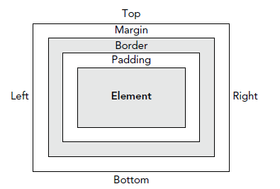
The CSS Box Model
The CSS Box Model describes the way three important CSS properties are applied to HTML elements: padding, border, and margin.

Slide 29
The CSS Box Model
Padding: The whitespace that surrounds the element within its border.
Border: After the padding, this is the next whitespace.
Margin: After the border, the last whitespace.
Adding up these 3 properties add up to the space an element takes up in the page.

Slide 30
The CSS Box Model
Given the following CSS, what is the total width?
.MyDiv
{
width: 200px;
padding: 10px;
border: 2px solid Black;
}
...
<div class="MyDiv">Element</div>
The Div has a width of 200px and a padding of 10px and a border of 2px. Final value?

Slide 31
Adding CSS to your Pages
One way to add CSS is to use an external file
<link href="StyleSheet.css" rel="Stylesheet" type="text/css" media="screen" />
Another Way is within the style tags
<head runat="server">
<title></title>
<style>
h1
{
color: Blue;
}
</style>
</head>
Last Way is to do it inline.
<span style="color: White; background-color: Black;">
This is white text on a black background.
</span>

Slide 32
CSS Overrides
An important thing to consider is the way that the various types of style sheets override one another.
If you have multiple identical selectors with different property values, the one defined last takes precedence.
Example:
<link href="Styles/Styles.css" rel="stylesheet" type="text/css" />
<style>
h1
{
color: Blue; ← This is the style that would work on H1
}
</style>

Slide 33
Try it Out
Complete Pg. 66
Complete Pg. 77
Complete Pg. 85

Slide 34
Summary
In this chapter we covered:
Understanding of how the HTML model is limited for styling and designing
Learned how CSS are used to overcome such shortcomings.
Reviewed how CSS syntax looks and behaves.
Identified several selectors and how to work with rules.
Reviewed the box model.
Reviewed how to add CSS to your pages.

