Slide 1
Chapter 4
Working with ASP.NET Server Controls

Slide 2
Objectives
Learn what ASP.NET Controls are.
How the ASP.NET runtime processes the server controls on our page.
Common behavior shared among different server controls.
How server controls are able to maintain their state across postbacks.

Slide 3
ASP.NET Server Controls
ASP.net controls are the powerful workhorses behind the framework. They help provide user interaction functionality by creating the UI components on the markup and the programmability on the code behind (source code)
The previous framework, classic ASP combined code and presentation
<input type="text" value="Hello World, the time is <%=Time()%>" />
.NET Server controls are more elegant and help maintain the code
<asp:TextBox Id=“txtHello” runat=“server” />
txtHello.Text = “Hello World, the time is “ + DateTime.Now.TimeOfDay.ToString()

Slide 4
ASP.NET Server Controls
Fundamentally, server controls operate on the server side, meaning that after the user has made a specific request from their browser and the url is found the web server which processes the page will now execute that server control.
With .NET Server controls, the ASP.NET runtime engine which is part of the web server (usually I.I.S.) processes all the server controls which live inside the web server.
After processing, these controls emit client side HTML code that gets sent to the browser.

Slide 5
ASP.NET Server Controls
The following is the format:
<asp:TypeOfControl ID="ControlName" runat="server" />
Where:
  TypeOfControl is the control (Button, Label, etc.).
  ID is a unique identifier to user to refer to the control on the page
  and the runat attribute tells the ASP.NET runtime to process that control.
You can also close the tag with the long version, as seen here
<asp:TextBox Id="Message" runat="server"></asp:TextBox>

Slide 6
ASP.NET Server Controls
As we mentioned, the power of these server controls is that you can program against them.
For example, Given the following Textbox, we can change the message with the following
Message.Text = "Hello World, the time is " + DateTime.Now.TimeOfDay.ToString();
With this flexibility, we can drive the design from the markup and the programmability from the code block.
Note that the markup is not case sensitive, but the code block is.

Slide 7
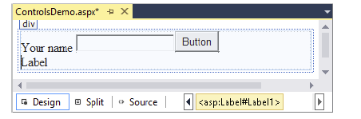
Postback and Programmability
Support we have a label, textbox and button like so:
The label has ID Result and the Textbox has an ID of Yourname.
In the design view, we can double click on the button and it generates some code for us known as an event handler.
The event handler will create a piece of code to handle our click.

Slide 8
Postback and Programmability
                protected void SubmitButton_Click(object sender, EventArgs e)
                {
                Result.Text = "Your name is " + YourName.Text;
                }
Once this button is actually clicked from a browser, it creates what is known as a postback which sends the information from all the .net controls to the server.
A postback is a call from the client to the server.
The SubmitButton _Click method is executed which adds the text to the Result label.

Slide 9
Postback and Programmability
The outcome is that our Label control changes with the name that was specified in the textbox.
The HTML that is sent from the server side back to the client, is the following:
<span id="Result">Your name is Tom</span>

Slide 10
A Closer look at ASP.NET Server Controls
You can drag and drop controls from the toolbox in markup view or you can type the control directly in markup view.
To make it easier, when you click on a control you can always use the properties grid to change.
Common properties for all controls
  ID: Unique identifier user by the server runtime for the page.
  runat: Tells the runtime engine to process this control
  clientID: ID that gets sent back o the browser/ HTML ID.

Slide 11
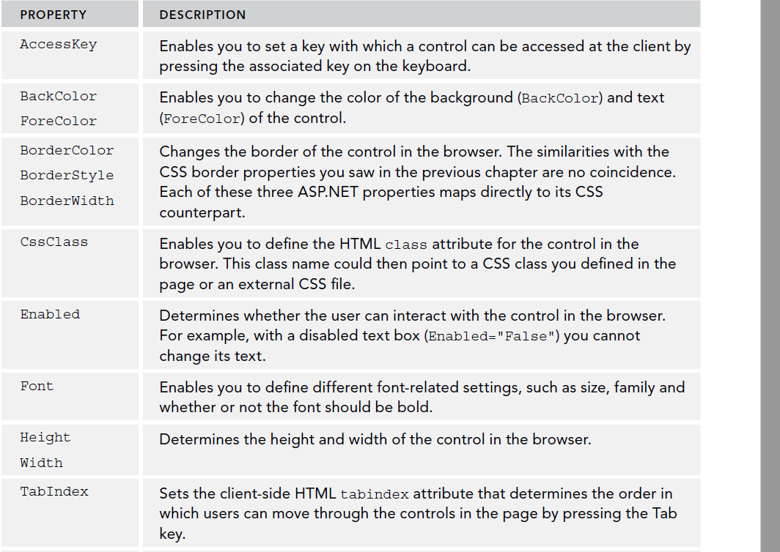
Other Properties

Slide 12
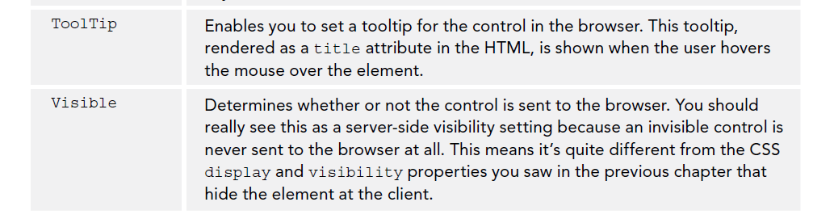
Other Properties

Slide 13
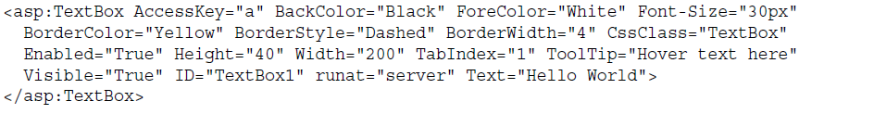

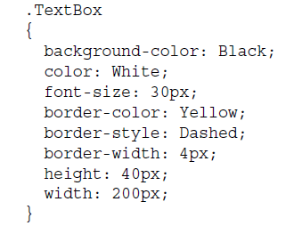
Maintain readability in your controls
Move the styling to CSS if possible if your expect the control to have a lot of the properties
OK →
Better →

Slide 14
Type of Controls
Simple Controls:
  TextBox, Button, Label, Hyperlink, RadioButton, Checkbox
List Controls, Presented as a list in the browser:
  ListBox, DropdwonList, CheckBoxList, RadioButtonList, BulletedList
Container Controls, used to group related content and controls:
  Panel, Placeholder, Multiview, Wizard
Other Standard Controls:
  LinkButton, ImageButton, Image, ImageMap, Calendar, FileUpload, Literal,
  Hiddenfield (very useful), Table

Slide 15
Type Of Controls
Data Controls: Used to access databases, XML or objects.
Validation Controls: Client/Server side controls that provide validation.
Navigation Controls: Treeview, Menu, Sitemappath
Login Controls: Creates secure login and related functionalities
Ajax extensions: Controls enable you to retrieve data from the server side with doing a full postback (sending the entire page to the server). Used for “flicker-free” interaction.

Slide 16
HTML Controls and when to use?
There are the client side HTML controls. You can access their properties on the server side by adding runat=“server”
Normally, you will need to leverage the functionality of a .NET control at development time or in the future, so in that case you would use a .NET control.
However, if you are absolutely sure that the control will not programmed against on the server side, you can use the HTML controls.
If unsure, use the .NET control.

Slide 17
ASP.NET State Engine
Consider that adding what happens when you have a label, you change its value and click a button which causes a postback.
When the request comes back from the postback the label still has the value which was entered. Why?
Given what we know about the HTTP protocol and its stateless nature, something should be occurring to maintain the state.
The value in the label is maintained by the ASP.NET state engine, a feature that is deeply integrated into the ASP.NET run time. It enables controls to maintain their state across postbacks, so their values and settings remain available after every postback of the page.

Slide 18
ASP.NET State Engine
Consider the form control HTML form control <form>.
<form method="post" action="State.aspx" id="form1">
...
</form>
This form can post information one of two ways:
  POST: All data from the form is added to the body of request.
  GET: All data is appended to the actual address of a request.
The form controls encapsulates controls to submit back to the server when a button control is clicked.

Slide 19
ASP.NET State Engine
Now consider an ASP Web Form, which has the runat=“server”. It always uses the POST method to add all the controls to the body of the request.
Every .NET Page contains a form element by default.
The Form normally posts back to itself. (Cross page posting is an option)
The form must be able to pass the value back to the server. We can find this in a hidden control known as the VIEWSTATE.
<form method="post" action="State.aspx" id="form1">
...
<input type="hidden" name="__VIEWSTATE" id="__VIEWSTATE"
value="IXcrUZ51B9YmtdoSL9csn2+VrYx5oW32kAw0oRXGsf3F0/W0l6/upieH7Nht1f
hyr99U0IRRKmjvYk4FdH5E9ZRucaja0xPkwCyRoNBI3KkidqR5eAVX86D
qOfEl584eSB0ff3IF4o3Y+ZqD7qZp3A==" />
</div>

Slide 20
ASP.NET State Engine
To protect the information stored in this field, ASP.NET has serialized the page state in the preceding string. If you were able to look inside the value of the fields, you’d find a value for the label that you changed.
Not all controls rely on the Viewstate however. Some send the values in the html they send.
  Examples: TextBox, CheckBox, RadioButton, DropwDownList
<input name="TextBox1" type="text" value="Initial Text" id="TextBox1" />
ASP.NET can just get the value from the “value” attribute. Adding it to the Viewstate would be unnecessary.
Controls have an attribute “EnableViewState” which you can set to false so their values don’t get included in the ViewState.

Slide 21
ASP.NET State Engine
Another item saved in the VIEWSTATE is a control state, which keeps track of data they need to operate correctly. This is not something that you can turn of..
So remember by default, ASP.NET controls track their state in the ViewState, which is serialized into a value for a hidden control. <form method="post" action="State.aspx" id="form1">
<input type="hidden" name="__VIEWSTATE" id="__VIEWSTATE"
value="IXcrUZ51B9YmtdoSL9csn2+VrYx5oW32kAw0oRXGsf3F0/W0l6/upieH7Nht1f
hyr99U0IRRKmjvYk4FdH5E9ZRucaja0xPkwCyRoNBI3KkidqR5eAVX86D
qOfEl584eSB0ff3IF4o3Y+ZqD7qZp3A==" />
</div>

Slide 22
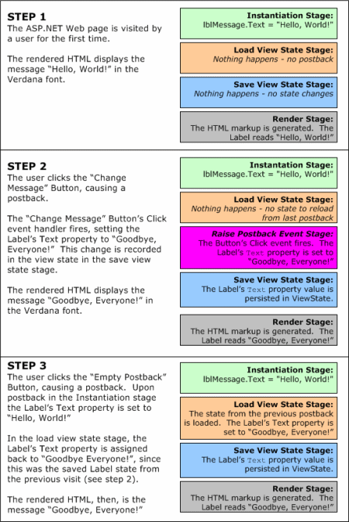

Slide 23
ViewState and Performance
The more controls get added to the Viewstate, the heavier its footprint on the page, so consider disabling the Viewstate when not used.
Viewstate can be turned off at:
  Website Level: Modify the web config under the <system.web> section
  <pages enableViewState="false">
  At the page level on the page directive
  <%@ Page Language="VB" AutoEventWireup="False" CodeFile="State.aspx.vb"
  Inherits="Demos _ State" EnableViewState="False" %>
  At the individual control level with EnableViewState = “False”
To turn of by default at page level, but respect individual controls:
<%@ Page Language="C#" … EnableViewState="True" ViewStateMode="Disabled" %>

Slide 24
Try it Out
Page 103
Page 110
Page 115
Page 117
Page 125

Slide 25
Summary
In this chapter we covered:
  ASP.NET Server Controls, what they are and what are their components.
  How a postback works.
  The different type individual .NET controls
  ASP.NET State Engine and the hidden ViewState control.
  How to disable ViewState at various levels.

