Slide 1
Chapter 5
Programming your ASP.NET Web Pages

Slide 2
Objectives
Learn the basics of C# in context with ASP.NET Web pages
Different ways to make decisions in your code
Write well-organized and documented code
What object orientation is and how you can leverage it in your applications
How to create statements and work with different data types

Slide 3
Introduction to Programming
You can add code to code behind files or class file in the App_Code folder.
When the code is compiled it becomes an intermediate language that the .NET framework can consume (MSIL).
The website is compile into one or more assemblies (.DLL files).
Compilation process occurs during the first time the site is accessed or when it changes.
This whole process occurs automatically, so no user intervention is needed.

Slide 4
Data Types and Variables
Every Data that we operation within our programming belongs to a data type.
Numbers : Int16, Int32, Double,
Strings: Char, String
Dates: DateTime
To work with Data inside the scope of a program, you can create a variable to store the data.
A variable must start with a letter or an underscore and can contain letters, numbers and underscores.

Slide 5
Variables
First you declare your variable….
// Declare a variable of type int to hold medium sized whole numbers.
int distanceInMiles;
// Declare a variable to hold some text like a first name.
string firstName;
Then you assign data into the variable…
distanceInMiles = “22”;
firstName = “Bob”;
Or you can do it all at once
String firstName = “Bob”;

Slide 6
Data Type and Variables
When naming variables use CamelCase. There is no need to prefix the variable with the data type (Hungarian Notation)
Example : String CustomerFirstName
All .NET Frameworks work with the Common Type System, a system that defines the data types across the .NET Framework.
The language that supports .NET then implements it’s version of the CTS type known as a primitive.

Slide 7
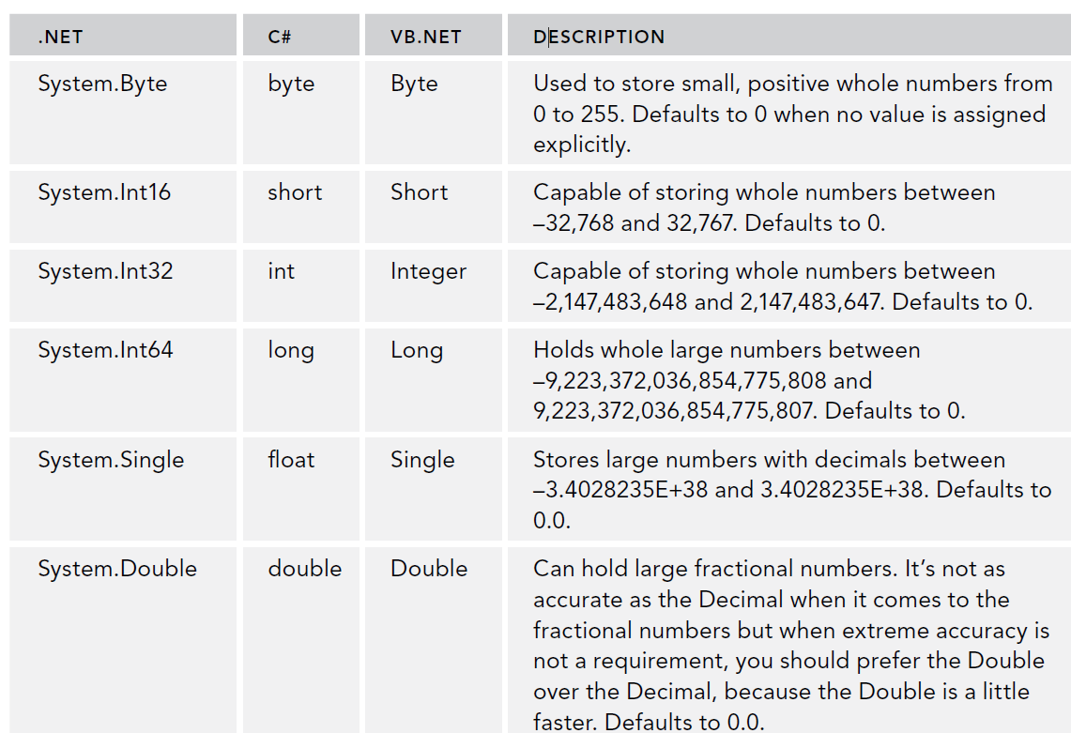

Slide 8
Converting and Casting Data Types
Data in .NET can convert from one data type to another.
Most common conversion is to a String data type. Objects usually have a .ToString() which converts the Object to a type of String.
An Object is a representation of particular item that you are working with. The HTML Asp .NET controls are represented as an Object.
ToString() is a method, an “action” that can be invoked on that Object
For Example, here we are using the Now Object and converting to a string and assigning it to the label Object’s Text property.
Label1.Text = System.DateTime.Now.ToString();.

Slide 9
Convert and Casting Data Types
To Convert, you can also use the Convert class, which has methods to help you convert such as ToBoolean(), ToInt32(), ToDateTime(), and ToString().
By passing an argument you convert to the desired type.
bool myBoolean1 = Convert.ToBoolean("True"); // Results in true
bool myBoolean2 = Convert.ToBoolean("False"); // Results in false
You can also Cast by expressing the desired data type in Parenthesis. However, to do this the data type must be able to converted into the desired type. For example, you can cast a number into a string, but you can’t cast a string into a number if the string contains nonnumeric characters.

Slide 10
Casting Examples
Casting from an Object to int and from double to int
object o1 = 1;
int i1 = (int) o1; // Works
double o2 = 1;
int i2 = (int) o2; // Works
Any incorrect casting will may crash when running the program.
An alternative is “AS” keyword, which attempts to cast but returns null if it can’t case instead of crashing.
object o1 = 1;
ArrayList myList = o1 as ArrayList; // Doesn't cast, but doesn't crash either.

Slide 11
Using Arrays and Collections
An array is essentially a list of the same things that
For example, suppose you want to keep a list of roles
string[] roles = new string[2];
roles[0] = "Administrators";
roles[1] = "ContentManagers";
This is statement creates an Array of size 2. Adding a 3rd element however will throw an error.
roles[2] = "Members"; // Throws an error
You can resize an array with:
Array.Resize(ref roles, 3); // Resize the array so it can
// hold three elements

Slide 12
Collections
Collections allow you to store items in a list but you don’t have to define an initial size and access the elements differently. (ArrayList, Hashtables)
Collections have the Add(), Remove() and Clear() methods.
ArrayList roles = new ArrayList(); // Create a new ArrayList. You don't need
// to set its size explicitly
roles.Add("Administrators"); // Add the first role
roles.Add("ContentManagers"); // Add the second role
roles.Add("Members"); // Keep adding roles and the ArrayList
Collections continue to grow as necessary so no resizing needed

Slide 13
Disadvantage with ArrayList
ArrayLists are not strongly typed (meaning the compiler doesn’t enforce that you create the list with the same type of Object).
An ArrayList will let you add elements of any type.
This causes a problem at run time if not all the elements are the same.
ArrayList roles = new ArrayList();
roles.Add("Administrators");
roles.Add("ContentManagers");
roles.Add(33); // ← This will cause a runtime error because the two types don’t match up

Slide 14
An Introduction to Generics
Generics allow you to resolve the disadvantage with collections by allowing you to define a template of the objects you expect, thus making it strongly type.
List<int> intList = new List<int>(); // Can hold ints only
List<bool> boolList = new List<bool>(); // Can hold bools only
List<Button> buttonList = new List<Button>(); // Can hold Button controls only
By using Generics with this format, we can limit the type of Object we add. So for example, adding a string ti intList above would cause a compile time error.
intList.Add(“aString”); // ← Would cause a compile error
We can use a collection initializer to add multiple values.
List<int> myList = new List<int>() { 1, 2, 3, 4, 5 };

Slide 15
Dictionary
Can also grow as needed.
Unlike ArrayList, collection contains key and value pairs.
Example:
Dictionary<string, string> myDict = new Dictionary<string, string>();
myDict.Add(“1", “Apples”);
myDict.Add(“2", “Oranges”);
myDict.Add(“3”,”Cherries”);

Slide 16
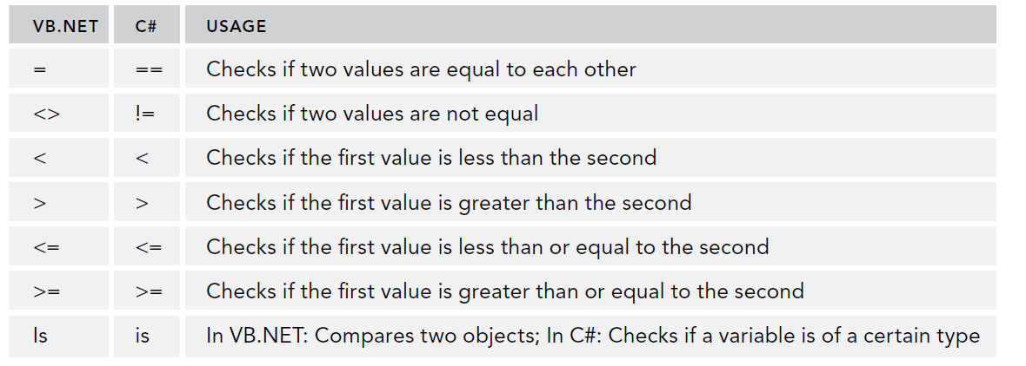
Statements and Operators
Statements are code expressions which operate on data with operators.
Operators available are assignment ( =) and arithmetic (+,-,,*,/,%)
Comparison operators are used to compare two variables

Slide 17
Statements and Operators
Concatenation Operators: +=, -=
result = firstString;
result = result + secondString;
result = firstString;
result += secondString; //Same as the statement above
Logical Operators

Slide 18
Making Decisions
If/else, used in logic decision making.
if (User.IsInRole("Administrators"))
{
DeleteButton.Visible = true;
}
else
{
DeleteButton.Visible = false;
}
Select case/switch constructs
switch (today.DayOfWeek)
{
case DayOfWeek.Monday:
discountPercentage = 40;
break;
case DayOfWeek.Tuesday:
discountPercentage = 30;
break;
default: //always use a default
discountPercentage = 10;
break;
}

Slide 19
Loops
For Loop: Iterates through the logic a number of predetermined times.
for (int loopCount = 1; loopCount <= 10; loopCount++)
{
Label1.Text += loopCount.ToString() + "<br />";
}
For Each Loop: Iterates through a collection of items
foreach (string role in roles)
{
Label1.Text += role + "<br />";
}
While Loop, Do While: Continues until exit condition is met
bool success = false;
int loopCount = 0;
while (!success && loopCount < 3) /Always avoid an endless loop
{
success = SendEmailMessage();
loopCount = loopCount + 1;
}

Slide 20
Loops
You can devise your logic to exit the loop prematurely with “break”;
for (int loopCount = 1; loopCount <= 10; loopCount++)
{
if (loopCount == 5)
{
break;
}
Label1.Text += loopCount.ToString() + "<br />";
}

Slide 21
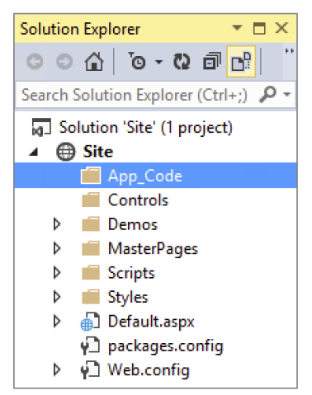
App_Code Folder
When working with the Website project, the App_Code folder is used to create any C# source file for adding functionality to your project.
Use this folder to add any functionality that is shared amongst all your web pages, that way you can update the code once and all the pages benefit from the updated code.

Slide 22
Organizing Code with Namespaces
Namespaces are a way to organize similar functionality (classes) into a logical bucket. A namespace usually contains multiple classes.
Also used to avoid class name collisions. (i.e. a class named Page from the .NET framework and a class named Page from Microsoft Word)
Think of it as the full name of a class, so you in the example above:
System.Net.Web.Page //Page is the class, System.Net.Web is namespace
Document.Word.Page //Page is the class, Document.Word is namespace
The namespace may be different from the .DLL file that gets created.

Slide 23
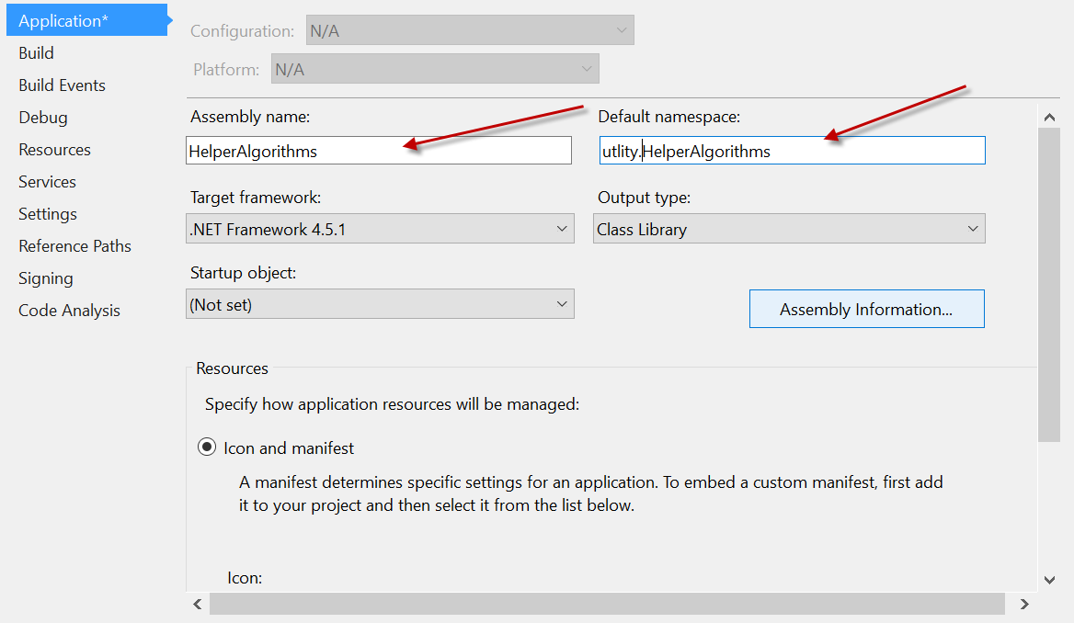
Namespaces
Support I wanted to create a helper Class library within my Website.
Go to the solution, right click and Add → New Project of type Class Library.
Name it “HelperAlgorithms”. Right click on this project and do properties.
You can see that the Assembly name and the namespace can be different.

Slide 24
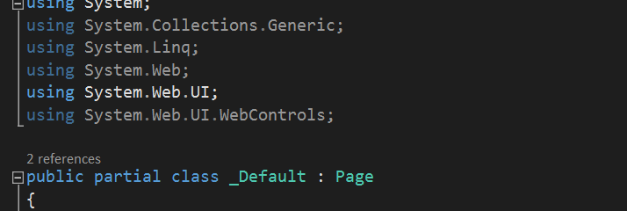
Namespaces
If you want to use an external library, first you must add the reference to the project.
Once its available for use in your project, you want to declare that you’ll be using it in your .cs file.
You can do this in the beginning with the “using” statement.
Once you import the namespace, you can use the classes in your code.

Slide 25
Writing Comments
Comments are invaluable to provide insight as to what the code should be doing.
Comments can be added one line at a time with //
// Used to store the number of miles the user has traveled last year.
int distanceInMiles;
They can be added in block format starting with /* and ends in */
/*
* This is a block of comments that is often used to add additional
* information to your code, for example to explain a difficult loop. You can
* also use this to (temporarily) comment a whole block of code.
*/
You can also use /// to write XML comments which can be used for documentation
/// <summary>
/// Sends out an e-mail to the address specified by emailAddress.
/// </summary>

Slide 26
Object Oriented Paradigm
A class is considered a blueprint of the item we wish to program.
An Object is an implementation of a class. We say that we are instantiating an object.
We can use fields to hold the data we are working with inside the class.
public class Customer
{
private string _customerName;
public Customer()
{
}
}
//implementing the object
Customer myCustomer = new Customer();

Slide 27
Object Oriented: Properties
Properties are attributed of the Object that gets instantiated. They can be retrieved and updated via a special convention (getter/ setter).
public class Person
{
private string _firstName; // This is a backing variable
public string FirstName
{
get { return _firstName; } //This is how we can get/set the values by referring to the class
set { _firstName = value; }
}
}
Accessing the properties
Person myPerson = new Person(); // Create a new instance of Person
myPerson.FirstName = "imar"; // Accessing setter to change the value
Label1.Text = myPerson.FirstName; // Accessing getter that now returns Imar

Slide 28
Methods
Methods: a block of code that encapsulates an action the class can perform
A method’s definition is called its signature and is composes of the access modifier, the return type, name of method and parameter(s) that it accepts
// Define a method
accessModifier DataType methodName([parameterList])
{
//Your logic goes here
//return any values if there is a data type
}

Slide 29
Methods
Examples of Methods:
public int Add(int a, int b)
{
return a + b; //returns an int, so it must match the data type
}
public void SendEmailMessage(string emailAddress)
{
// Code to send an e-mail goes here
}
If returning a data type out of the method, it must be the same type as the one defined in the signature (in this case int)

Slide 30
Constructors
Constructors: Constructors are special blocks of code that help you instantiate an object. The are executed when someone instantiates a class with the new keyword. You can add any code that helps you setup the object.
public class Person
{
public Person() //This is the constructor. Notice there is nothing return
{
//your logic could go here or be empty
}
}
//instantiate the Person class
Person myVIP = new Person(); //Calls the constructor defined above.
You can create multiple constructors as long as they have a different signature (the parameters are different).

Slide 31
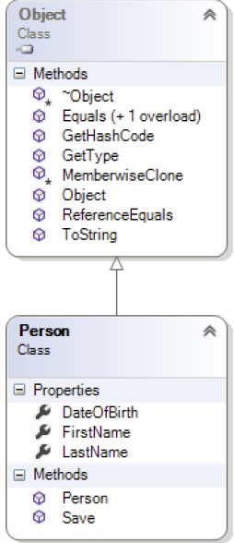
Inheritance
Inheritance means that the objects we create in C# can inherit the variables and methods from a parent class, so no duplication of code needs to take place.
In .NET everything inherits from an Object.
If we already had a Person class created, we
Can create a Student class which inherits all of
The Person properties.
public class Student : Person
{
//Inherits the methods and variables from Person
}

Slide 32
Inheritance and Overriding Methods
Suppose you inherit a method from the parent class, but you want to change the way the method works. You can do that in the child class by overriding the method.
The parent method must allow it, the method must be declared as “virtual”.
//Parent class’s original method definition
public virtual string ToString()
{
return theObject.String();
}
The child class must recreate the function with the same parameters and specify “override” in its signature.
//Child class doing the overriding
public override string ToString()
{
return FullName + ", born at " + _dateOfBirth.ToShortDateString();
}

Slide 33
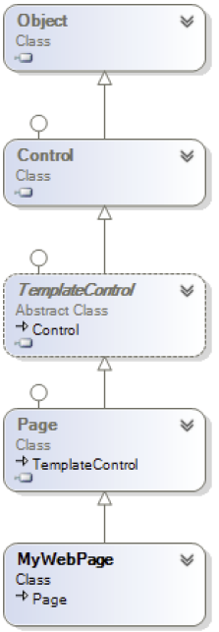
Inheritance and .NET
All the pages inherit from System.Web.UI.Page
Some classes cannot be instantiated, they exists to serve
solely as a common base class, these are know an
“Abstract” class.

Slide 34
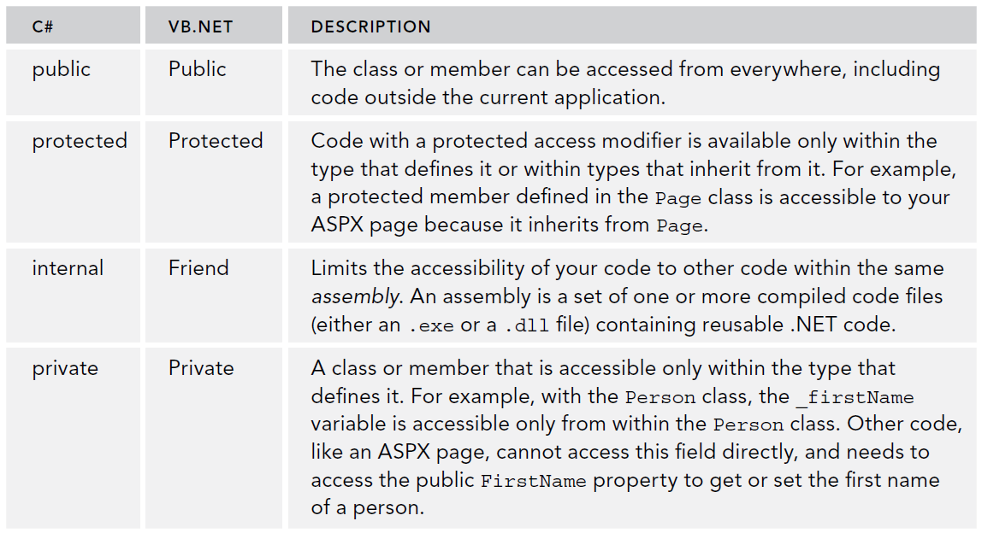
Access Modifiers
Core concept to enforce encapsulation.
Access modifiers specify how other programming entities have access with the class/method/property. Internal is default if none is specified.

Slide 35
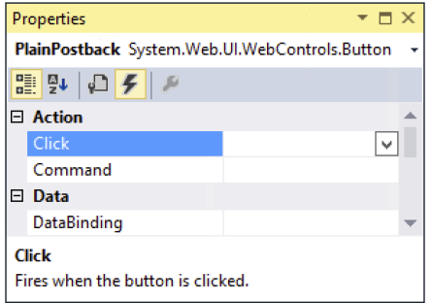
Events
Certain controls, such as buttons can raise an event.
Event Handlers are special methods written to intercept these events and do something in response
You can look at a control’s properties and see what actions are available, clicking on the lightning bolt.

Slide 36
Events
We can double click on a button control in design mode for example, and it will auto generate the event handler.
Parameters used are an Object called sender and EventArgs e. Sender contains a reference to the object that triggered the event and EventArgs supplies additional arguments to the event if needed.
Markup:
<asp:Button ID="Button1" runat="server" Text="Button" OnClick="Button1_Click" />
Code Behind
protected void Button1_Click(object sender, EventArgs e)
{
//Do Something to handle controls.
TextBox myTextBox1 = (TextBox) form1.FindControl(“myTextBox1");
}

Slide 37
Try it Out
Pg. 159
Pg. 170

Slide 38
Summary
Learned the basics of C# in context with ASP.NET Web pages
Understood different ways to make decisions in your code
Learned to write well-organized and documented code
Discovered what object orientation is and how you can leverage it in your applications
Learned how to create statements and work with different data types

