Slide 1
Chapter 6
Creating Consistent Looking Websites

Slide 2
Objectives
How to use master and content pages that enable you to define the global look and feel of a web page
How to work with a centralized base page that enables you to define common behavior for all pages in your site
How to create themes to define the look and feel of your site with an option for the user to choose a theme at run time
How to create skins to make site-wide changes to control layout
What the ASP.NET page life cycle is and why it’s important

Slide 3
Master Pages
A template solution to allow more flexible creation of web sites.
A master page looks like a normal ASPX page. It contains static HTML such as the <html>, <head>, and <body> elements, and it can also contain other HTML and ASP.NET Server Controls.
Inside the master page, you set up the markup that you want to repeat on every page, like the general structure of the page and the menu.
A master page is not a true ASPX page and cannot be requested in the browser directly; it only serves as the template on which real web pages — called content pages — are based.
A master page also has a code behind.

Slide 4
Master Pages
In the master page mark up:
<%@ Master Language="C#" AutoEventWireup="true" CodeFile="Frontend.master.cs“ Inherits="MasterPages _ Frontend" %>
To create regions that content pages can fill in, you define ContentPlaceHolder controls in your page like this:
<asp:ContentPlaceHolder ID="ContentPlaceHolder1" runat="server">
</asp:ContentPlaceHolder>

Slide 5
Master Pages
The content pages, which are essentially normal ASPX files, without the code that they’re going to take from the master page, are connected to a master page using the MasterPageFile attribute of the Page directive:
<%@ Page Title="" Language="C#" MasterPageFile="~/MasterPages/Frontend.master"
AutoEventWireup="true" CodeFile="Default.aspx.cs" Inherits=" _ Default">
The page-specific content is then put inside a Content control that points to the relevant ContentPlaceHolder:
<asp:Content ID="Content1" ContentPlaceHolderID="ContentPlaceHolder1"
runat="Server"></asp:Content>
The ContentPlaceHolderID attribute of the Content control points to the ContentPlaceHolder that is defined in the master page.

Slide 6
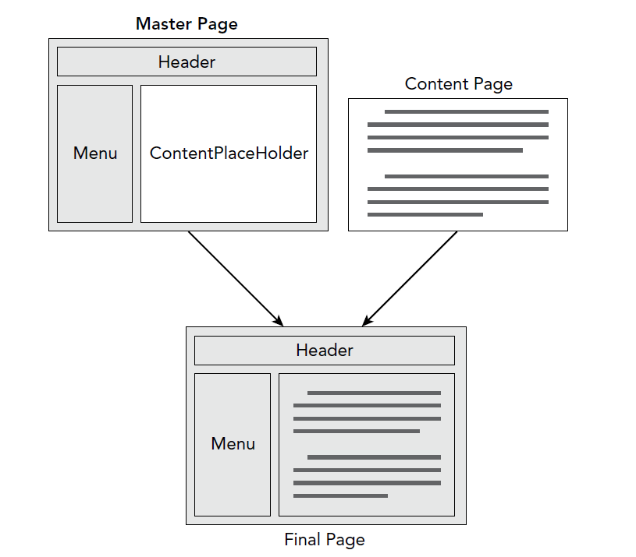
How the master page is rendered

Slide 7
Creating a Content Page
A Content page is similar to an .aspx page except it wraps its content with <asp: content> and must be tied to a master page.
To add a content page, add a web form but check “Select master page” in Visual Studio.

Slide 8
Creating a Content Page
Now Select the Master Page

Slide 9
Creating a Content Page
The added Default.aspx content page will have the following markup
<%@ Page Title="" Language="VB" MasterPageFile="~/MasterPages/Frontend.master"
AutoEventWireup="false" CodeFile="Default.aspx.vb" Inherits="_Default" %>
<asp:Content ID="Content1" ContentPlaceHolderID="head" runat="Server">
</asp:Content>
<asp:Content ID="Content2" ContentPlaceHolderID="cpMainContent" runat="Server">
</asp:Content>
Notice it is now bound to the template master page “Frontend.master”
When a page based on a master page is requested in the browser, the server reads in both the content page and the master page, merges the two, processes them, and then sends the final result to the browser.
Because the entire design and layout of your site is defined in the master page, you only need to touch that single file when you want to make any changes. All content pages will pick up the changes automatically.

Slide 10
Master Pages- Default Content
You can create default content to a master page, which will serve as the default content as long as it’s not overriding by a content page.
<asp:ContentPlaceHolder ID="cpMainContent" runat="server">
This is default text that shows up in content pages that don't
explicitly override it.
</asp:ContentPlaceHolder>
Choose on the Content Control’s smart task panel to “Default to Master’s Content” and it will overwrite with the master content

Slide 11
Master Pages
You can nest master pages, by selecting a master page when adding a new master page.
Controls inside a content page end up having different Id’s and names because they are part of a master page.
If we have a button inside a ContentPlaceHolder control (<asp:Content>)
<asp:Button ID="Button1" runat="server" Text="Click Me" />
This would be rendered in the browser as:
<input type="submit" name="ctl00$cpMainContent$Button1“ value="Click Me" id="cpMainContent_Button1" />

Slide 12
Using a Centralized Page
All .NET pages derived from System.Web.UI.Page and that provides some functionality.
However, you can create your own page to derive from using inheritance by creating a common base page.
MyWebPage can inherit from Page or
It can inherit from your own BasePage.

Slide 13
Using a Centralized Page
If you want your pages to inherit from a common BasePage
  Create a class that inherits from System.Web.UI.Page in the App_Code folder of your website.
  Make the web pages in your site inherit from this base page instead of the standard Page class.

Slide 14
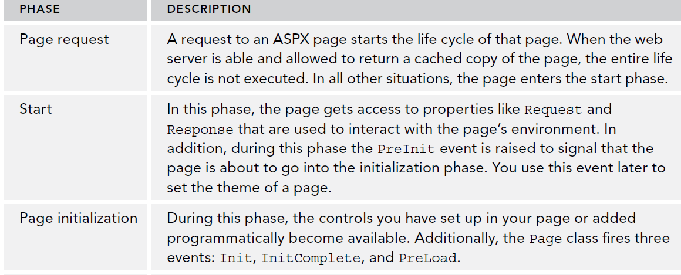
Introduction to ASP.NET Page Lifecycle
Any .NET page goes through several phases in its life which raise events that the developer can program against.
These lifecycle phases only occur at the server side.

Slide 15
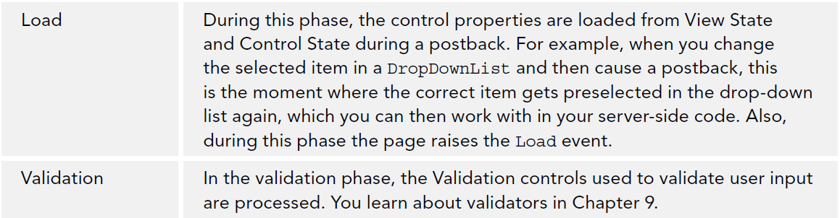
ASP.NET Page Lifecycle

Slide 16
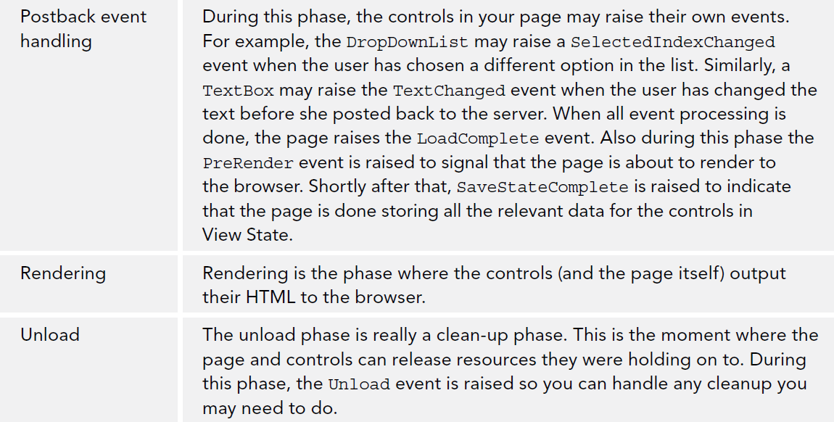
ASP.NET Page Lifecycle

Slide 17
Creating a Base Page
Create a class file in the app_code folder called BasePage
using System;
public class BasePage : System.Web.UI.Page
{
private void Page_PreRender(object sender, EventArgs e)
{
if (string.IsNullOrEmpty(this.Title) || this.Title.Equals("Untitled Page",
StringComparison.CurrentCultureIgnoreCase))
{
throw new Exception(
"Page title cannot be \"Untitled Page\" or an empty string.");
}
}
public BasePage()
{
this.PreRender += Page_PreRender;
}
}

Slide 18
Creating a Base Page
Now, we can create a new web form page and have inherit from our page
This page will inherit our own BasePage functionality
  public partial class Login : BasePage
  {
  ...
  }
The page’s preRender is executed and then the BasePage’s PreRender is also executed.

Slide 19
Templates
Visual Studio provides a mechanism to export a template of different file types (.aspx.,.css, .class).
By creating a custom template, you define the code or markup that you need in every file once and then create new files based on this template, giving you a jump start with the file and minimizing the code you need to type.
Visual Studio creates a zip file with the necessary files. This zip file is then stored in the ItemTemplates subfolder of the Visual Studio folder under your Documents folder. Some of the files in the zip file contain the placeholders $relurlnamespace$ and $safeitemname$.
When you add a new file to the site that is based on your template using the Add New Item dialog box, VS replaces $relurlnamespace$ with the name of the folder (nothing, in the case of a file added to the root of the site) and $safeitemname$ with the actual name of the page.

Slide 20
Themes
A collection of files that defined the look and feel of a page. It includes skins files, CSS files and images.
They are added to a special folder named “App_Themes”
A link to each CSS file in the theme folder is added to your
page’s <head> section automatically whenever the
theme is active.
Two different type of Themes:
  Theme Property
  StyleSheetTheme Property

Slide 21
Themes
StyleSheetTheme property:
  Applied very early in the page’s life cycle, shortly after the page instance has been created. This means that an individual page can override the settings from the theme by applying inline attributes on the controls
  Use if you want to set default, but can be overwritten.
Example, BackColor overwrites theme:
  <asp:Button ID="Button1" runat="server" Text="Button" BackColor="Red" />
Theme property:
  Applied late in the page’s life cycle, effectively overriding any customization you may have for individual controls.
  Used to enforce a style.

Slide 22
Themes
Where can themes be applied:
  Page Level (Populate Theme or StyleSheetTheme property):
    <%@ Page Language="VB" AutoEventWireup="false" CodeFile="Default.aspx.vb“ Inherits="_Default" Theme="DarkGrey" %>
  Site Level:
    Find the <pages> section in the web.config under system.web
      <pages theme="DarkGrey" styleSheetTheme="DarkGrey">
      ...
      </pages>
  Programmatically:
    Via Page.Theme

Slide 23
Skins
Skins are files which detail the appearance of controls. They appear just like the control itself, except they do not allow the ID attribute (runtime error will occur).
Example of skin content which will affect all Buttons:
  <asp:Button BackColor="#cccccc" ForeColor="#308462" runat="server" />
The attributes allowed on skins usually affect the appearance only.
They are separate files of type .skin extension and are stored in the Themes folder directly.
You should create .skin files for each element that you want to skin, such as Button, Label, etc.

Slide 24
Skins
Instead of applying formatting elements directly to the control’s properties in the skin and thus to the final markup in the page, it’s often better to use the CssClass property to point to a CSS class in one of your CSS files.
Example:
  <asp:Button CssClass="MyButton" runat="server" />
  .MyButton
  {
  color: #308462;
  background-color: #cccccc;
  }

Slide 25
Named Skins
Named Skins are skins that have SkinID attribute. This attribute identifies them so that they can be placed on specific elements.
For example, on the Button.skin file you would create
<asp:Button BackColor="Red" ForeColor="Black" SkinID="RedButton" runat="server" />
Then on the .aspx page, you would reference this by
<asp:Button ID="Button2" runat="server" Text="Button" SkinID="RedButton" />
If you want one of your controls NOT to be affected by a skin, you can disable skinning at the control level by setting EnableTheming=“False”
<asp:Button ID="Button1" runat="server" EnableTheming="False" Text="Button" />

Slide 26
Try it Out
Pg. 198
Pg. 200
Pg. 209
Pg. 213
Pg. 218
Pg. 222
Pg. 226

Slide 27
Summary
How to use master and content pages that enable you to define the global look and feel of a web page
How to work with a centralized base page that enables you to define common behavior for all pages in your site
How to create themes to define the look and feel of your site withan option for the user to choose a theme at run time
How to create skins to make site-wide changes to control layout
What the ASP.NET page life cycle is and why it’s important

