Slide 1
Chapter 8
User Controls

Slide 2
Objectives
What user controls are, how they look, and why they are useful
How to create user controls
How to consume (or use) user controls in your pages
How you can improve the usefulness of user controls by adding coding logic to them

Slide 3
User Controls
User controls are custom created controls that can essential group other asp controls.
They are useful If you have a set of controls that are always used in multiple pages or need to work together.
Supposed you want a control with 4 labels and 4 textboxes that have a specific functionality and look and feel. You can create this as one user control and then use the user control on all the pages needed.
User controls are very similar to .aspx pages. They have a markup and a code behind.

Slide 4
User Controls
User controls have the following similarities to normal ASPX pages:
  They have a markup section where you can add standard markup, server controls, and plain HTML.
  They can be created and designed with Visual Studio in Markup, Design, and Split View.
  They can contain programming logic, either inline or with a Code Behind file.
  They give you access to page-based information like Request.QueryString.
  They raise some (but not all) of the events that the Page class raises, including Init, Load, and PreRender.
Keys Differences: extension is .ascx and they cannot be called by the browser directly and must be added to a page (.aspx).

Slide 5
Creating User Controls
You can Added it the same as any other item Add -> New Item and choose type “Web User Control”

Slide 6
Creating User Controls
Notice that the User Control get added to the website structure.
It doesn't have a “Page” directive like the normal pages, but instead it has:
<%@ Control Language="C#" AutoEventWireup="true" CodeFile="WebUserControl.ascx.cs“ Inherits="WebUserControl" %>
Treat the User Control as you would an .aspx page. You should have most of the same functionality available…

Slide 7
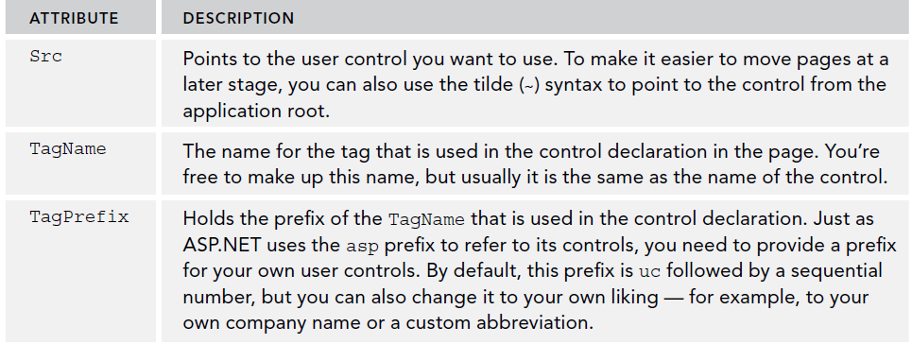
Adding User Controls to a Content Page or Master Page
To add a user control to a content page or master page, you need to take the following steps.
1) Register the control in your page by adding the @Register directive.
  A typical @ Register directive for a user control looks like this:
  <%@ Register Src="ControlName.ascx" TagName="ControlName" TagPrefix="uc1" %>
2) Add the tags of the user control to a page and set attributes as needed.
The Register directive contains the following attributes:

Slide 8
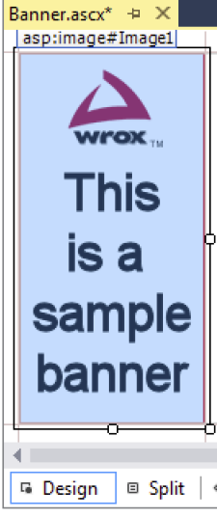
Example of a User Control
Suppose we add a user control to represent a banner. We create our user control like so…
<%@ Control Language="C#" AutoEventWireup="true" CodeFile="Banner.ascx.cs"
Inherits="Controls_Banner" %>
<asp:Panel ID="VerticalPanel" runat="server">
<a href="http://p2p.wrox.com" target="_blank">
<asp:Image ID="Image1" runat="server" AlternateText="This is a sample banner"
ImageUrl="~/Images/Banner120x240.gif" />
</a>
</asp:Panel>

Slide 9
Example of a User Control
Create a page, master page or use an existing one and switch to design view.
From the solution explorer, drag your user control into the desired position.
Switch to the markup view once the control has been added and find the @Register directive and make sure it is pointing to the correct file. Notice the user control tag prefix as well.
<%@ Register Src="~/Controls/Banner.ascx" TagName="Banner" TagPrefix="uc1" %>
When the control is registered, you can add it to the page using the TagPrefix:TagName construct, similar to the way you add standard server controls to a page.

Slide 10
Adding a User Control to a Page
Given the @ Register directive for the banner control, you need the following markup to add the control to your page:
  <uc1:Banner ID="Banner1" runat="server" />
This is the minimum code needed for a user control in a page. Note that the control is defined by a combination of the TagPrefix and the TagName.
So suppose this is what you added another user control and declared it as such:
<%@ Register Src="~/Controls/MainData.ascx" TagName=“MainData" TagPrefix="uc2" %>
Then on the markup, you would add it to the content like this
  <uc2:Maindata ID=“myUCMainData1” runat=“server” />

Slide 11
Adding a User Control inside a page
Our User Control resides in the page (Master page in this case)

Slide 12
Page Rendering of the User Control
Even though you now page a user control inside a file, the rendering becomes contents inside a div. Note the Div Id.
When user control gets rendered by the ASP.NET engine, it appears on the client side as
  <div id="Banner1_VerticalPanel">
  <a href="http://p2p.wrox.com" target="_blank">
  <img id="Banner1_Image1" src="Images/Banner120x240.gif"
  alt="This is a sample banner" />
  </a>
  </div>

Slide 13
Sitewide Registration of User Controls
User controls that are going to be used sitewide can be registered through the web.config file.
Once a control is configure site wide, you no longer need the @Register page directive.
Within the <pages> tag, create a <controls> tag and create a new tag prefix and source to locate that control
<pages theme="Monochrome">
<controls>
<add tagPrefix="Wrox" tagName="Banner" src="~/Controls/Banner.ascx" />
</controls>
</pages>
Make sure you find the instances of the control and change the tag prefix to your new site tag prefix (in his case “Wrox”

Slide 14
Understanding and managing client IDs
By design, all elements in an HTML page need to be unique.
Giving them an id attribute is not required, but if you do so, you have to make sure they are unique.
To avoid conflicts in the final HTML code of the page, ASP.NET ensures that each server-side element gets a unique client id by prefixing them with the name of their naming container.
Within a naming container all elements should have unique IDs.
Example: If you have an <asp:panel> with id of “VerticalPanel” within a user control that has an id of “Banner1”, then the panel (which gets rendered as a div) will have the following Id:
  <div id="Banner1_VerticalPanel">
  ...
  </div>

Slide 15
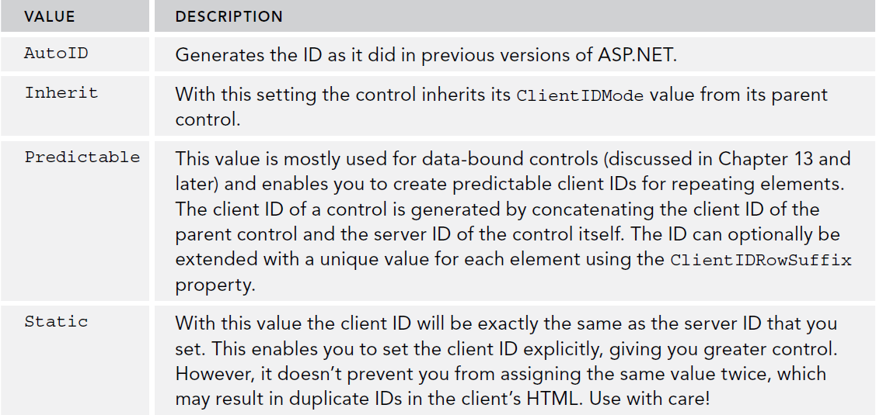
Managing IDs with ClientIDMode
Introduced with ASP 4, the ClientIDMode determines how Client Id is rendered.
This can be setup in the web.config on the <pages> tag
<pages controlRenderingCompatibilityVersion="3.5" clientIDMode="AutoID"/>

Slide 16
Adding Logic to your User Controls
You can add properties to user controls to make them more useful.
For useful properties, you can also use enums in C#.
The .NET Framework supplies a nice way to solve this by enabling you to create your own data type in the form of an enumeration. With an enumeration, or enum for short, you assign numbers to human-friendly text strings.
You can use class file in the app_code folder to declare these values.
  public enum Direction
  {
  Horizontal = 0,
  Vertical = 1
  }

Slide 17
Adding Logic to your User Controls
You can program against a user control like an .aspx page.
Example: Adding a property
Outside the page load on the user control, add:
  //Direction is of an enum type that we need to have previously created.
  public Direction DisplayDirection { get; set; }
We can set the DisplayDirection of our Enum type by adding this property to the user control.
Now that we have a property we can program against it in the user control…

Slide 18
Adding Logic to our User Control
We can add logic in our User Control’s page load event to check on the enum
protected void Page_Load(object sender, EventArgs e)
{
  switch (DisplayDirection)
  {
  case Direction.Horizontal:
  HorizontalPanel.Visible = true;
  VerticalPanel.Visible = false;
  break;
  case Direction.Vertical:
  VerticalPanel.Visible = true;
  HorizontalPanel.Visible = false;
  break;
  }
}
We can pass the “DisplayDirection” variable when defining the user control on the page
<Wrox:Banner ID="Banner1" runat="server" DisplayDirection="Horizontal" />

Slide 19
Checking For First load of Page
On the page’s code behind, you can use Page.IsPostBack to see if its the first time a page loads.
If Page.IsPostBack = false, that is the first time the page has been loaded to the user.
If Page.IsPostBack = true the user has initiated an action on the client side that has caused the page to be posted back to the server.
//This would only occur the first time a page is loaded
if (!Page.IsPostBack)
{
Banner2.DisplayDirection = Direction.Vertical;
}

Slide 20
Implementing a View State Property
https://msdn.microsoft.com/en-us/library/ms178198(v=vs.85).aspx
We can add values to be stored in the View State and they will persist across sessions.
The View State is represent as a Dictionary collection in the .NET Framework that can be accessed programmatically.
We add something to the viewstate with the following syntax:
  ViewState[key] = value;
  Where key is the identifier and value is what we want to keep between sessions.
For example, supposed you want to keep the variable across postbacks for a navigation URL.
  ViewState["NavigateUrl"] = value;

Slide 21
Implementing a View State Property
Be careful with what you add to the ViewState. It increases the page’s footprint on every transfer.
Never store large objects such as database records in the ViewState. It is often fast to load the data on the fly.
ViewState information is transferred on every request and even though it is serialized, you shouldn’t store any sensitive information.

Slide 22
Recommendation for User Controls
Don’t overuse user controls. User controls are great for encapsulating repeating content, but they also make it a little harder to manage your site because code and logic is contained in multiple files.
Keep user controls focused on a single task. Don’t create a user control that is able to display five different types of unrelated content with a property that determines what to display.
When you create user controls that contain styled markup, don’t hardcode style information like the CssClass for the server controls contained in the user control. Instead, consider creating separate CssClass properties on the user control, which are then used to set the CssClass of your server controls.

Slide 23
Try it out
Pg. 275
Pg. 278
Pg. 281
Pg. 286
Pg. 290

Slide 24
Summary
In this chapter we covered:
  Learned what user controls are, how they look, and why they are useful
  Learned how to create user controls
  Figured out wow to consume (or use) user controls in your pages
  Improved the usefulness of user controls by adding coding logic to them

