Slide 1
Predicting Future-Term Student Performance Based on Historical Enrollment Data
Andrea Garcia
Data Science Capstone
IDC 6940 – Spring 2022

Slide 2
Background
Board of Governors Performance Funding Model
Student performance in undergraduate courses is crucial to the success of the student and the institution
Educational Data Mining to improve learner outcomes
Data driven decision making process in higher-ed

Slide 3
Motivation
Higher education sector full of unexplored data
Drop-out rate for undergraduate college students is 40%
30% of the drop-out rate comes from freshmen and sophomores
Measuring student success with a proactive approach to improving student outcomes
Link: https://educationdata.org/college-dropout-rates

Slide 4
Use Cases
Course Recommender System
Students at Risk Alert System
Advisor Alert System
Instructor Intervention

Slide 5
Objectives
Build a classification model to identify students at risk of failing
Identify factors that are influential to a student’s success
Can a student’s historical undergraduate course performance be used to predict future-term outcomes?
What are the most influential factors to student success in an undergraduate course?
What is the best performing model for this classification task?
Is performance in gateway courses and university core curriculum courses influential in students’ future-term course performance?

Slide 6
Implementation
Stage One
Stage Two
Stage Three *
Stage Four
Data Collection
Build Course-specific model
Anonymization
Feature Engineering
Build enriched course-specific model
Model Performance Analysis
Preprocessing
Train/Validation/
Test Split
Feature Selection
Feature Importance Analysis
Exploratory Data Analysis
Build enriched course-specific model w/ features selected
* Hyperparameter tuning and cross-validation happen throughout Stage Three

Slide 7
Preprocessing Stage One
Data anonymization: codify student PII
Removal of duplicated attributes
Dealing with NULLS
Casting to appropriate data type
Removal of non-GPA contributing grades
Removal of retakes
Removal of P’s from Spring 2020
Feature engineering

Slide 8
Feature Information Stage One
Core information
Side information
Engineered Features
Course-specific sparse matrix of pass/fail outcomes
Demographics
Student attributes (i.e. gpa)
Course attributes (i.e. course modality)
Aggregate enrollment measures
(i.e. UCCs passed, credits attempted)

Slide 9
Dataset Stage One
Raw Shape Summary
48 attributes | 637,327 unique-student course pairs | 38,738 unique students | 2,899 courses | 17 enrollment terms
Final Shape Summary
43 attributes |~ 145,000 unique student-course pairs | 16,928 unique students | 1,837 courses | 13 enrollment terms

Slide 10
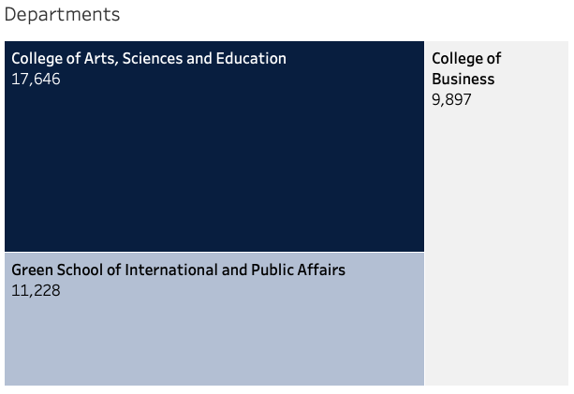
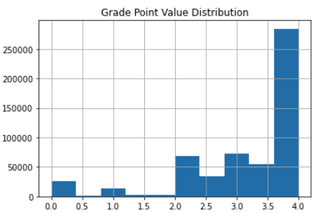
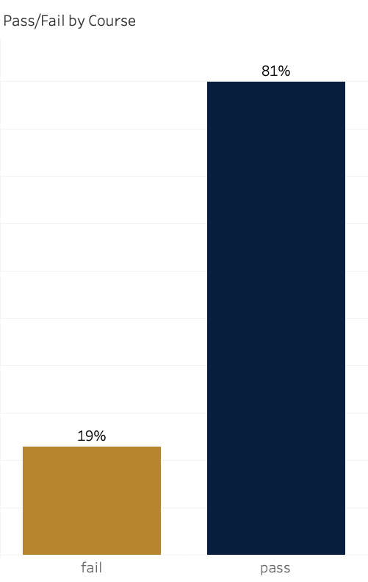
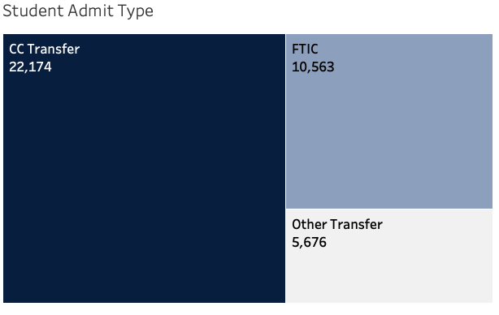
Data Exploration Stage One
Student counts by College
GPV Distribution
(average gpv – 3.1)
Pass/Fail distribution in data
Student counts by Admit Type

Slide 11
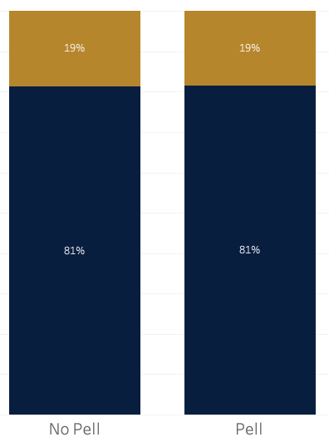
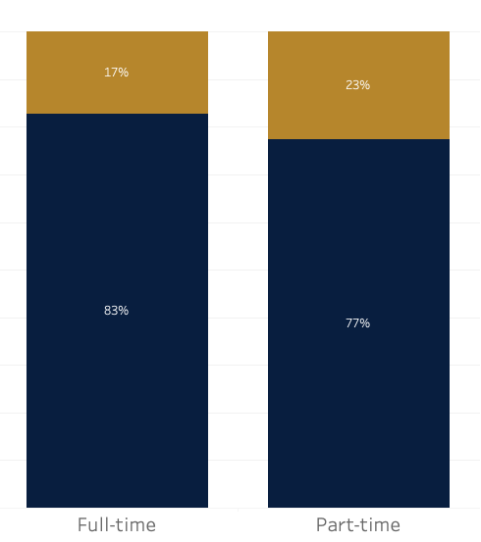
Data Exploration Stage One
No Difference
Slight Difference
Pass/Fail by Pell Grant Indicator
Pass/Fail by Enrollment Status

Slide 12
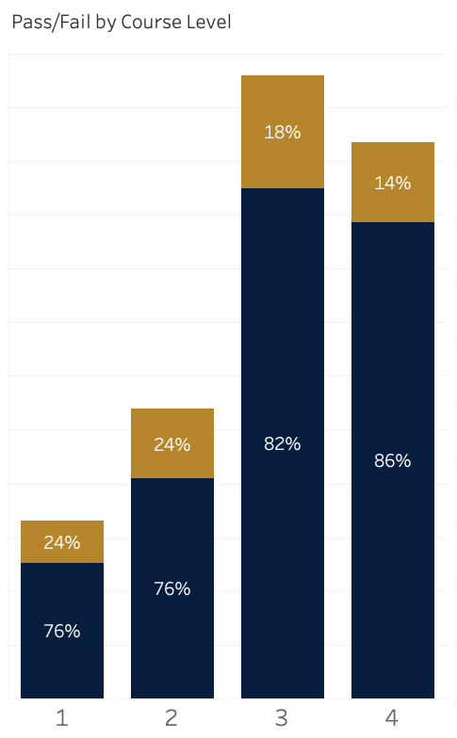
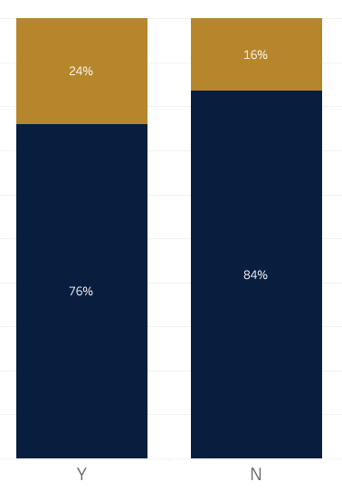
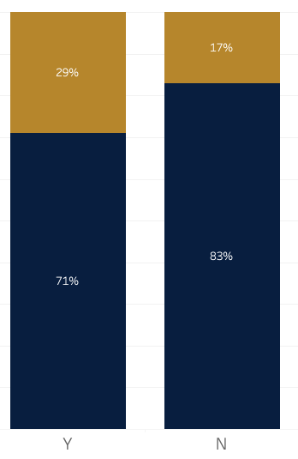
Data Exploration Stage One
More pronounced difference
Pass/Fail by Course Level
Pass/Fail by UCC Flag
Pass/Fail by Gateway Flag

Slide 13
Experiment Setup Stage Two
24 Highest Enrollment Courses
CJL-4064- | MAN-3025-
BSC-2023- | DEP-3305-
CLP-4146- | COM-3112-
STA-2122- | FIN-3403-
SOP-3004- | QMB-3200-
MAN-4720- | EAB-3002-
CCJ-3628- | MAR-3023-
BUL-4310- | ENC-1102-
EXP-3523- | PSY-4931-
CCJ-4014- | PSY-3215-
QMB-4680- | PSY-3024-
GEB-3003- | PSY-3211-
Train: Spring 2020 and prior
Validation: Fall 2020
Test: Spring 2021
Features (prior courses)
Student List
Dataset size
Course Selection
Train/Validation/Test Split
Different Course Level Info

Slide 14
Evaluation Metric & Baseline Stage Two
Chosen Metric
Dummy Classifier
Imbalanced dataset
F1 score for positive class (fails)
Strategy = Stratified

Slide 15
Model Building Stage Three
Step One: Choose Attribute Set
Course Specific Model
Enriched Course Specific model
A sparse matrix of pass/fail outcomes
Sparse matrix of course outcomes + side information + engineered features
Step Two: Choose Machine Learning Algorithm
Decision Tree
AdaBoost
Support Vector Machines

Slide 16
Can a student’s historical undergraduate course performance be used to predict future-term outcomes?
[Objective 1: Build a classification model to identify students at risk of failing]

Slide 17
Data Evaluation Stage Three
Comparing Attribute Sets
Overall Averages
Metric | Course specific model | Enriched Course specific model
f1_positive | 0.086174 | 0.119531
f1_macro | 0.488073 | 0.531349
Table 1. Overall f1 positive average achieved on using attribute set (across all 24 courses tested )
Averages by College
College | Metric | Course specific model | Enriched Course specific model
CASE | f1_positive | 0.121852 | 0.160984
 | f1_macro | 0.496640 | 0.542473
COB | f1_positive | 0.044239 | 0.074398
 | f1_macro | 0.492823 | 0.517651
SIPA | f1_positive | 0.055289 | 0.074074
 | f1_macro | 0.441137 | 0.523380
Figure 1. Comparison of attribute sets using Decision Tree
Table 2. Per college f1 positive average achieved on using attribute set (across all 24 courses tested )

Slide 18
Model Choice Stage Three
Step One: Choose Attribute Set
Course Specific Model
Enriched Course Specific model
A sparse matrix of pass/fail outcomes
Sparse matrix of course outcomes + side information + engineered features
Step Two: Choose Machine Learning Algorithm
Decision Tree
AdaBoost
Support Vector Machines

Slide 19
What is the best performing model for this classification task?
[Objective 1: Build a classification model to identify students at risk of failing]

Slide 20
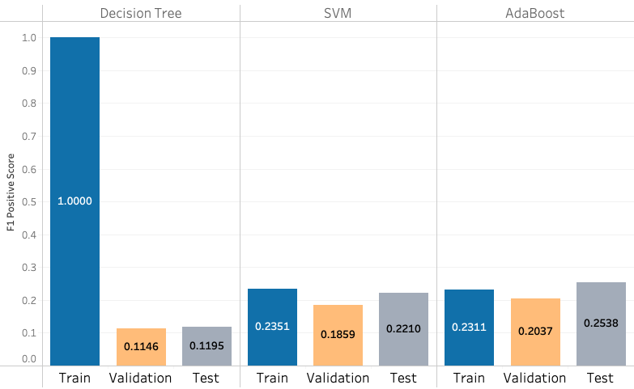
Model Evaluation Stage Three
Baselines
Metric | Baseline Dummy Classifier
f1_negative | 0.946510
f1_positive | 0.054023
f1_macro | 0.500267
Average Performance per Model
Table 3. Baselines using Stratified dummy classifier
Overall Averages
Metric | Decision Tree | SVM | AdaBoost
f1_negative | 0.943167 | 0.865571 | 0.902278
f1_positive | 0.119531 | 0.221028 | 0.253759
f1_macro | 0.531349 | 0.543300 | 0.578019
Table 4. Model averages across all 24 courses tested
Averages by College
College | Metric | Decision Tree | SVM | AdaBoost
CASE | f1_negative | 0.923962 | 0.871971 | 0.894562
 | f1_positive | 0.160984 | 0.272884 | 0.339485
 | f1_macro | 0.542473 | 0.572428 | 0.617023
COB | f1_negative | 0.960903 | 0.893445 | 0.909783
 | f1_positive | 0.074398 | 0.161113 | 0.168382
 | f1_macro | 0.517651 | 0.527279 | 0.539083
SIPA | f1_negative | 0.972685 | 0.765641 | 0.913128
 | f1_positive | 0.074074 | 0.173382 | 0.138528
 | f1_macro | 0.523380 | 0.469511 | 0.525828
Figure 4. Comparison of three machine learning algorithms tested on the Enriched Course Specific Model
Average AUC per Model
Decision Trees | SVM | AdaBoost
0.534061 | 0.601556 | 0.647154
Table 5. Model averages per college for all 24 courses tested

Slide 21
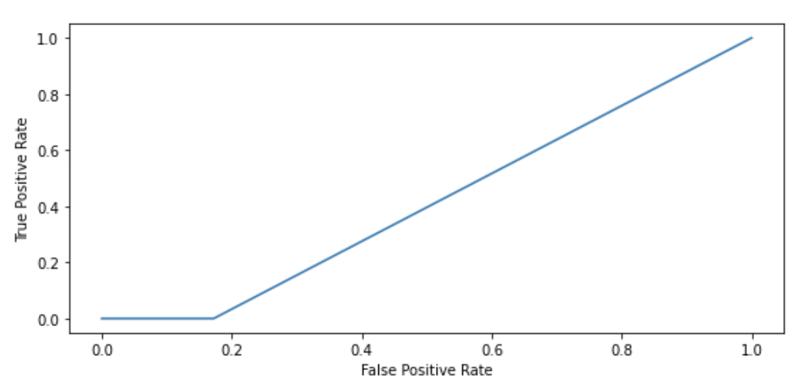
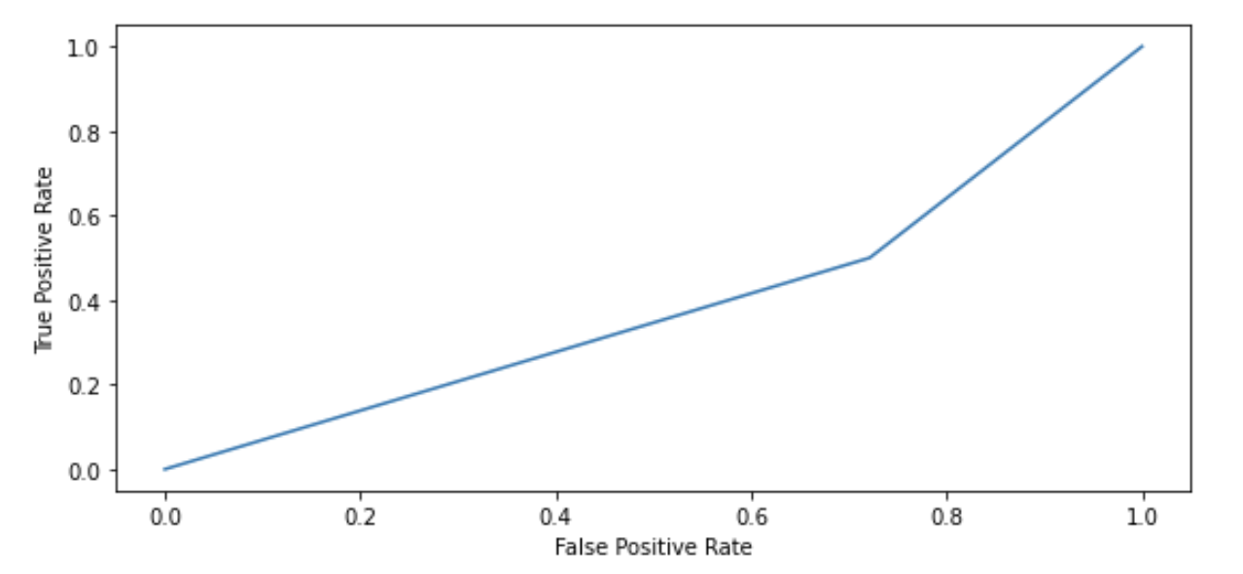
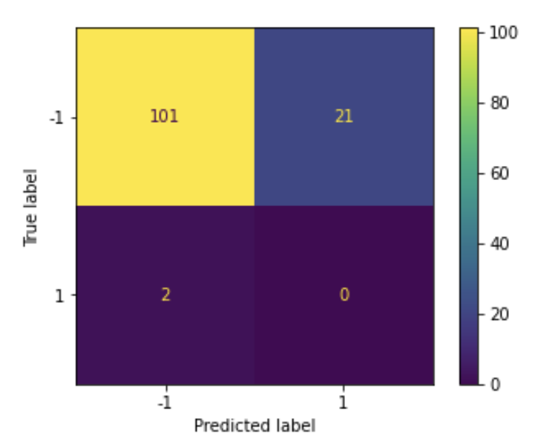
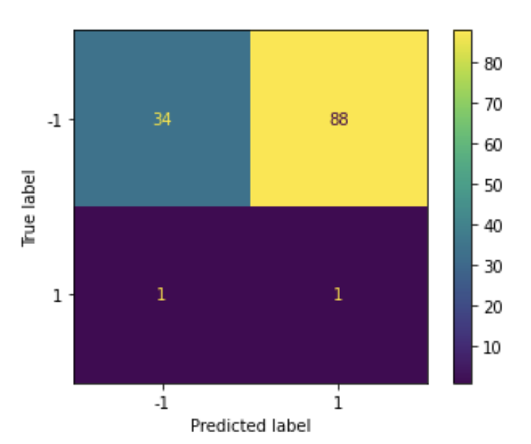
Model Evaluation - CCJ3628 Stage Three
AdaBoost
SVM
CCJ 3628 - ROC Curve
CCJ 3628 - ROC Curve
AUC Score
AUC Score
Classification Report
Confusion Matrix
Classification Report
Confusion Matrix

Slide 22
Model Choice Stage Three
Step One: Choose Attribute Set
Course Specific Model
Enriched Course Specific model
A sparse matrix of pass/fail outcomes
Sparse matrix of course outcomes + side information + engineered features
Step Two: Choose Machine Learning Algorithm
Decision Tree
AdaBoost
Support Vector Machines

Slide 23
What are the most influential factors to student success in an undergraduate course?
[Objective 2: Identify factors that are influential to a student’s success]

Slide 24
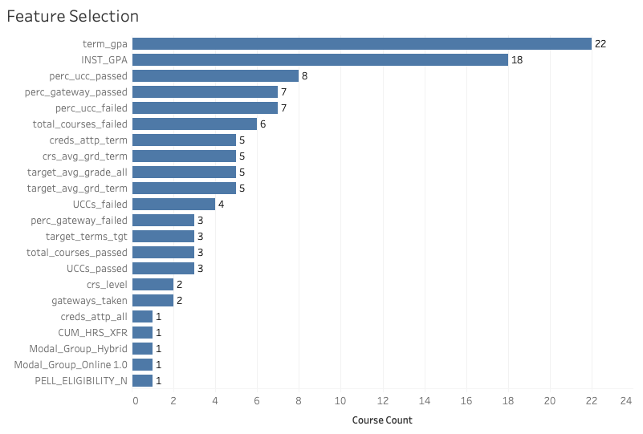
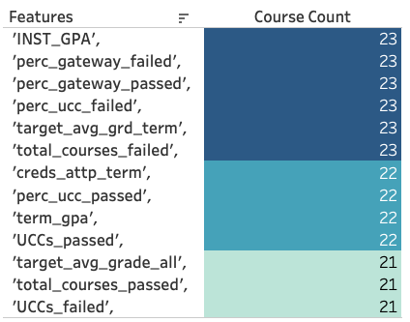
Feature Selection Stage Three
Commonly Selected Features Across All 24 Courses Tested
Step
Recursive Feature Elimination
Step
Analysis of Variance
Figure 5. This only takes into account side information (excludes courses)
Figure 6. ANOVA on RFE selected attributes for further refinement

Slide 25
Is performance in gateway courses and university core curriculum courses influential in students’ future-term course performance?
[Objective 2: Identify factors that are influential to a student’s success]

Slide 26
Important Features Stage Four
Figure 6. ANOVA on RFE selected attributes for further refinement
Figure 7. Pass/Fail by Gateway flag
Figure 8. Pass/Fail by UCC course flag
6 features related to Gateways or UCCs
Identified in the majority of courses
Supports differences in pass/fail distributions

Slide 27
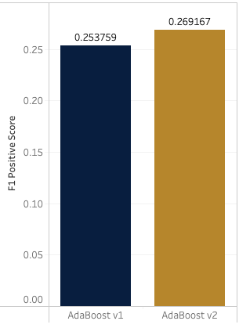
Model Performance Stage Four
Overall Averages
Metric | AdaBoost v1 | AdaBoost v2
f1_negative | 0.902278 | 0.893256
f1_positive | 0.253759 | 0.269167
f1_macro | 0.578019 | 0.581211
Average Performance per Model
Baselines
Metric | Baseline Dummy Classifier
f1_negative | 0.946510
f1_positive | 0.054023
f1_macro | 0.500267
Table 6. Model averages across all 24 courses tested
Table 3. Baselines using Stratified dummy classifier
Final AdaBoost Model
Averages by College
College | Metric | AdaBoost v1 | AdaBoost v2
CASE | f1_negative | 0.894563 | 0.885103
 | f1_positive | 0.339485 | 0.356749
 | f1_macro | 0.617024 | 0.620926
COB | f1_negative | 0.909784 | 0.885153
 | f1_positive | 0.168383 | 0.166182
 | f1_macro | 0.539084 | 0.525667
SIPA | f1_negative | 0.913128 | 0.947478
 | f1_positive | 0.138528 | 0.193473
 | f1_macro | 0.525828 | 0.570475
4X
Better than baseline
Avg Overall Classification Ability
Figure 9. Comparison of AdaBoost versions
Baseline AUC: 0.501977
v1 AUC : 0.647154
v2 AUC : 0.656771
Table 7. Model averages per college for all 24 courses tested
v1: Enriched Course Specific model
v2: Enriched Course Specific model w/selected features

Slide 28
Findings
Best attribute set for predicting future-term student outcomes:
Enriched Course Specific model w/selected features
Best performing model for course outcome classification task:
AdaBoost with Decision Tree as base classifier
Student’s aggregate enrollment measures such as GPA, courses failed and credits attempted
are informative attributes to predicting success
Student’s performance in Gateway and UCC courses (even as a count of Gateways and UCCs failed) is an influential factor in future-term student outcomes

Slide 29
Future Work
Incorporate more financial as well as demographic information to expand the scope of the model outside of academic performance
Incorporate the entire student body instead of just three colleges for a more comprehensive analysis
Create a model that incorporates the non-gpa contributing grades that were excluded to
capture drops, withdrawals and incompletes

Slide 30
QUESTIONS?

