Slide 1
Mobile Application Development
lecture1
Fall 2011 - COP 4655 U1
T/R 5:00 - 6:15pm – ECS 135
Steve Luis

Slide 2
Agenda
Mobile Application Development Intro
Development Platform
Syllabus Review

Slide 3
Mobile Application Development
Design and develop software for mobile devices like a phone or tablet.
Understand how mobile apps are different from conventional desktop apps.
Learn how to use the language, OS, IDE and frameworks to effectively create mobile applications.
Realize the full potential of your app by utilizing the capabilities of mobile device.
Notes:
Phones and tablets embody the latest in mobile device technology and are a very large part of the computing marketplace.
Developing for mobile is very different than desktop or other interfaces. That about what was learned Windows CE debacle.
Language, OS, IDE and frameworks → we will be learning all four at the same time.
Think beyond the conventional application. Consider task, quick data entry, specific U/I response. Reduce

Slide 4
Mobile Devices: A brief history
http://www.livbit.com/article/2009/08/18/evolution-of-mobile-phones-in-matryoshka-style/

Slide 5
Mobile Devices: A brief history
Cellular Phones
1980s – early 1990s
1G Analog
Dial tone
alphanumeric LED display
Device specific OS
Manufacturer software only

Slide 6
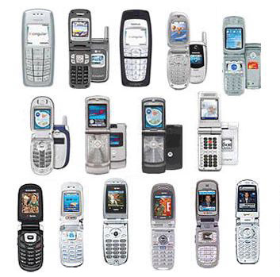
Mobile Devices: A brief history
Feature Phones
1990s to mid 2000s
2G Digital
full featured telephony
addressable screens
Embedded reusable OS
simple applications
calendar/SMS/games
Limited 3rd party apps

Slide 7
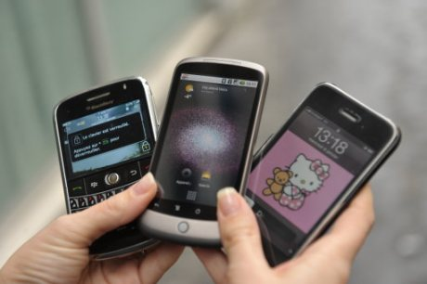
Mobile Devices: A brief history
Smart Phone
mid 2000s to ???
3G Multi-Network
Integrated telephony
high-res screens
Sensing devices
full OS/software stack
3rd party - media rich applications

Slide 8
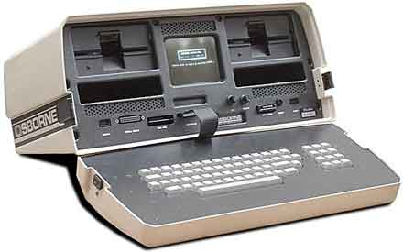
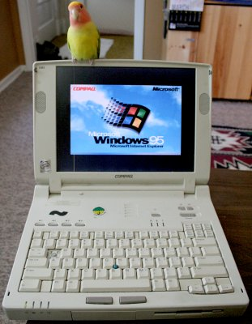
Mobile Devices: A brief history
Portable Computers
Laptops
Netbooks

Slide 9
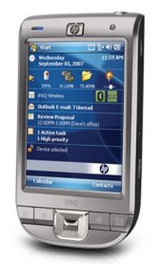
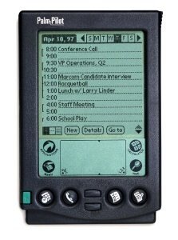
Mobile Devices: A brief history
PDAs

Slide 10
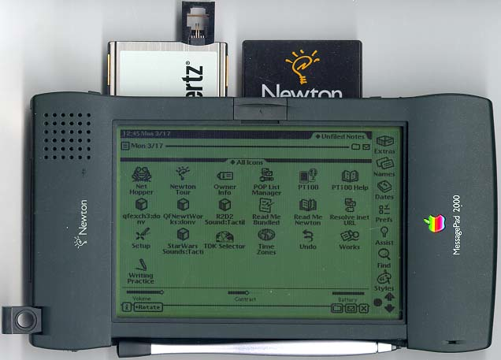
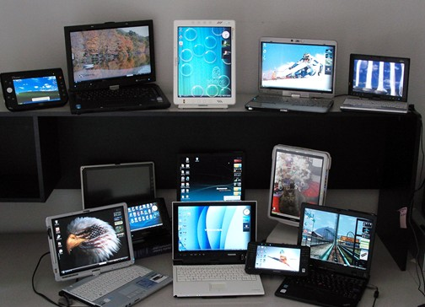
Mobile Devices: A brief history
Tablet

Slide 11
What makes mobile development different?

Slide 12
What makes mobile development different?
Desktop = large screen, mouse, stationary
Laptop = smaller desktop UX, keyboard
Mobile =
Hand-held, small, hi res, screen
Multi-touch: Gesture
Anywhere: not just sitting
Aware: sensors
Always on and connected

Slide 13
Special Development Considerations
Limited operating memory
Small screen
Real-time application constraints
Application response time
Suspend/Resume
System and application reliability
Notes:
Consider trade-off of always on applications vs. available memory.
Small screen means you can display everything and you cannot make your navigation too deep.
Phone rings, an SMS message is received, app received a notification from apples notification server, in the middle of a game.
Geolocation running updating maps on the fly --- smooth user experience.
Phone cannot crash, slow down, drop calls, loss data,

Slide 14
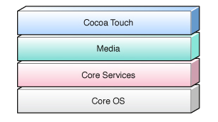
Mobile Development Platform
Apple iMac
Apple iPhone and iPad
Apple iOS 4.3
Apple iOS Frameworks
Objective – C 3.0
Xcode 4.02

Slide 15
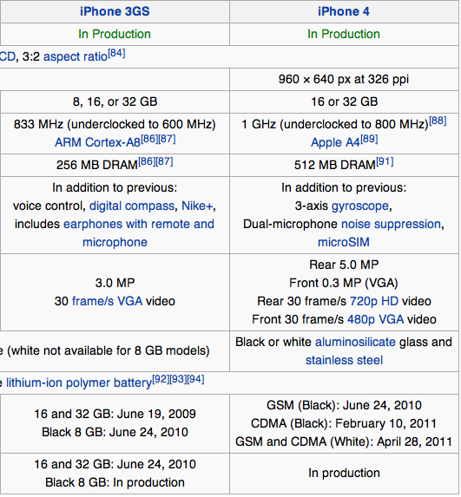
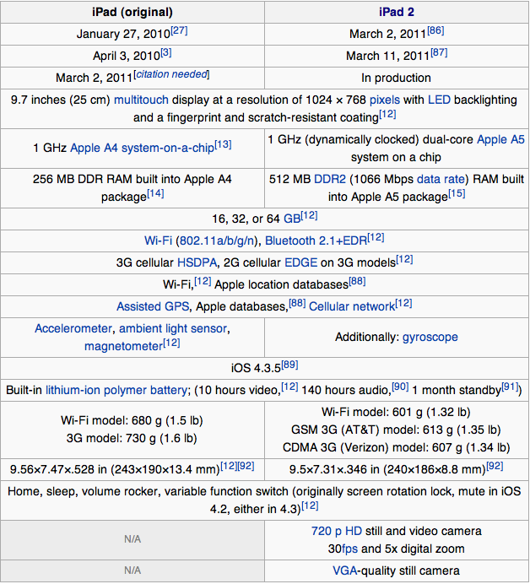
iPhone & iPad

Slide 16
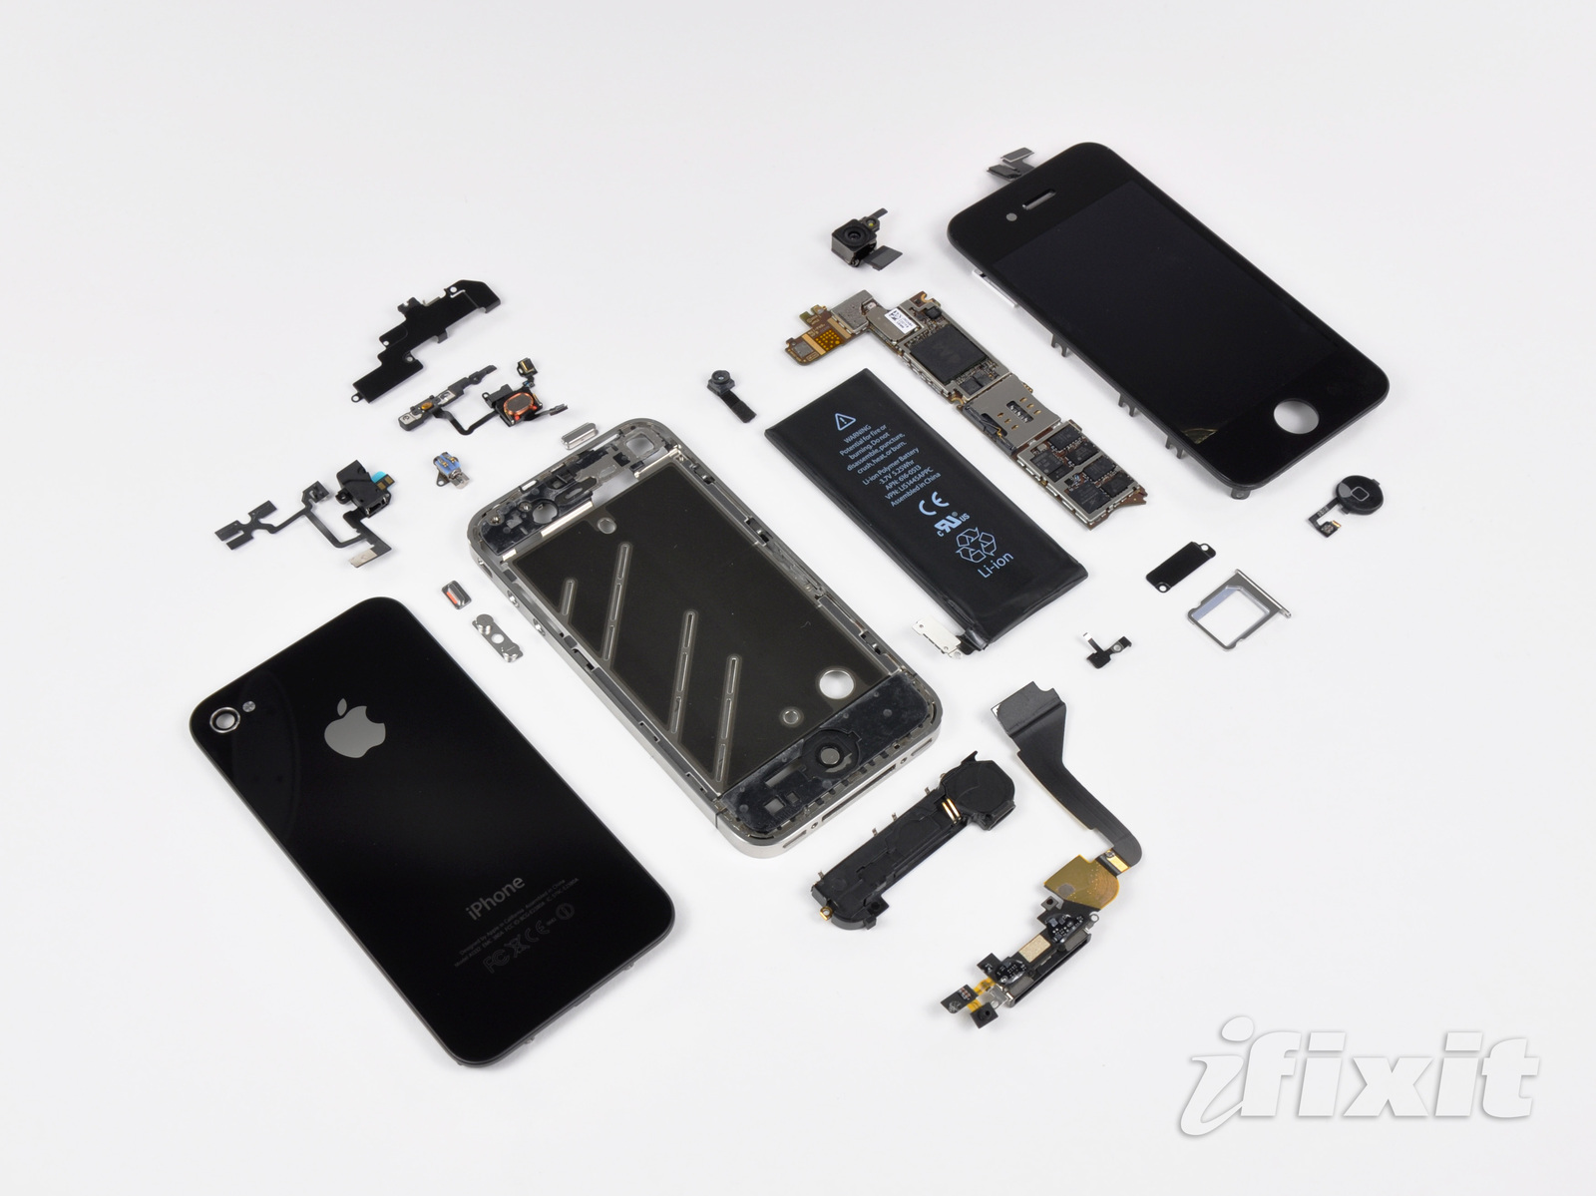
Notes:
iPhone 4

Slide 17
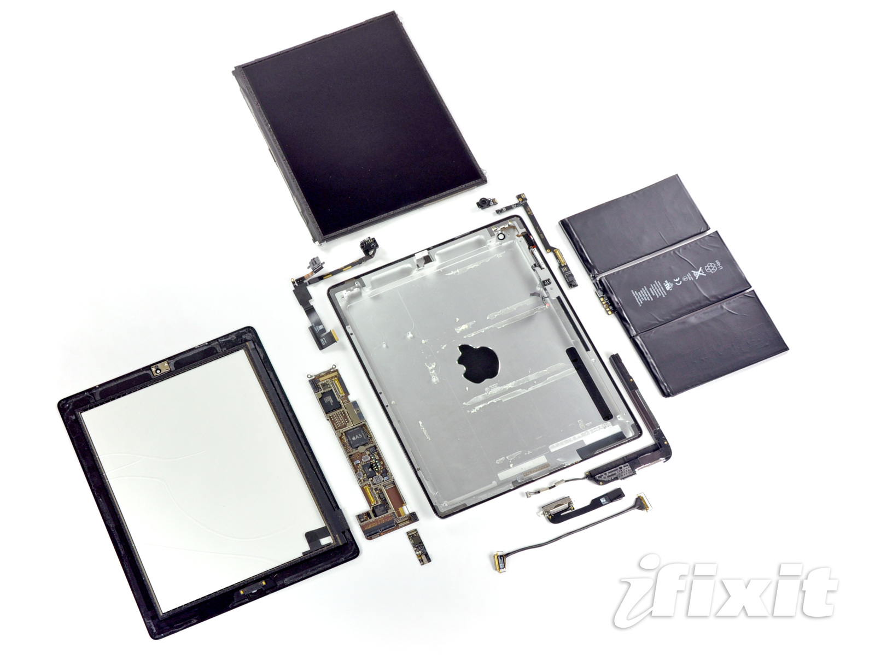
Notes:
iPad 2
Video 10 play test by David Pogue --- A5 Chip

Slide 18
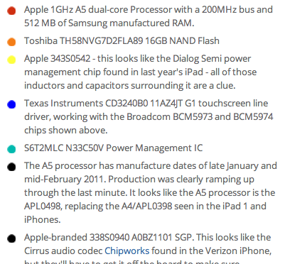
Notes:
A5 CPU and GPU

Slide 19
Apple iOS
Unix based Mach Kernel and BSD interfaces
Same as Mac OS X with some variations
Virtual Memory wo/ paging
Background applications
Notes:
Consider embedded OS vs. conventional OS.

Slide 20
iOS App Runtime Environment
Designed for fast and secure execution
Multi-tasking environment
Save state
Constrained memory → Purge app
Restore state

Slide 21
iOS SDK 4.3
Cocoa Touch
Multi-touch events and controls
Accelerometer support
View hierarchy
Camera support
Media
OpenAL
audio mixing and recording
Video playback
Image file formats
Quartz
Core Animation
OpenGL ES
Core Services
Networking
Embedded SQLite database
Core Location
Threads
CoreMotion
Core OS
TCP/IP
Sockets
Power management
File system
Security

Slide 22
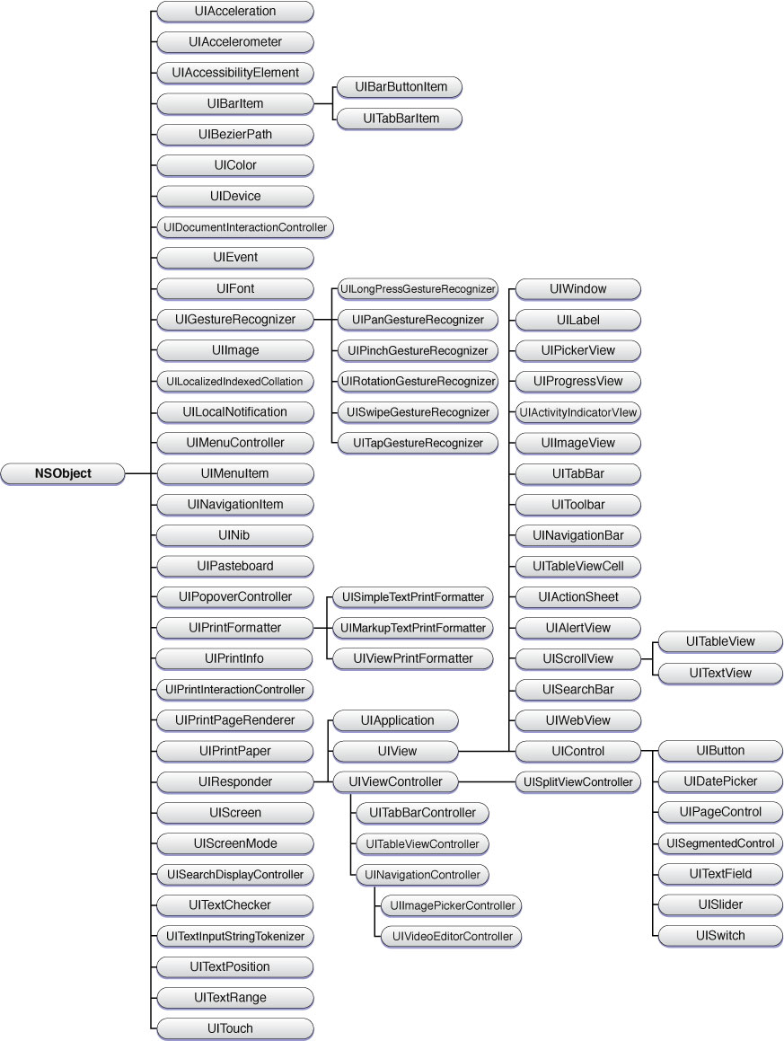

Slide 23
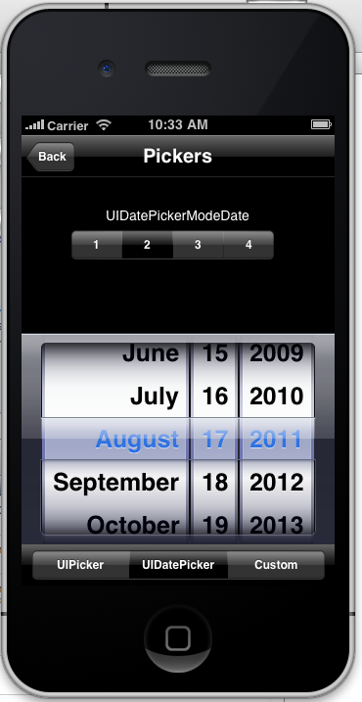
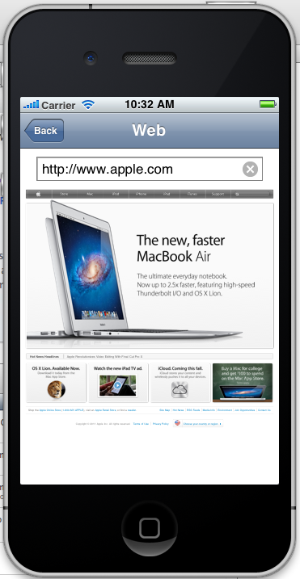
Demo: UICatalog

Slide 24
Required Apple Developer Registration
Software, Documentation, Tutorials, Videos, Sample Code, Support Forum
Free Apple Developer Account at: developer.apple.com
Use your FIU student email account as ID
Provide your ID to me next class

Slide 25
Buy the class textbook
Study assignment:
Review the Glossary: Appendix A
Begin reading Chapter 21

Slide 26
Syllabus Review

