Slide 1
Performance Evaluation of Large-Scale Scientific Applications on Grid Computing Environments with PRIME
By Miguel A. Erazo
Advisor: Jason Liu
March 2009

Slide 2
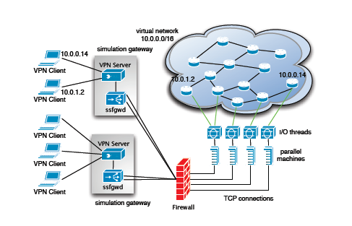
PRIME network simulator

Slide 3
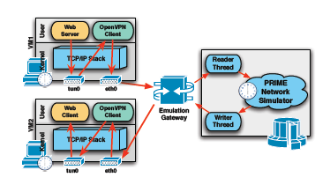
PRIME cont.

Slide 4
Previous mid-size experiment
Simulated – emulated hundreds of nodes
Tested real applications performance in presence of background traffic

Slide 5
Previous work
In previous work we built a platform to evaluate TCP variants
We showed that PRIME accurately models real applications and TCP behavior

Slide 6
Our objective
Develop a large-scale Grid application performance evaluation platform based on PRIME
PRIME will be augmented with the ability to model various specific networking resources in global Grid environments

Slide 7
Our objectives cont.
We will extend the performance evaluation platform to predict the power signatures of large-scale Grid applications

Slide 8
Proposed approach
Number of distributed sites, each simulating a portion of network
Real and simulated traffic are integrated
A single site may consist of a cluster of parallel computers
We map the sub-model to the available machines

Slide 9
THANKS !

