Slide 1
SNMP Monitoring with Kaseya
IT Managed
Services Defined

Slide 2
Course Overview
Uploading MIBs and OIDs
Creating SNMP Monitor Sets
Assigning SNMP Monitor Sets
Reporting on SNMP

Slide 3
Lesson Overview
Introduction to Kaseya SNMP Monitoring
Introduction to MIB’s and OID’s
Uploading MIB’s to Kaseya
Adding OID’s to the Kaseya Monitor List

Slide 4
Kaseya SNMP Monitoring
SNMP Manager
SNMP Enabled Device
Five Basic SNMP Messages
GET
GET-NEXT
GET-RESPONSE
SET
TRAP
Only the TRAP message is generated by the SNMP device

Slide 5
Kaseya SNMP Monitoring
An agent installed on a managed machine will contact the SNMP enabled Device using an SNMP Polling message (such as SNMPGet).
The Agent will then collect the data from the device and report it to your Kaseya server.
The Kaseya server will record the data in the VSA database tables for reporting and alert a predefined thresholds.

Slide 6
Introduction to MIB’s and OID’s
All SNMP events (traps), names, data, etc. are assigned a unique Object ID number (OID) in the Management Information Base (MIB).
This number is assigned by www.iana.org (Internet Assigned Numbers Authority)
The OID will form a unique identifier fore each event, name, or data element.

Slide 7
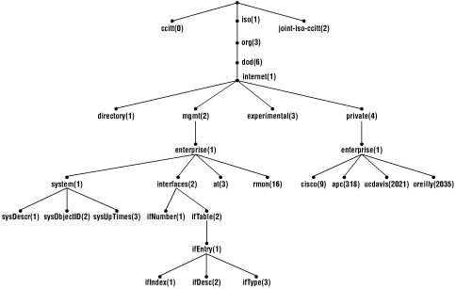
Introduction to MIB’s and OID’s
The OID numbers will form an OID tree.

Slide 8
Introduction to MIB’s and OID’s
Fore example, Cisco would fall under
iso.org.dod.internet.private.enterprises.Cisco
This translates to 1.3.6.1.4.1.9
Each of the Cisco Systems unique event, name, or data elements would build up this number.
The MIB translates the OID numbers to plan language.

Slide 9
Uploading MIB’s to Kaseya
The MIB associates each OID with a readable label and various other parameters related to the object.
The MIB then serves as a data dictionary or code book that is used to assemble and interpret SNMP messages.
For the Agent to collect data and report it you must locate and upload the device MIB or create one by doing an SNMP Walk.

Slide 10
Lesson Overview
Creating and Editing SNMP Monitor Sets.
Define collection operators.
Define collection and alarm thresholds.
Time out and re-alarm duration.

Slide 11
Lesson Overview
Prepare an agent for SNMP monitoring
Conduct a LAN Scan
Assign The Community Password.
Assign SNMP monitor set to the agent.
Set alarm actions.

Slide 12
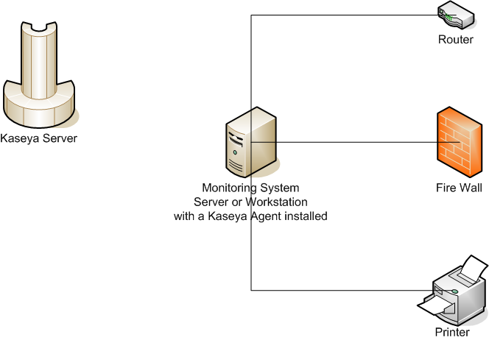
Monitoring SNMP
A system with a Kaseya Agent installed will query the SNMP enable devices and store the information defined in the SNMP Monitor Set locally.

Slide 13
Monitoring SNMP
The Monitoring system will then transmit the SNMP data to the Kaseya server to record in the Server Database.

Slide 14
Monitoring SNMP
If any of the Data elements are beyond the established alarm threshold set in the Monitor Set, the Kaseya server will alarm.

Slide 15
Lesson Overview
Reviewing SNMP Monitor Logs.
Creating SNMP Monitor set reports.

