Slide 1
A Feature-Based Analysis & Comparison of IT Automation Tools: Comparing Kaseya to LabTech Software
Developed By: Brennan Leblanc & Edward Guerra
Advisor : Dr. S. Masoud Sadjadi School of Computing and Information Sciences Florida International University
sadjadi@cs.fiu.edu
http://www.cs.fiu.edu/~sadjadi/
(305)348-1835

Slide 2
Agenda
Introduction
Comparison & Discussion
Glossary
Acknowledgements
References

Slide 3
Overview
LabTech provides a flexible and customizable all-in-one environment that has many tools and features to help System Administrators of any size organization boost productivity and save time
The cost of purchasing licensing must be done directly with a LabTech representative who will provide quotes which are based on the number of machines needing to be managed

Slide 4
Overview
A free 30 day trial of the full application is available upon completing registration on the LabTech website
The robust set of features offered by LabTech are very similar to those offered by Kaseya; although LabTech’s software utilizes a slightly different approach to providing its services
LabTech Managed Service Provider (MSP) software retains a high level of quality comparable to that of Kaseya

Slide 5
Background
LabTech is originally the creation of Greg Buerk and Jim Bell and is designed “with the goal of making IT support simpler.”
The first version was released in July 2007 aimed at supporting small business; however, its significance as a substantial support tool for any size organization was quickly realized
LabTech’s mission “is to become the standard tool used by IT professionals internationally.”

Slide 6
Background
LabTech 2.5 is the most current release of the software
Based on a central management interface
Provides forum with a shared knowledge base of LabTech support and System Administrators from all the world over who help to contribute and constantly improve the quality of the product and help others find solutions

Slide 7
OS Coverage
Windows 2000
Windows XP
Windows Server 2003 (32-bit only)
Windows XP64
Windows Vista

Slide 8
Grouping Managed Devices
LabTech utilizes the LabTech Control Center to provide an overall snapshot of any type of managed device
Assets are organized under their assigned Locations
Locations are tied to a specified router with it’s own settings
These settings can be linked to specific administrative passwords and remote backup setups
Managed devices can be added to groups that allow view filtering based on several options

Slide 9
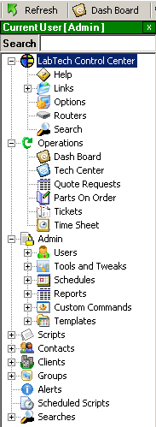
Functional Coverage
Remote Desktop and Server Control
Background Troubleshooting
Network Sniffing
Network Monitoring and Alerting
Advanced Scripting
Patch Management
Software Deployment

Slide 10
Functional Coverage Con’t
Backup and Recovery Management
Inventory, Asset, and Information Management
Advance Searching
License Management
Contact Information
Ticketing, Scheduling, and Dispatching
Time Keeping and Management

Slide 11
Functional Coverage Con’t
Technician Tracking and Management
Advanced Security and Rights Management
(LabTechSoft.com)

Slide 12
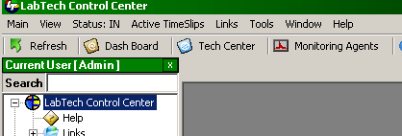
1.1 Architecture
LabTech has an agent-based architecture similar to that from Kaseya
LabTech’s Control Center must be installed on a machine to begin. The machine is then set as “Master” and LabTech client can then be pushed to other machines on the network. The “Network Probe” feature must be selected to detect other machines

Slide 13
1.1 Architecture
Image courtesy of LabTechSoft.com

Slide 14
1.2 Auditing & Asset management
Information concerning hardware and software configuration cab be obtained under the Auditing tab in the System Dashboard
A long listing of audit actions are available such as: emails that failed to send, remote commands, service logs, alerts, tickets, login, logout, and modifications to most of these actions just to name a few

Slide 15
1.3 Remote Control
LabTech includes LabVNC as a Remote Control solution
LabTech can be setup to use any other Remote Control application as well by using redirectors
The LabVNC interface has several features that you can use such as the Command Prompt, MSTSC, Telnet, SSH
Kaseya offers similar features, however, does not allow the use of any other Remote Control application

Slide 16
1.4 Automation
LabTech supports automation by the use of predefined scripts.
LabTech offers the ability to schedule scripts as agent procedure
In this area, Kaseya offers a friendlier user graphical interface

Slide 17
1.5 Monitoring
LabTech includes several built in monitoring tools
Monitoring is managed through the navigation menu under the managed machine
The monitor setup wizard allows you to monitor event logs, system information, performance counters, services and processes, files or directories, WMI query, and the results of an executable
Kaseya can monitor machines that don’t have agents installed and offer better group monitoring setups

Slide 18
1.6 Patch Management
LabTech also offers patch management, under its Hotfix Template Settings menu
Hotfix settings can be configured using a template setup as in Kaseya
Patches can be deployed on a specified day and time to needed computers
LabTech downloads its updates directly from Microsoft

Slide 19
1.7 Backup & Disaster Recovery
LabTech offers a remote backup feature under its Computer Management
ShadowProtect can be installed on client machines to allow for full monitoring, scheduling, and control of remote backups
The Remote Backup feature allows you to backup data of selected file types to any specified directory

Slide 20
1.8 Endpoint Security
LabTech does not include the level of security that Kaseya does
Security is accomplished through packet encryption and compression before transmission with the option of using SSL for added VNC security
LabTech contains SpyBot scripts and McAfee cleaning tools; however, these are in response to attacks and not as preemptive as Kaseya's’ KES model

Slide 21
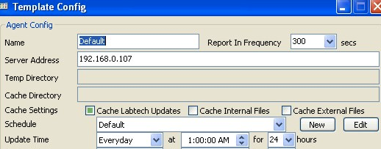
1.9 User State Management
LabTech allows administrators to create default group policies, group templates, and most importantly auto join scripts
Using group templates and auto join scripts there is no limit to the level of customization and state management
LabTech is on the same level with Kaseya however, Kaseya requires the KDPM feature to be bought an as add on.

Slide 22
1.10 Help Desk
LabTech features a Help Desk Ticketing System which is driven by an email based support ticketing system
Software is geared towards preemptive maintenance
Clients have the option of sending requests for support through emails with up to six priority levels.

Slide 23
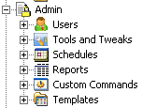
1.11 Reporting
LabTech has integrated Information and Reporting
LabTech uses a combination of data stored MySQL tables with the Crystal Reports software to provide detailed information on any and all system data
Customizable reports are easily created and stored in the LTShare or directly from the web

Slide 24
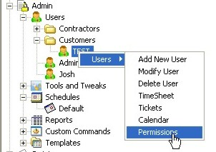
1.12 System/User/Admin Management
LabTech allows for the creation of different roles from Administrators, Technicians, and Clients or any other user policy desired
New users and roles can be created simply with a right click and then customized from the same window

Slide 25
1.13 Usability
Overall LabTech is:
Both Control Center and Web based
Extremely user friendly and familiar
Quick and easy to learn especially with tons of tutorials and online help
Intelligently designed with features integrated into the Control Center as is the same with Kaseya

Slide 26
1.14 Reliability
LabTech runs reliably as far as testing was concerned
Requires very little network bandwidth or processor power
Backups are thorough
Disaster Recovery tools could be better
Antivirus is left to System Administrator discretion instead of forcing use of any particular system

Slide 27
1.15 Performance
Overall performance of LabTech was impressive
System installed quickly
System was ready to go as soon as agents installed
No wait time between commands
Smooth functioning of features

Slide 28
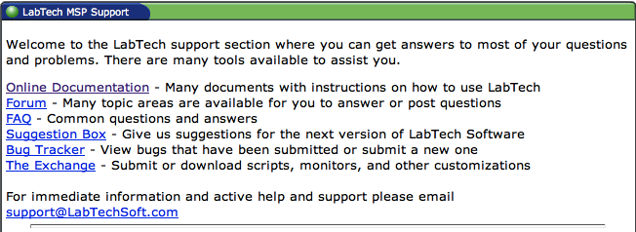
1.16 Supportability
LabTech response time
Immediate support available from support@LabTechSoft.com
Help from FAQ section
Help in Forums
Plenty of online documentation

Slide 29
Agenda
Introduction
Comparison & Discussion
Glossary
Acknowledgements
References

Slide 30
2. Comparison and Discussion
LabTech and Kaseya based on similar ideas
Streamlined into a single platform
Different presentation/layout style
Security

Slide 31
2.1 Evaluating and Discussing
1 | Architecture Rating: 5 | The LabTech Control Center is agent based and has every feature available in a user friendly and highly familiar Windows menu style format.
2 | Audit & Asset Mgt Rating: 4 | LabTech's ability to quickly and constantly gather data on a connected system and the systems installed components allows for reliable auditing and asset management.
3 | Remote Control Rating: 5 | The LabTech Control Center provides every tool on screen without interfering with the hosts computer allowing seamless fixes with minimal obstruction to the users environment.
4 | Automation Rating: 5 | The ability to add custom written scripts or use premade scripts within LabTech and schedule tasks to occur on a repeating basis make automation a breeze.
5 | Monitoring Rating: 5 | Monitoring in LabTech is very easy. The moment a connection is established with a server or workstation the console instantly begins reporting and refreshing at specified intervals.
6 | Patch Mgt Rating: 5 | Patches come directly from Microsoft or can be hosted in a local folder which works exactly like Kaseya.
7 | Backup & Disaster Recovery Rating: 4 | Backing up files is possible via ShadowProtect and it gets the job done although Kaseya seems to have more detailed information in terms of visual displays to indicate progress.
8 | Endpoint Security Rating: 1 | LabTech leaves endpoint security up to the System Administrator. The only options it provides are to scan for spyware and viruses in a reactive manner rather than protect against them in the first place
9 | User State Mgt Rating: 5 | User state management is easily accomplished like most things with just a right click and addition of a new user and permissions can be instantly set for that role.
10 | Help Desk Rating: 5 | Help Desk is very easy requiring users to simply send in an email request for help which creates a ticket for a technician to respond to.
11 | Reporting Rating: 5 | LabTech has outstanding reporting features which allow custom reports to be sent with generic or very specific information once, or on reoccurring basis.
12 | System Rating: 5 | The System itself is very easy to use especially after having used Kaseya. There is nothing to dig through in order to accomplish a task. Everything is right in front of you at all times so finding features is simple.
13 | Usability Rating: 5 | The LabTech Control Center is very easy to use. Its all in one design with tabs for every feature are very useful. The visual design of the console mimics windows form themes which is familiar.
14 | Reliability Rating: 3 | It would not be fair to access the Reliability because given the circumstances there were no strains on the server or chance for anything to possibly go wrong.
15 | Performance Rating: 4 | Performance seemed great with our setup, however, there is room to question what could happen as more machines are added and more users access the network bandwidth.
16 | Supportability Rating: 5 | LabTech does a great job providing live web seminars, forums, and constant support making it very supportable.

Slide 32
2.2 Rating Results Explanation/Discussion
 |  | Kaseya | Your Assigned Solution
1 | Architecture | 4 | 5
2 | Audit & Asset Mgt | 3 | 4
3 | Remote Control | 4 | 5
4 | Automation | 5 | 5
5 | Monitoring | 3 | 5
6 | Patch Mgt | 5 | 5
7 | Backup & Disaster Recovery | 5 | 4
8 | Endpoint Security | 4 | 1
9 | User State Mgt | 4 | 5
10 | HelpDesk | 5 | 5
11 | Reporting | 4 | 5
12 | System | 4 | 5
13 | Usability | 4 | 5
14 | Reliability | 2 | 3
15 | Performance | 2 | 4
16 | Supportability | 5 | 5
 | Total | 63 | 71

Slide 33
3. Glossary
MSP - Managed Service Provider

Slide 34
4. Acknowledgements
Mike Inzerillo – Providing Demo CD Key
Regional Sales Manager, Labtech Software LLCOffice: 877-LabTec-3 Ext.222

Slide 35
5. References
www.LabTechSoft.com
www.LabTechSoft.com/wiki
www.Kaseya.com

