Slide 1
A Feature-Based Analysis & Comparison of IT Automation Tools:
Comparing Kaseya to LogMeIn
Developed By: Christine Marie Rodriguez & Richard Calvo
Advisor : Dr. S. Masoud Sadjadi
School of Computing and Information Sciences
Florida International University
sadjadi@cs.fiu.edu
http://www.cs.fiu.edu/~sadjadi/
(305)348-1835

Slide 2
Agenda
Introduction
Comparison & Discussion
Acknowledgements
References

Slide 3





Overview
LogMeIn services: consumers, mobile workers, businesses, and IT service providers
LogMeIn components:
  LogMeIn Central
  LogMeIn Rescue
  LogMeIn Free
  LogMeIn Pro
  LogMeIn Backup

Slide 4
Background
Technology developed by 3am Labs in Budapest, Hungary in 2003
In 2006, 3am Labs changed its name to LogMeIn
LogMeIn world headquarters is located in Boston, Massachusetts
LogMeIn also has headquarters in Amsterdam, the Netherlands, and Sydney, Australia as well as development centers in Budapest and Hungary
LogMeIn customers include:
  large corporations
  small to medium sized businesses
  internal and outsourced IT service providers
  mobile professionals
  individual PC users and technicians
LogMeIn is partners with Intel
Company Highlight:
  LogMeIn Pro now supports Macs!

Slide 5
OS Coverage
The operating systems that are supported for LogMeIn Free and Pro2:
  Windows 7 (32-bit or 64-bit)
  Server 2008 (32-bit or 64-bit)
  Vista (32-bit or 64-bit)
  XP (32-bit or 64-bit)
  Server 2003 (32-bit or 64-bit)
  Windows 2000 or Server 2000 (32-bit)
  Mac OS X 10.4.6 or later
The operating systems that are supported for LogMeIn Backup:
  Windows 2000/Server 2000 (VSS not supported)
  XP 32 and 64 bit
  Server 2003 32 and 64 bit
  Vista 32 and 64 bit
  Please Note: On Windows 2000/Server 2000, Backup can’t backup open files because of limitations of the operating systems

Slide 6
OS Coverage (conti..)
LogMeIn Central does not require any operating systems; however, these are its supported browsers:
  Internet Explorer 7 or above
  Firefox 3.0 or above
  Chrome 2.0 or above
  Safari 4.0 or above
  Please Note: Java must be enabled for LogMeIn Central to run
The system requirements that are needed in order for LogMeIn Rescue to run:
  Windows 7, Vista, XP, Server 2003, Server 2008 (all including 64-bit); Windows 2000/Server 2000
  Compatible browser:
    Internet Explorer 5.5 or later, with support for 128-bit or 256-bit encryption
    Mozilla-based browsers that are compatible include Firefox 1.5 or later, and Mozilla 1.7 or late
    Broadband connectivity to the Internet
    Up to 20MB of memory + 20MB per RC session
    Up to 30MB of storage space + 20MB for all virtualization and mobile skins

Slide 7
Grouping Managed Devices
LogMeIn Central allows an administrator to manage all of the computers under an account by allowing central management of all added computers.
Using LogMeIn Central the administrator can create alert packages, reports, and groups.
Agents can be distributed for download via “deployment links”
LogMeIn Central also allows for creating a “Host Preference” package which set the settings for the agents that will be deployed
The grouping tab does not include a “filter” view function like in Kaseya, however, it does have a handy search box which searches in real time (as letters are typed) for computers added to any groups

Slide 8
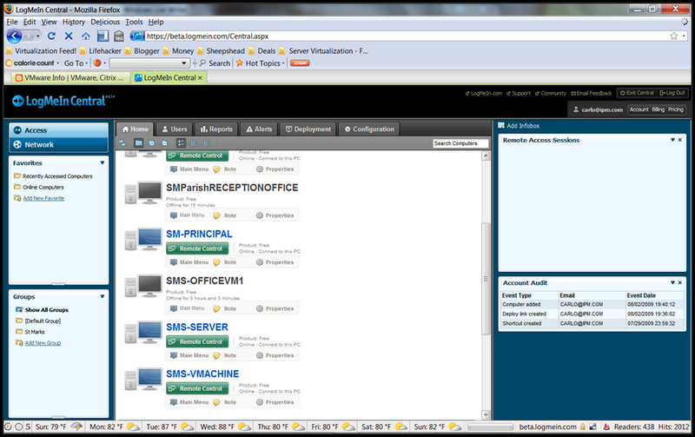
Grouping Managed Devices (conti..)

Slide 9
Functional Coverage
LogMeIn covers the following functionalities:
  Agent and agent-less architecture
  Auditing and Asset Management
  Remote Control
  Monitoring
  Backup and Disaster Recovery
  User State Management
  Help Desk
  Reporting
  System
Unlike Kaseya, LogMeIn does not have built-in:
  Patch Management
  Endpoint Security

Slide 10
1.1 Architecture
LogMeIn does not integrate its different modules together as well as Kaseya
LogMeIn’s components must be bought separately whereas Kaseya’s modules come together in one package
Some components require an agent whereas others are agent-less
  LogMeIn Central is agent-less
  LogMeIn Backup, Pro, Free require an agent
Agents can be installed in two ways:
  Directly from LogMeIn.com
  Through an assisted install using “Deploy Link Generator” provided by LogMeIn Central

Slide 11
1.2 Auditing & Asset Management
Is accomplished through:
  LogMeIn Central
  LogMeIn Pro
LogMeIn Pro provides auditing on:
  CPU Load
  Memory Load
  Disk Space
  Drive and Partition Info
  Open TCP/IP Ports
  Network Load
  Open Files
  Registry Keys in Use
  DLLs in Use
  LMI Connections
  Installed Applications
  Loaded Device Drivers
Data audited through LogMeIn Pro is available immediately and a report does not have to be built

Slide 12
1.2 Auditing & Asset Management (conti..)
LogMeIn Central provides a higher level of auditing
LogMeIn Central provides auditing on:
  Hardware Inventory
    CPU, hardware history, installed memory, motherboard, network interfaces, service tag, storage hardware, top disk usage
  Host Software Details
    Deploy Links, Host Software Installs, Journal Entries, Last Boot Date
  Software Inventory
    Installed Applications, Installed Operating System Snapshot, Software History, System History
Data audited through LogMeIn Central is generated through a report, which can then be turned into a graphical chart

Slide 13
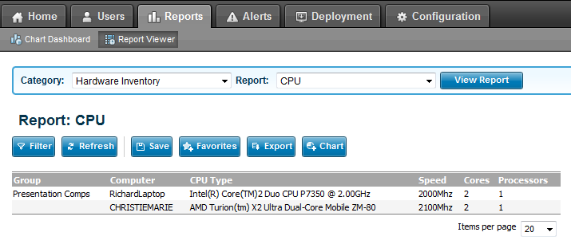
1.2 Auditing & Asset Management (conti..)

Slide 14
1.3 Remote Control
Remote Control Sessions can be opened through LogMeIn Pro and LogMeIn Central using the Dashboard
In a remote session, a user can control:
  Volume
  Screen Settings
  Connection Settings
  Printer Settings
Available tools include:
  Laser pointer
  Chat
  Pen tool
Desktop Sharing, File Management, and Remote Printing is possible
User permission setting can be configured for remote control sessions

Slide 15
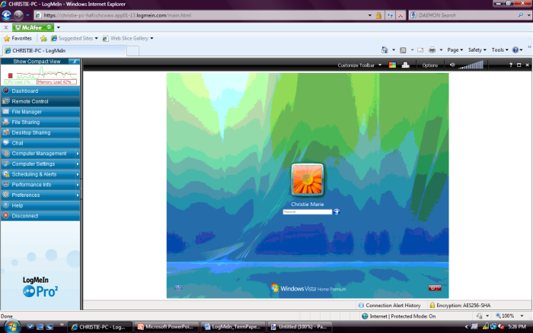
1.3 Remote Control (conti..)

Slide 16
1.4 Automation
LogMeIn Pro provides some level of automation through its Task Scheduler, which allows a user to create basic scripts
Once a new task (script) has been created, it can be scheduled to run on a reoccurring basis or just one time
However, unlike Kaseya, LogMeIn does not have a built-in agent procedures that allow a user to create several steps in a script as well as IF-ELSE-THEN statements

Slide 17
1.5 Monitoring
Accomplished through LogMeIn Central
Automated alerts can be created to notify administrators of any updates/changes via email
Alert Packages can be created to include wanted alerts such as:
  CPU Utilization
  Used Memory
  Free Disk Space
  Folder/File Size
  Computer Online/Offline
  Service
  Event
  Hardware Inventory
  Software Inventory
  System Inventory
Each alert has parameters which specifies the level of the alert
Alert packages can be assigned to a group or an individual computer
Unlike Kaseya, LogMeIn does not provide Event Logs

Slide 18
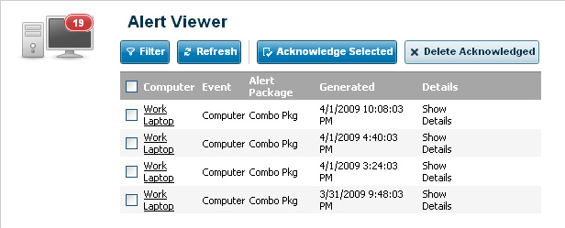
1.5 Monitoring (conti..)

Slide 19
1.6 Patch Management
LogMeIn does not offer built-in patch management
However, patch management can be implemented on LogMeIn through the use of scripts, which runs a patch management program of choice
WUInstall is a free patch management program that can be downloaded from the web
A script (setup through Task Scheduler) can be setup to run WUInstall on a computer or group of computers, which looks for missing patches and performs updates
The script can be set to run at login, logout, or on schedule

Slide 20
1.7 Backup & Disaster Recovery
LogMeIn Back has the ability to:
  Create new backup sets (by selecting folders/files)
  Set a schedule for when backup sets should run (automatically or manually)
  Has an integrity checker to verify files are not corrupted
  Has built-in encryption
  Has compression support
  Keep track of backup history
Data sets across the LogMeIn network can be restored straight into all computers or into chosen computers; this allows for remote disaster recovery
LogMeIn Backup can be installed on remote computers through a “Backup Link”

Slide 21
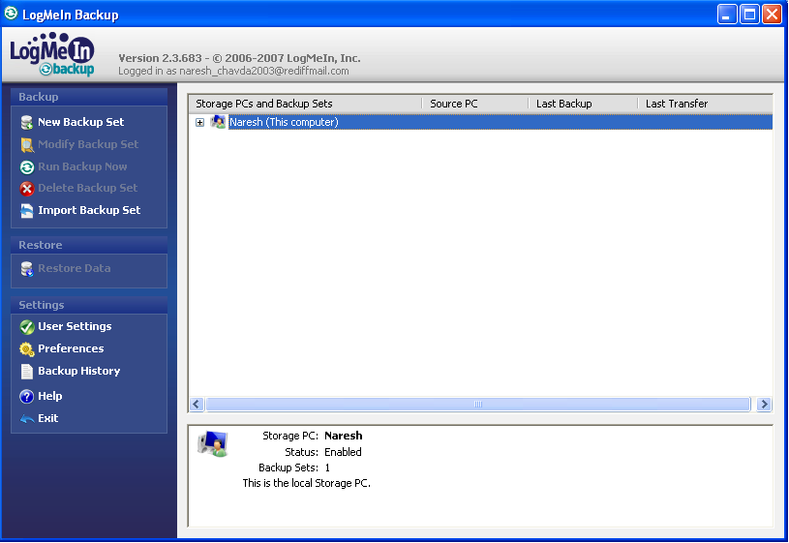
1.7 Backup & Disaster Recovery
(conti..)

Slide 22
1.8 Endpoint Security
LogMeIn does not provide built-in end point security
However, endpoint security can be implemented on LogMeIn through the use of scripts
Microsoft Security Essentials provided by Microsoft for free can be safely downloaded from the Microsoft website
Microsoft Security Essentials protects against spyware, viruses, and Trojans
Microsoft Security Essentials can be set to run automatically on a computer or a group of computers using a script, which an administrator sets up automatic definition updates to the security program as well as automatic scans and fixes

Slide 23
1.10 Help Desk
LogMeIn Rescue provides instantaneous helpdesk support
An administrator creates a support session which generates a virtual room
Clients can connect to the support session via a link or pin code that is sent to them via email, IM, or SMS
Once the client has connected, the technician has the ability to:
  Remote control
  File Management
  View System Info
  Reboot the remote computer
  Manage script
  Communicate with client via the built-in chat function
  Record the entire session
  Input notes for later reference
  Invite another technician for maximum support
Clients may also request support through the “Calling Card” option

Slide 24
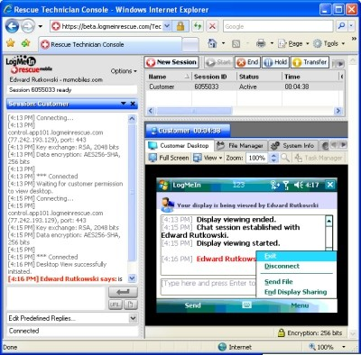
1.10 Help Desk (conti..)

Slide 25
1.11 Reporting
LogMeIn Central provides custom reports
All data is returned as text but can be easily converted to a graphical chart
Reports can be exported to XLS (excel) or TSV (tabbed delimited) files
Common Reports featured in the Report Viewer include:
  % free of disk space on all installed computers (lists all drives as well)
  the top 10 installed applications across all computers
  alerts in the past week
  installed operating systems on the computers
Reports can be filtered by:
  Groups
  Computer
  Discovered time
  Category
  Property
  Specific value
  Old value

Slide 26
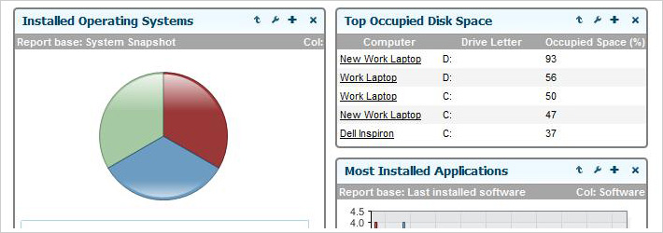
1.11 Reporting (conti..)

Slide 27
1.12 System/User/Admin Management
LogMeIn Central provides system options whereas Kaseya uses the System module
User settings, preferences, and permissions can be modified
User Info can be collected, such as:
  Total User Activity
  Most Active Users
  User Summary
  Account Audit (to view logon information)
  Account Activity and Usage (remote access sessions and user account access)
  User and Computer Access Rights (computer access permissions, local users, user permissions, and user profiles)
LogMeIn clients/organizations are named under a group, unlike Kaseya that gives a client/organization a name and then assigns various groups to that one client/organization
Once a group has been created, a Host Preference Package can be assigned to it, which manages group preferences

Slide 28
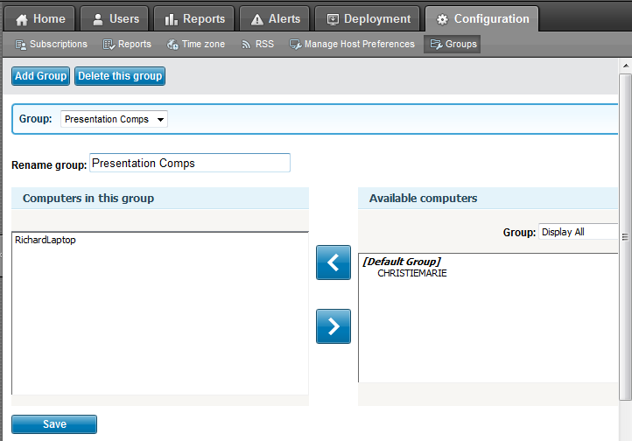
1.12 System/User/Admin Management
(conti..)

Slide 29
1.13 Usability
LogMeIn provides a very sleek user interface with a bug free (as far as we can tell) environment, complemented by a very easy to navigate menu system
All LogMeIn components are web-based, which provides users with easy access at any time
LogMeIn offers the option of installing a plug-in to easily run everything from the browser. It integrates a snippet at the top left of the web browser window with easy access to control buttons
Overall, it has been proven to be a very quick and easy-to-use interface

Slide 30
1.14 Reliability
LogMeIn is very stable and is always available to its customers
One customer review:
  “LogMeIn is a solid software program that’s user-friendly and secure. One of my favorite free programs I recommend to everyone I know”
LogMeIn provides detailed and straight forward instructions and wording on to how to navigate and use each component, unlike Kaseya, that uses words that are sometimes too technical to understand what a function means

Slide 31
1.15 Performance
The LogMeIn agents do not slow down the host system in any way
Running multiple LogMeIn agents at a time shows no decrease in performance or increase in CPU/memory usage
The software is compatible with almost all versions of windows, including Windows 7 x64 bits and the Macintosh operating systems

Slide 32
1.16 Supportability
LogMeIn provides support to each of its products by:
  including a knowledge base system (which allows you to search for answers to a question by providing useful articles)
  downloads to help with installation
  documents such as white papers and user guides
  technical support to answer questions not found on the LogMeIn website.
Receiving technical support can be accomplished in two ways:
  By filling out the easy online support form , which creates a ticket
  Calling the technical support number provided on the website (they require a 24 hour turnaround time)

Slide 33
Agenda
Introduction
Comparison & Discussion
Acknowledgements
References

Slide 34
2. Comparison and Discussion
LogMeIn strengths:
  solid remote control sessions
  provides a concrete monitoring solution allowing users to arrange many alerts
  help desk support is strong by allowing many technicians to take part of a session
  support of many operating systems
  has an integrated and easy to use backup and disaster recovery solution
LogMeIn weaknesses:
  future audits may not be scheduled
  does not have patch management
  does not have endpoint security
  does not focus on automation
  several components must be purchased separately in order to integrate LogMeIn

Slide 35
2.1 Evaluating and Discussing
Architecture Rating: 3 | LogMeIn modules should be available as one download like Kaseya. Instead, modules must be separately purchased an integrated. However, agents are deployed on a machine as easily as Kaseya. Ports do not need to be opened, which reduces the risk of being hacked.
Audit & Asset Mgt Rating: 4 | Auditing is simple and intuitive. Auditing is straightforward and very easy to generate. It also gives detailed information. However, it does not give you the option to block certain files, folders, or applications like in Kaseya. It also does not let you schedule future audits.
Remote Control Rating: 5 | The remote control interface is very simple to use. Once agent is installed, your computer is listed on a dashboard on your account’s main page. You can simply click on your computer and it will open up a menu, in which it gives you an option to remote control.
Automation Rating: 1 | LogMeIn does not focus on automation like Kaseya does. It does not provide any scheduling, which plays a large role in automation.
Monitoring Rating: 5 | LogMeIn Central provides an easy monitoring solution. Alerts can be set up by categories that contain subcategories. The phrasing of each alert is less technical than Kaseya, which makes it much easier to understand and set up.
Patch Mgt Rating: 1 | LogMeIn does not provide automatic patch management. A user may setup scripts or run the patch manually by using remote desktop login.
Backup & Disaster Recovery Rating: 5 | LogMeIn Backup provides a straightforward tool, which lets you perform incremental or full set backups locally or remotely. You can also restore the backup data remotely instead of having to physically be onsite.
Endpoint Security Rating: 1 | LogMeIn does not provide endpoint security. You must install your own antivirus solution.

Slide 36
2.1 Evaluating and Discussing (conti..)
User State Mgt Rating: 4 | LogMeIn provides access to a specified machine, registry, drivers, remote printers, and command prompt.
Help Desk Rating: 5 | LogMeIn Rescue provides a simple help desk solution. Sessions can be shared between technicians to provide maximum support and tickets may be escalated to a higher tier support. Ongoing communication with the client is possible through the integrated chat function. Sessions may also be recorded for later reference.
Reporting Rating: 5 | LogMeIn Central provides collective and individual reporting on selected machines. It provides templates that you can use or modify which output graphical charts and/or raw data.
System Rating: 4 | User settings and information on users can easily be configured with LogMeIn Central. Organizations/clients are created into a group, in which computers can easily be assigned to.
Usability Rating: 5 | LogMeIn is extremely user friendly. It provides easy to navigate menus and submenus. Each LogMeIn component provides a user guide that explains each feature thoroughly.
Reliability Rating: 5 | Every component has functioned as expected. There have been no browser crashes while using LogMeIn and connection to the host server has always been successful.
Performance Rating: 5 | LogMeIn’s agent does not slow your computers performance even when multiple agents are running.
Supportability Rating: 5 | LogMeIn provides its customers with strong support via telephone, email, support ticketing, and a knowledge base.

Slide 37
2.2 Rating Results Explanation/Discussion
 |  | Kaseya | LogMeIn
1 | Architecture | 5 | 3
2 | Audit & Asset Mgt | 5 | 4
3 | Remote Control | 5 | 5
4 | Automation | 5 | 1
5 | Monitoring | 4 | 5
6 | Patch Mgt | 5 | 1
7 | Backup & Disaster Recovery | 4 | 5
8 | Endpoint Security | 5 | 1
9 | User State Mgt | 5 | 4
10 | Help Desk | 5 | 5
11 | Reporting | 5 | 5
12 | System | 5 | 4
13 | Usability | 5 | 4
14 | Reliability | 5 | 5
15 | Performance | 5 | 5
16 | Supportability | 5 | 5
 | Total | 83 | 62

Slide 38
2.2 Rating Results Explanation/Discussion (conti..)
As the previous slide’s rating system table illustrates, Kaseya has been rated higher than LogMeIn. This does not mean that LogMeIn is not a good IT automation software; Kaseya just proves to be better. Richard and I were able to come up with this rating by using both Kaseya and LogMeIn to each of its fullest potential and then comparing both. Kaseya has a developed a better way to integrate all of its components together whereas LogMeIn is on the right track but not quite there yet. This is because LogMeIn customers must purchase the different components separately in order to use all of LogMeIn’s features. Unlike Kaseya, LogMeIn does not have built-in patch management or end point security. Kaseya also has a strong module that implements agent procedures, whereas LogMeIn only provides a simple use of scripts. Although Kaseya has proven to be a stronger solution, LogMeIn provides its customers with a great service as well.

Slide 39
4. Acknowledgements
1. www.logmein.com (which includes the use of all its components)
2. www.kaseya.com (which includes the use of all its modules)

Slide 40
5. References
[1] "The LogMeIn and Intel® Partnership". LogMeIn. April 5, 2010 <https://secure.logmein.com/US/about/intel_partnership.aspx>
[2] Tab_Tab, "LogMeIn Reviews". CNet. April 5, 2010 <http://reviews.cnet.com/e-mail/logmein/4852-3536_7-31394067.html?tag=mncolBtm;rnav>

