Slide 1
A Feature-Based Analysis & Comparison of IT Automation Tools: Comparing Kaseya to ManageEngine’s Msp Center Plus
Developed By: <Christopher Fine> & <Charles Martinez>
Advisor : Dr. S. Masoud Sadjadi School of Computing and Information Sciences Florida International University
sadjadi@cs.fiu.edu
http://www.cs.fiu.edu/~sadjadi/
(305)348-1835

Slide 2
Agenda
Introduction
Comparison & Discussion
Glossary
Acknowledgements
References

Slide 3
Overview
ManageEngine offers MSP Center Plus to automate regular daily tasks such as….
Device Monitoring
Patch Management
Desktop Management
Reporting
Remote Control
Auditing

Slide 4
Background
ZOHO Corp. is the parent company of ManageEngine, ManageEngine is the IT software division of ZOHO Corp. The corporation did not come about until around 1996 by creating SNMP API’s and network management platforms. Then in early 2000’s ZOHO Corp. branched out into the IT management business by creating ManageEngine. ManageEngine currently supports over 40,000 clients around the world they also provide over 20 products to oversee many crucial areas of IT management.

Slide 5
OS Coverage
MSP Center Plus
Server
Windows Server 2003 Standard Edition/Enterprise Edition
Windows Server 2008
Probe Server
Windows Server 2003 Standard Edition/Enterprise Edition
Windows Server 2008
Windows XP Professional
Windows Vista

Slide 6
Grouping Managed Devices
Before grouping devices first you have to discover them. Once discovered MSP Center Plus groups them into network devices (servers, switches etc..) you can also create your own device type. You’re able to monitor routers, firewalls, printers, desktops, URL’s, UPS, Wireless, and Domain Controllers.
These devices can be grouped based on customer, category, and locality.

Slide 7
Functional Coverage
Agent and probe architecture, auditing, asset management, monitoring, patch management, remote control, help desk, and reporting.
Is not able to back up end systems.
Can be integrated with other ManageEngine products such as NewFlow Analyzer.

Slide 8
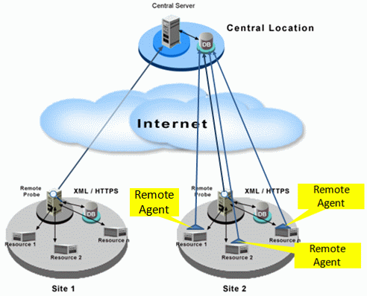
1.1 Architecture
Both Msp Center Plus and kaseya use an agent based architecture.
Agents- software installed in each and every end system.

Slide 9
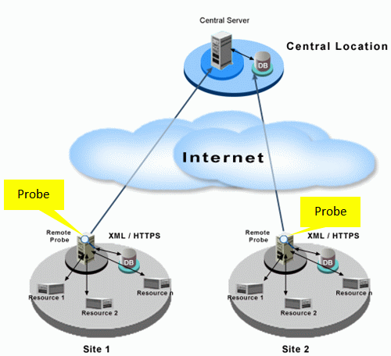
1.1 Architecture
Msp Center Plus also has a probe based architecture.
Probe- software installed in a single machine to monitor all the other machines.

Slide 10
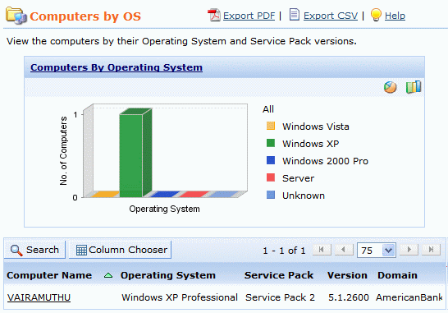
1.2 Auditing & Asset management
With MSP center plus you can monitor how many different kinds of operating systems you have and now many machines are in each type.

Slide 11
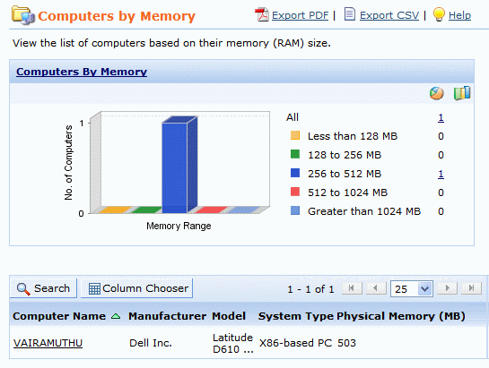
1.2 Auditing & Asset management (Cont.)
You can monitor how much ram there is on each machine.

Slide 12
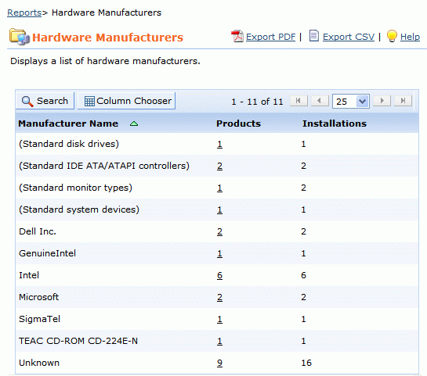
1.2 Auditing & Asset management (Cont.)
Different Hardware vendors

Slide 13
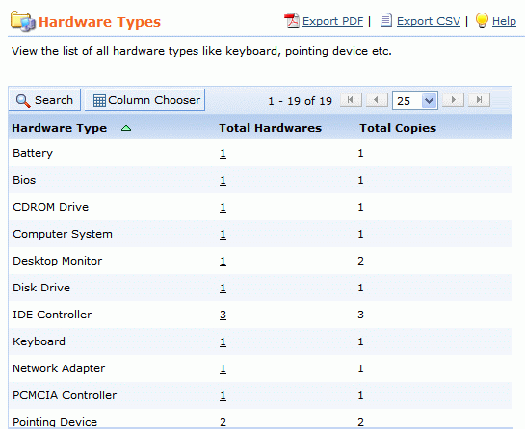
1.2 Auditing & Asset management (Cont.)
Different hardware types.

Slide 14
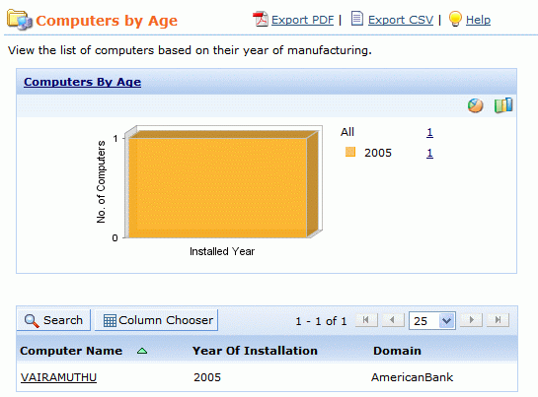
1.2 Auditing & Asset management (Cont.)
Even see a report to see how old the computers are.

Slide 15
1.3 Remote Control
Remote control feature is web-based.
Allows sending of CTRL + ALT + DEL & ALT + TAB commands.
Gives the user the ability to black out a users screen.
Window will pop up to ask end user for permission to ensure privacy.

Slide 16
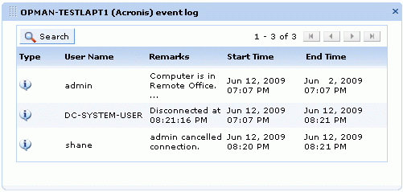
1.3 Remote Control (Cont.)
Record is automatically kept of who initiated, when the remote connection was established, and how long the session lasted .

Slide 17
1.4 Automation
Provides a use of scripting
Scripts can be written in either Visual Basic, Jscript, Perl or Python.
Scripts are executed during certain events:
Log on
Log off
Start up
Shut down

Slide 18
1.5 Monitoring
MSP center plus has default monitoring templates
Templates can monitor machines within specified intervals.
Allows alarms to go off if a device goes down or has reached a certain threshold
Set SNMP traps
Use Windows event logs

Slide 19
1.6 Patch Management
Manually install each patch or automate the process.
Display which patches are missing, installed, and total patches.
Patches originate from Microsoft.
Schedule patch scans.

Slide 20
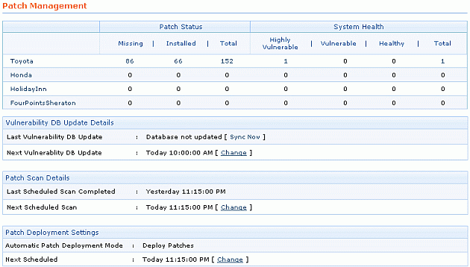
1.6 Patch Management (Cont.)

Slide 21
1.7 Backup & Disaster Recovery
MSP Center Plus currently does not have a back up and disaster recovery function.
Can back up Msp Center Plus itself (not machines).

Slide 22
1.8 Endpoint Security
Event logs can be configured to trigger an alarm.
Security policies can allow or restrict access on a desktop.
Firewalls can be configured to open and close ports as needed.

Slide 23
1.9 Reporting
Can be made into PDF, XLS, or CSV format.
Predefined report categories include:
Account reports
Reports by all requests
Reports by completed requests
Reports by overdue requests
Reports by pending requests
Summary reports
Survey reports
Time spent reports

Slide 24
1.9 Reporting (Cont.)
Customized reports can be generated.
Query reports can be generated to collect data from the database.
Scheduling a report to run a particular time is also possible.

Slide 25
1.10 System/User/Admin Management
Allows you to specify the following settings for admin:
Global
Patch
Inventory
Repository
Tools

Slide 26
1.10 System/User/Admin Management (Cont.)
Allows you to specify the following settings for users:
Roles
Contact additional fields
Support rep additional fields
Support rep
Account additional field

Slide 27
1.11 Usability/Performance
May be necessary to use more than one ManageEngine product.
Can be integrated with other ManageEngine products.
Web-based
After installation a guide is displayed informing the user of each step necessary to make the product work.
Most steps have a link which when clicked will give more in depth information on how to complete the particular step.

Slide 28
1.11 Usability/Performance (Cont.)
System is responsive.
The system performs at an acceptable rate.

Slide 29
1.12 Reliability
Did not experience the system going offline.
Users in the forum did not indicate any sizeable problem with the system going down.

Slide 30
1.13 Supportability
A help desk feature is included in this product.
Support was provided by the ManageEngine support team.
Support was given through email within 24 hours.
Live demos are available through the site.

Slide 31
Agenda
Introduction
Comparison & Discussion
Glossary
Acknowledgements
References

Slide 32
2. Comparison and Discussion
Kaseya is a more powerful and comprehensive tool.
ManageEngine does not have as many features as Kaseya all in one product (Ex: back up of a machine).
Kaseya is easier to get up and running.
We give Msp Center Plus a rating of 3 out of 5.

Slide 33
2.1 Evaluating and Discussing
1 | Architecture Rating: 3 | Msp Center Plus uses probes and agents while Kaseya uses only agents. Kaseya as a result is simpler.
2 | Audit & Asset Mgt Rating: 4 | Both products are close in capability. Kaseya is slightly more robust in this area.
3 | Remote Control Rating: 3 | Kaseya is better in this area because of it’s many features and has less restrictions .
4 | Automation Rating: 5 | Both products allow scripting.
5 | Monitoring Rating: 5 | Both products are even. Both give you the ability to set thresholds, set alarms, etc.
6 | Patch Mgt Rating: 5 | Msp Center Plus is more user friendly.
7 | Backup & Disaster Recovery Rating: 1 | Kaseya is better because it’s function backs up machines while Msp Center Plus backs itself (Msp Center Plus configuration).
8 | Endpoint Security Rating: 3 | Kaseya is more powerful because it includes AVG to scan for viruses.
9 | Reporting Rating: 5 | Msp Center Plus has one additional feature which is query reporting.
10 | System/User/Admin Management Rating: 4 | Both products are even.
11 | Usability/Performance Rating: 3 | ManageEngine is comprised of many products. No one products contains all the functions of Kaseya. Both products perform efficiently.
12 | Reliability Rating: 4 | Both products are reliable.
13 | Supportability Rating: 5 | Msp Center Plus offers forums, live demos, responds quickly. Is overall excellent in this regard.

Slide 34
2.2 Rating Results Explanation/Discussion
 |  | Kaseya | ManageEngine
1 | Architecture | 5 | 3
2 | Audit & Asset Mgt | 5 | 4
3 | Remote Control | 4 | 3
4 | Automation | 5 | 5
5 | Monitoring | 5 | 5
6 | Patch Mgt | 4 | 5
7 | Backup & Disaster Recovery | 5 | 1
8 | Endpoint Security | 4 | 3
9 | Reporting | 3 | 5
10 | System/Users/Admin Mgmnt | 4 | 4
11 | Usability/Performance | 5 | 3
12 | Reliability | 4 | 4
13 | Supportability | 5 | 5
 | Total | 58 | 50

Slide 35
3. Glossary
MSP - Managed Service Provider. Allows remote managing of computers.
SNMP – Simple management protocol. “A UDP-based network protocol”. Is used most commonly for network management systems for the purpose of monitoring devices connected to a network for situations in which an administrator attention might be required.

Slide 36
3. Glossary (Cont.)
API – Application protocol interface. Enables interaction to take place with a different software.
Command Line Interface (CLI) - Allows you to enter commands through a command prompt to use the computer.

Slide 37
3. Glossary (Cont.)
Unreliable Datagram Protocol (UDP) – Transfer protocol which allows packets to be dropped.
Transmission Control Protocol (TCP) – Transfer protocol which determines which packets have been dropped and makes sure they are retransmitted. Tcp is a reliable transfer protocol.

Slide 38
4. Acknowledgements
We would like to thank Zoho Corp. for providing free use of their product to us.
We would also like to thank the following people for assisting us with our report:
Rob Marshall : Zoho Corp, (925) – 965 – 6921
ManageEngine support team, support@mspcenterplus.com
Masoud Sadjadi: Florida International University, 305-348-1835

Slide 39
5. References
"Simple Network Management Protocol." Web. <http://en.wikipedia.org/wiki/Simple_Network_Management_Protocol>.
"Windows Management Instrumentation." 2010. Web. <http://msdn.microsoft.com/en-us/library/aa394582%28VS.85%29.aspx>.
"MSP Center Plus - Help Document." 2010. Web. <http://help.mspcenterplus.com/>.

Slide 40
5. References (Cont.)
"Command-line interface." 2010. Web. <http://en.wikipedia.org/wiki/Command-line_interface>.
Mitchell, Bradley. "UDP." About.com, 2010. Web. <http://compnetworking.about.com/od/networkprotocolsip/g/udp-user-datagram-protocol.htm>.
“TCP Protocol Overview” 2010. Web. <http://www.lincoln.edu/math/rmyrick/ComputerNetworks/InetReference/83.htm>.

