Slide 1
A Feature-Based Analysis & Comparison of IT Automation Tools: Comparing Kaseya to N-Central
Developed By: Manny Farinas & Carlos Sequeira
Advisor : Dr. S. Masoud Sadjadi School of Computing and Information Sciences Florida International University
sadjadi@cs.fiu.edu
http://www.cs.fiu.edu/~sadjadi/
(305)348-1835

Slide 2
Agenda
Introduction
Comparison & Discussion
Glossary
Acknowledgements
References

Slide 3
Overview
The product we are demonstrating is N-Central. N-Central is a remote monitoring and management platform for IT departments and management service providers. N-Central has a variety of products to choose from. For example, they offer a complete platform N-central that controls all services from one console. N-central can manage multiple networks and sites from a single interface. Also, monitor servers and desktop. Provide reports to help troubleshooting and protect all endpoints with enterprise class security. Automate tasks with the N-Central invented self healing. Supports to all Windows 7 devices. All N-Central products are reliable and for further help representatives friendly and eager to help if the situation would arrive. The user interface is very user friendly and easy to manage. Each of N-Central products come with a 30 day trial version so users can try the software free.

Slide 4
Background
N-Central was established in Ontario, Canada by President and CEO Gavin Garbutt. N-Central is a global leader in IT management services . With offices in Canada, North America, the U.K., the Netherlands and Australia N-Central is a leader in management platforms. N-Central has received many notable awards such as Everything channel 5-star Partner Program 2010 for the six years in a row for being one of North Americas leading IT vendors. N- able IT executive Mike Cullen for the fourth straight year has earned a top spot in CRN channel Chiefs list. Business Solutions Magazine Best Channel Vendor in 2010. In 2009 N-Central had its annual Partner Summit where they discuss the companies state and future endeavors. Also, in October 20-22, 2010 in Scottsdale, Arizona this years Partner Summit where they discuss how to bring costs down and increase revenue and strive for market leadership. N-Central competitors are companies such as Kaseya and any other company who offers IT management solutions. To contact N-Central they can be reached at their corporate headquarters in Ontario, Canada. Their Address is 450 March Road, 4th Floor Ontario, Canada K2K 3K2. Their telephone number is +1(613) 592-6676. By email they can be contacted info@nable.com

Slide 5
OS Coverage
N-Central covers all Windows platforms. Now with complete covers of all Windows 7 devices. N-Central covers all Apple devices including their OSX operating system. N-Central is completes covering all operating systems because it covers Linux systems such as SuSe Linux and Red Hat Linux.

Slide 6
Grouping Managed Devices
Through the use of N-Central, there are many options as to what is possible to control. N-Central makes it very convenient to manage large groups of devices and machines through the web based offering. N-Central is very user friendly and has the ability to control various types of devices such as severs, PCs, Laptops, netbooks, network enabled devices, printers, firewalls, even down to control BIOS settings on most desktops and laptops.

Slide 7
Functional Coverage
N-Central
Functional Coverage
Self-Healing
Endpoint Security
Architecture
Monitoring
Management
Remote Control
Patch Management
Script Execution/Software Distribution
Reporting
Third-Party Interoperability

Slide 8
1.1 Architecture
N-Central works through the use of Agents and Probes
Like Kaseya, N-Central uses Agents to distribute and to provide functionality but N-Central provides Probes which act as stations on machines on the network in order to sense every possible device on the network.
Much like Kaseya, they use the same structure in order to establish connections throughout the network but goes through additional features with Probes in order to find additional items

Slide 9
1.2 Auditing & Asset management
Like Kaseya, any Agent enabled device will begin running a basic and through Audit of the current specs through out the system.
N-Central has a audit system which is capable of examining devices and organizing them into a Windows like Explorer format for great sorting and organization.
Through Asset and the great organization capability of N-Central, N-Central can take information like CPU, RAM, HDD size, and programs/updates installed and sort them into a useful view.

Slide 10
1.3 Remote Control
N-Central has a more complete and elaborate establishment when compared to other tools.
N-Central has the basic features of any Remote Control protocols but offers advanced features such as very coveted support of other OS such as MAC OS and Linux
Compared to Kaseya, N-Central is a more powerful and well rounded product when it comes to remote control.

Slide 11
1.4 Automation
N-Central has a very good setup for Automation and Script Execution protocol
While N-Central does not offer compatibility with other Automation tools, N-Central has a wide range of compatible languages which it can read and execute
The strength, level of sophistication, and ease of use of N-Central is on par to other tools in the market such as Kaseya. While it does outshine others, it keep up with the pace and is a great tool.

Slide 12
1.5 Monitoring
N-Central has a monitoring solutions that has a wide range over various Oss and devices.
N-Central has a model similar to Kaseya in which it works on a Agent Enabled device, in which it will monitor the stats and specs of the device while keeping an eye open for any other device on the network.
Through the use of N-Central, N-Central can monitor even devices which aren’t the standard OS of windows such as MAC OSX and Linux

Slide 13
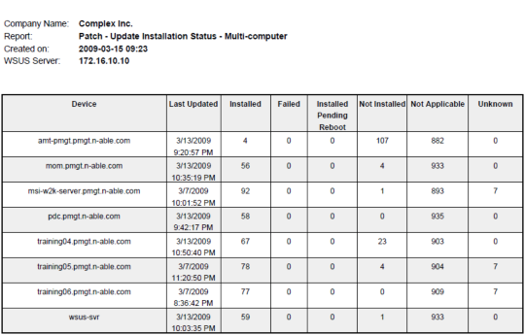
1.6 Patch Management

Slide 14
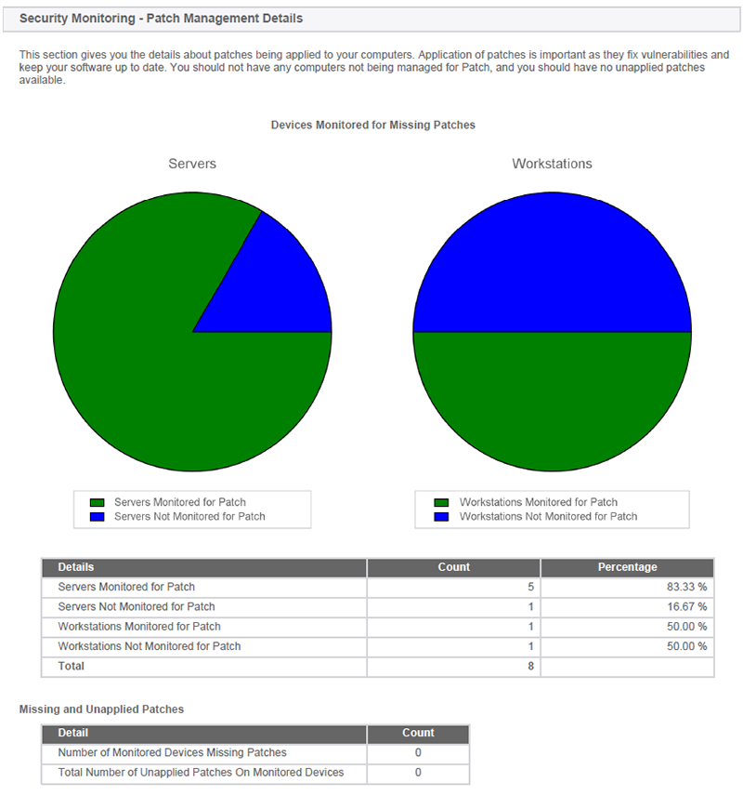
1.6.2 Patch Management

Slide 15
1.7 Backup & Disaster Recovery
N-Central has a unique solution to the Backup and Disaster Recovery
N-Central offers the standard options of common Backup and Disaster Recovery products such as schedule and automatic backup and image recovery functions, but also offers a advanced option called “Self-Healing”
Self-Healing works with the monitoring engine in N-Central and attempts to either detect or predict possible problems and failures before they occur.

Slide 16
1.8 Endpoint Security
Just as Kaseya, N-Central offers a high class of protection which attempts to prevents any kind of intrusion and attacks from any outside sources.
N-Central tries to implements a consumer friendly approach in which it tries to show a easy to understand template while remaining extremely powerful under the hood.
Powered by a separate engine, N-Central provides an Antivirus, AntiSpam, AntiMalware, and firewall protection.

Slide 17
1.9 User State Management
N-Central has a built in management tool called professional services automation. For example you can monitor every desktop, server, network device, manage networks, and create reports
User state management is accomplished in several ways using third party software such as Autotask, connectwise and tigerpaw these software connect to the database and retrieve information about current machine status
User state management has features such as project management, billing, and creating reports for customers.
All user state management services can be obtained and placed in a nice report to send to customers
User state management is better in N-Central because it gives you more options to choose from. You can choose from three software’s. Kaseya KDPM uses same Kaseya software and doesn’t give any options besides the Kaseya software

Slide 18
1.10 Help Desk
N-Central allows to monitor requests for Remote Desktop Support you can even remote control your customers computers without those computers being managed by N-central
Help Desk is accomplished using the Help Desk Link in the navigation column . You advise the customer to access the sign in page of N-central, click start, type their user name, get their access code with was given to them, click submit and tell them to install the software. Then you will see the customer computer in Help Desk column
All Help Desk information can be obtained and N-Central Help Desk is easy to use
N-Central has Help Desk but it does not have a ticketing service like Kaseya. Service Desk in Kaseya is used to generate a message when something goes wrong in N-Central there is a BES message status that sends a messages to your mobile phone when something goes wrong

Slide 19
1.11 Reporting
N-Central has the ability to use predefined executive reports that provide general information about all the customers machines.
N-Central can customize reports you can choose the devices you want in the report , details, and status of your machines. Also, you can email the report in a PDF format and can even create scheduled reports
The ease of use is very user friendly and level sophistication is great because you can send the report a quickly or you can schedule reports to go out at a pre determined time.
Both Kaseya and N-Central reporting are very user friendly. They both generate reports and have the email functionality

Slide 20
1.12 System/User/Admin Management
N-Central allows administrator to customize their environment to their specific needs. You use the Service Organization feature in N-Central, if you are the top administrator you control how much access you give to other administrator or customers.
Yes N-Central offers restriction to other Administrator it calls them Service Organization you have three levels of hierarchy from 1-3 with 1 being the highest
The Service Organization admin has the authority to restrict or allows users from using certain functionality and machines and devices
N-Central admin management is easy to use just go to setup ->user account s and fill in the information on how much access you want to give to other admins or customers
N-Central has a better admin utility than Kaseya because it is easy to use and you modify environments for others very quickly. This feature is simple but has great ability

Slide 21
1.13 Usability
Overall usability is great. The user interface is easy to use, the online help is great and N-Central representatives are always there to help. The dashboard is very well distributed and items are easy to find.
The interface is Web based you log into your account and manage the environment
User interface is very visual and easy to use
The learning curve is not too much you have to become familiar with N-Central or you can contact representatives or use the online help. N-Central offers live demos every week day at 1pm eastern time to demonstrate how to use the N-central
In N-Central everything is well distributed into one portal you can access customers account and other admins accounts from a single interface. Also, Kaseya portal is easy to use and has a everything integrated into one portal . Both products are easily managed and everything is integrated together

Slide 22
1.14 Reliability
N-Central reliability is great it’s rare to have lost connections or system going down. If such events occur the admin creates an alert to be notified to such errors and can quickly correct the problem
If the system goes down on rare occasions it goes down for a few minutes. Most of the time it restores itself. N-central can be managed from any computer you just login to your account and manage the machine
N-Central functionality is great everything you need you in an automation tool. The remote control is amazing , endpoint security is great and it’s Windows 7 compatible
All the functions in N-Central are easy to use, do great tasks, and can accomplish everything from backup and disaster recovery and great end point security

Slide 23
1.15 Performance
N-Central performance is great very reliable and has great system performance. N-central is web based with means easily accessed and configured easily.
The system performance is very fast it does not lag or slow down processes.
System is very responsive when tasks are performed the system responds great

Slide 24
1.16 Supportability
Also, N-central supports all major OS Windows, Mac and SUSE and Red Hat Linux.
N-central supports all types of SNMP devices

Slide 25
Agenda
Introduction
Comparison & Discussion
Glossary
Acknowledgements
References

Slide 26
2. Comparison and Discussion
Through out this project, we have been comparing N-Central to Kaseya and have reached a very extensive understanding of the offerings of both products and how they compare to each other. In the following slides we shall be discussing and evaluating the features and capabilities of both Automation tools.

Slide 27
2.1 Evaluating and Discussing
1 | Architecture Rating: 4 | Great setup which follows the standard Agent protocol but provides additional capabilities through the use of Probes
2 | Audit & Asset Mgt Rating: 4 | Standard interface which matches Kaseya’s set up and keeps the pace up.
3 | Remote Control Rating: 5 | More full fledged and expansive with support for other OSs and through options such as BIOS and remote boot up shows its superiority over other products
4 | Automation Rating: 5 | Standard setup with excellent Scripting understanding but does not work with other tools scripts
5 | Monitoring Rating: 4 | With the options of Other OSs, Monitoring for N-Central has a slight advantages over other market tools.
6 | Patch Mgt Rating: 4 | Standard implementation as with other tools on the market
7 | Backup & Disaster Recovery Rating: 5 | With it’s option of Self-Healing, N-Central has a step above over the competition .
8 | Endpoint Security Rating: 5 | With many options available from AntiVirus to firewall protection, N-Central is on par with other options on the market.
9 | User State Mgt Rating: 4 | Very diverse feature allows users to choose from three different software to access customer information and create a report on the machine status.
10 | HelpDesk Rating: 5 | Help Desk is very knowledgeable and very friendly. They have great positive attitudes
11 | Reporting Rating: 4 | Reporting is great you can use predefined reports or you can customize your own reports and email them.
12 | System Rating: 5 | The system can be configured to specific needs. This allows the top administrator to manage users and other admins with ease.
13 | Usability Rating: 5 | The N-Central usability is great very well distributed dashboard. Easy to configure accounts and manage
14 | Reliability Rating: 4 | N-Central is as reliable as automation tools come . Everything is managed from a central server and hardly ever has issues.
15 | Performance Rating: 4 | N-Central has great performance that is why it receives numerous awards year after year
16 | Supportability Rating: 4 | N-Central has great support features such as connecting remotely quickly to any users in need. Also, all major OS are supported.

Slide 28
2.2 Rating Results Explanation/Discussion
 |  | Kaseya | N-Central
1 | Architecture | 4 | 4
2 | Audit & Asset Mgt | 4 | 4
3 | Remote Control | 4 | 5
4 | Automation | 4 | 5
5 | Monitoring | 4 | 4
6 | Patch Mgt | 4 | 4
7 | Backup & Disaster Recovery | 3 | 5
8 | Endpoint Security | 3 | 5
9 | User State Mgt | 3 | 4
10 | HelpDesk | 3 | 5
11 | Reporting | 4 | 4
12 | System | 3 | 5
13 | Usability | 4 | 5
14 | Reliability | 3 | 4
15 | Performance | 4 | 4
16 | Supportability | 4 | 4
 | Total | 58 | 71

Slide 29
3. Glossary
MSP- MANAGEMENT SERVICE PROVIDERS
RMM – Remote Monitoring & Management
SMB – Small and Medium sized Business
UI – User Interface
Self-Healing – Tools used by N-Central for Back up and Disaster Recovery

Slide 30
4. Acknowledgements
Special thank to Erin Waterfall for help and dedication
Also Special Thanks to Lenny Simon for advice and guidance throughout the entire semester.

