Slide 1
COP 4610 — Chapter 2 Operating-System Structures
Dr. Jinpeng Wei

Slide 2
Outline
Operating-System Services
User Operating-System Interface
System Calls
Types of System Calls
System Programs
OS Design and Implementation
Operating-System Structure
Virtual Machines

Slide 3
Outline
Operating-System Services
User Operating-System Interface
System Calls
Types of System Calls
System Programs
OS Design and Implementation
Operating-System Structure
Virtual Machines

Slide 4
Operating System Services
User interface
Almost all OSes have a user interface (UI)
Command-Line (CLI), Graphics User Interface (GUI), Batch
Program execution
Must be able to load a program into memory and to run that program, end execution, either normally or abnormally (indicating error)
I/O operations
A running program may require I/O involving a file or an I/O device
File-system manipulation
Programs need to read and write files and directories, create and delete them, search them, list file Information, manage permissions

Slide 5
Operating System Services
Communications
Processes may exchange information, on the same computer or between computers over a network
Communications may be via shared memory or through message passing (packets moved by the OS)
Error detection
OS needs to be constantly aware of possible errors
May occur in the CPU and memory hardware, in I/O devices, in user program
For each type of error, OS should take the appropriate action to ensure correct and consistent computing
Debugging facilities can greatly enhance the user’s and programmer’s abilities to efficiently use the system

Slide 6
Operating System Services
Resource allocation
When multiple users or multiple jobs running concurrently, resources must be allocated to each of them
Many types of resources
Some (CPU cycles, main memory, and file storage) may have special allocation code, others (such as I/O devices) may have general request and release code
Accounting
To keep track of which users use how much and what kinds of computer resources
Protection and security
The owner of information may want to control use of that information; concurrent processes should not interfere with each other
Protection involves ensuring that all access to system resources is controlled
Security of the system from outsiders requires user authentication, extends to defending external I/O devices from invalid access attempts

Slide 7
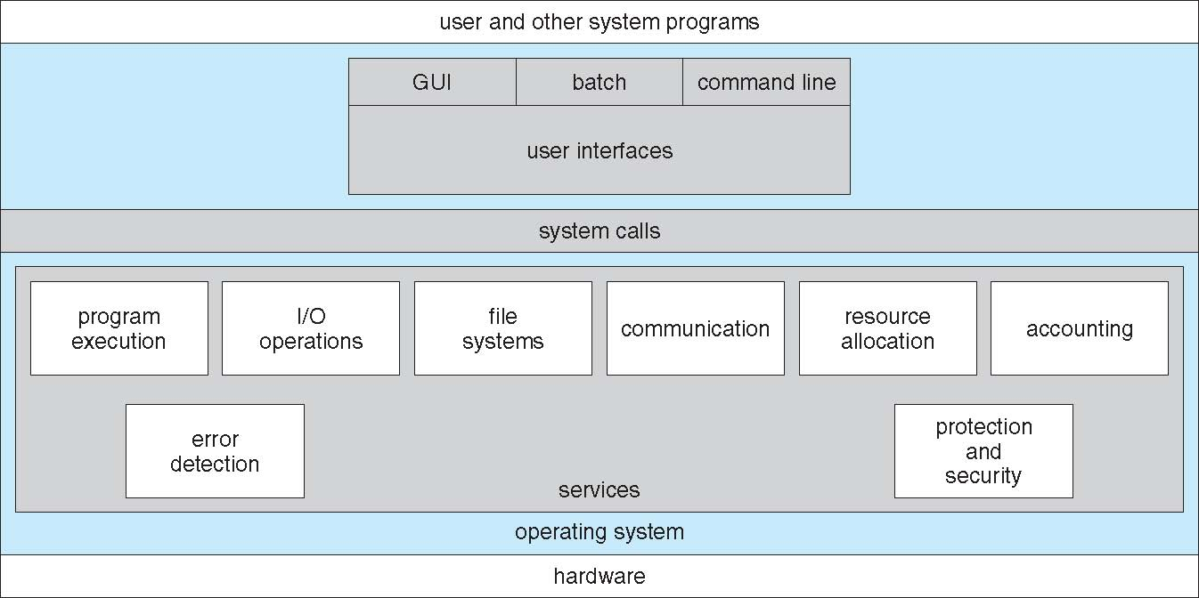
A View of Operating System Services

Slide 8
Outline
Operating-System Services
User Operating-System Interface
System Calls
Types of System Calls
System Programs
OS Design and Implementation
Operating-System Structure
Virtual Machines

Slide 9
User Operating System Interface — CLI
Command Line Interface (CLI) or command interpreter allows direct command entry
Sometimes implemented in kernel, sometimes by systems program
Sometimes multiple flavors implemented – shells
Primarily fetches a command from user and executes it
Sometimes commands built-in, sometimes just names of programs
If the latter, adding new features doesn’t require shell modification
Demo: Linux shell …

Slide 10
User Operating System Interface — GUI
User-friendly desktop metaphor interface
Usually mouse, keyboard, and monitor
Icons represent files, programs, actions, etc
Various mouse buttons over objects in the interface cause various actions
Invented at Xerox PARC
Many systems now include both CLI and GUI interfaces
Microsoft Windows is GUI with CLI “command” shell
Apple Mac OS X as “Aqua” GUI interface with UNIX kernel underneath and shells available
Solaris is CLI with optional GUI interfaces (Java Desktop, KDE)

Slide 11
Outline
Operating-System Services
User Operating-System Interface
System Calls
Types of System Calls
System Programs
OS Design and Implementation
Operating-System Structure
Virtual Machines

Slide 12
System Calls
Programming interface to the OS services

Slide 13
Transition from User to Kernel Mode

Slide 14
System Calls
Programming interface to the OS services
Format: system_call_name (parameters)
Typically written in a high-level language (C or C++)
E.g., open (“lab1.pdf”, O_RDONLY)

Slide 15
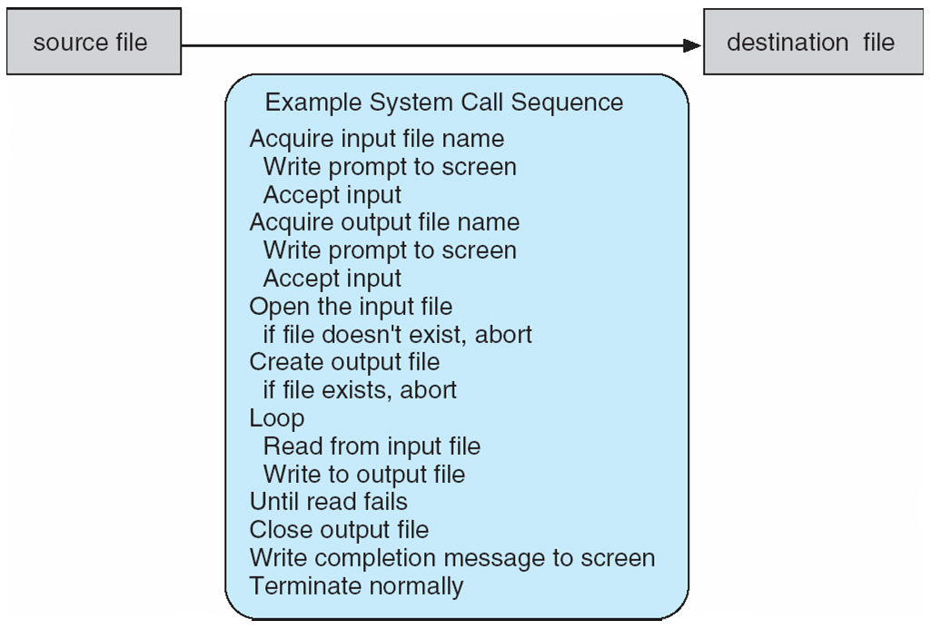
Example of System Calls
System call sequence to copy the contents of one file to another file

Slide 16
System Calls
Programming interface to the OS services
Typically written in a high-level language (C or C++)
Mostly accessed by programs via a high-level Application Program Interface (API) rather than direct system call use
Three most common APIs
Win32 API for Windows
POSIX API for POSIX-based systems (including virtually all versions of UNIX, Linux, and Mac OS X)
Java API for the Java virtual machine (JVM)

Slide 17
Example of Standard API
ReadFile() function in the Win32 API — a function for reading from a file
A description of the parameters passed to ReadFile()
HANDLE file—the file to be read
LPVOID buffer—a buffer where the data will be read into and written from
DWORD bytesToRead—the number of bytes to be read into the buffer
LPDWORD bytesRead—the number of bytes read during the last read
LPOVERLAPPED ovl—indicates if overlapped I/O is being used

Slide 18
System Call Implementation
Typically, a number associated with each system call
System-call interface maintains a table indexed according to these numbers
E.g., sys_call_table in Linux (see http://lxr.linux.no/#linux+v2.6.36/arch/x86/kernel/syscall_table_32.S)
The system call interface invokes intended system call in OS kernel and returns status of the system call and any return values
The caller need not know how the system call is implemented
Just needs to obey API and understand what OS will do
Most details of OS interface hidden from programmer by API
Managed by run-time support library (set of functions built into libraries included with compiler)
Notes:
http://lxr.linux.no/#linux+v2.6.36/arch/x86/kernel/syscall_table_32.S

Slide 19
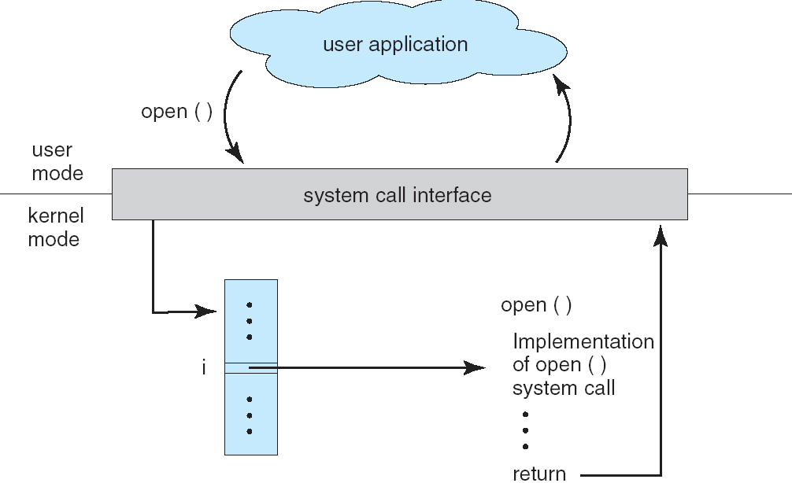
API – System Call – OS Relationship

Slide 20
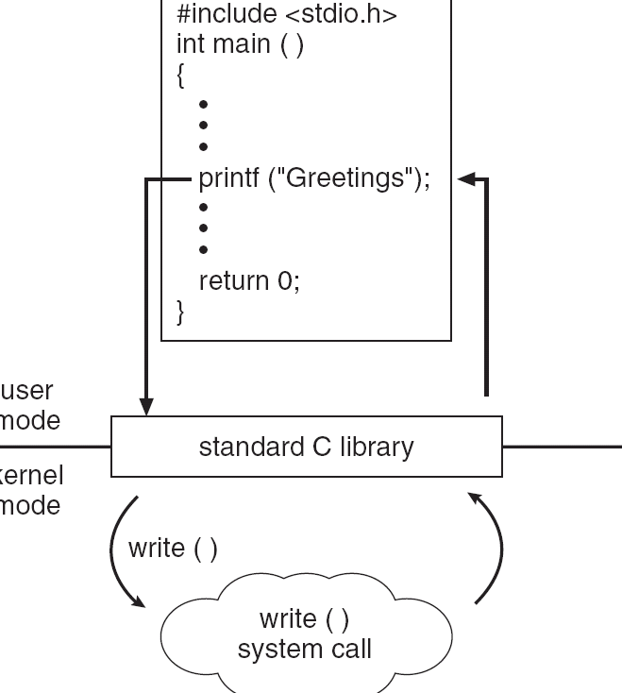
Standard C Library Example
C program invoking printf() library call, which calls write() system call

Slide 21
System Call Parameter Passing
Often, more information is required than simply identity of desired system call
Exact type and amount of information vary according to OS and call
Three general methods used to pass parameters to OS
Simplest: pass the parameters in registers (e.g., Linux, http://lxr.linux.no/#linux+v2.6.36/arch/x86/kernel/entry_32.S, line 530)
In some cases, may be more parameters than registers
Parameters stored in a block in memory and address of block passed as a parameter in a register
Parameters placed, or pushed, onto the stack by the program and popped off the stack by the OS
Block and stack methods do not limit the number or length of parameters being passed
Notes:
http://lxr.linux.no/#linux+v2.6.36/arch/x86/kernel/entry_32.S

Slide 22
Outline
Operating-System Services
User Operating-System Interface
System Calls
Types of System Calls
System Programs
OS Design and Implementation
Operating-System Structure
Virtual Machines

Slide 23
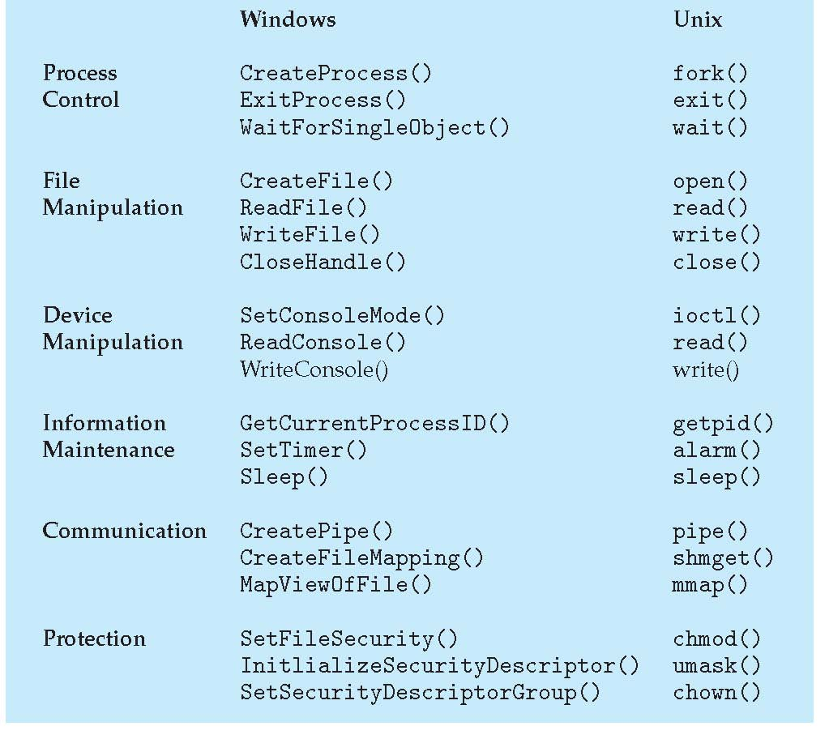
Types of System Calls
E.g., http://lxr.linux.no/#linux+v2.6.36/arch/x86/kernel/syscall_table_32.S

Slide 24
Outline
Operating-System Services
User Operating-System Interface
System Calls
Types of System Calls
System Programs
OS Design and Implementation
Operating-System Structure
Virtual Machines

Slide 25
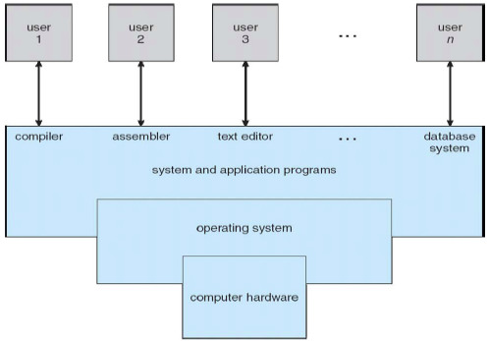
System Programs
System programs (system utilities) provide a convenient environment for program development and execution
Most users’ view of the operation system is defined by system programs, not the actual system calls
E.g., GNU utilities for Linux

Slide 26
System Programs
File management
Create, delete, copy, rename, print, dump, list, and generally manipulate files and directories
Status information
System information — date, time, amount of available memory, disk space, number of users
Detailed performance, logging, and debugging information
Typically, these programs format and print the output to the terminal or other output devices
Some systems implement a registry — used to store and retrieve configuration information

Slide 27
System Programs
File modification
Text editors to create and modify files
Special commands to search contents of files or perform transformations of the text
Programming-language support
Compilers, assemblers, debuggers, and interpreters
Program loading and execution
Loaders, linkers, debugging systems
Communications
Provide the mechanism for creating virtual connections among processes, users, and computer systems
Allow users to send messages to one another’s screens, browse web pages, send electronic-mail messages, log in remotely, transfer files from one machine to another

Slide 28
Outline
Operating-System Services
User Operating-System Interface
System Calls
Types of System Calls
System Programs
OS Design and Implementation
Operating-System Structure
Virtual Machines

Slide 29
OS Design and Implementation
Design and Implementation of OS not “solvable”, but some approaches have proven successful
Internal structure of different OSes can vary widely
Affected by choice of hardware, type of system
Start by defining goals and specifications
User goals – OS should be convenient to use, easy to learn, reliable, safe, and fast
System goals – OS should be easy to design, implement, and maintain, as well as flexible, reliable, error-free, and efficient

Slide 30
OS Design and Implementation
One important principle is to separate policy fro mechanism
Policy: What will be done?
E.g., I/O intensive programs should have higher priority than CPU-intensive ones
Mechanism: How to do it?
E.g., giving priorities to certain types of programs over others
Allows maximum flexibility if policy decisions are to be changed later
Otherwise each change in policy requires a change in mechanism

Slide 31
Outline
Operating-System Services
User Operating-System Interface
System Calls
Types of System Calls
System Programs
OS Design and Implementation
Operating-System Structure
Virtual Machines

Slide 32
Simple Structure
MS-DOS – written to provide the most functionality in the least space
Not divided into modules
Although MS-DOS has some structure, its interfaces and levels of functionality are not well separated
Limited by the hardware of its era
Intel 8088 has no dual mode, no hardware protection

Slide 33
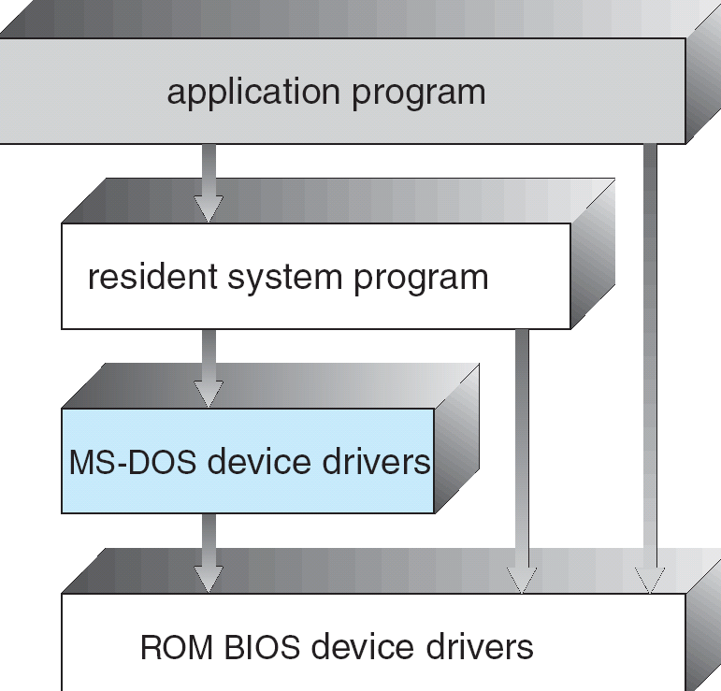
MS-DOS Layer Structure

Slide 34
UNIX
Limited structuring with two separable parts
Limited by the original hardware functionality too
Systems programs
The kernel
Everything below the system-call interface and above the physical hardware
A large number of functions for one level: File system, CPU scheduling, memory management, and other OS functions

Slide 35
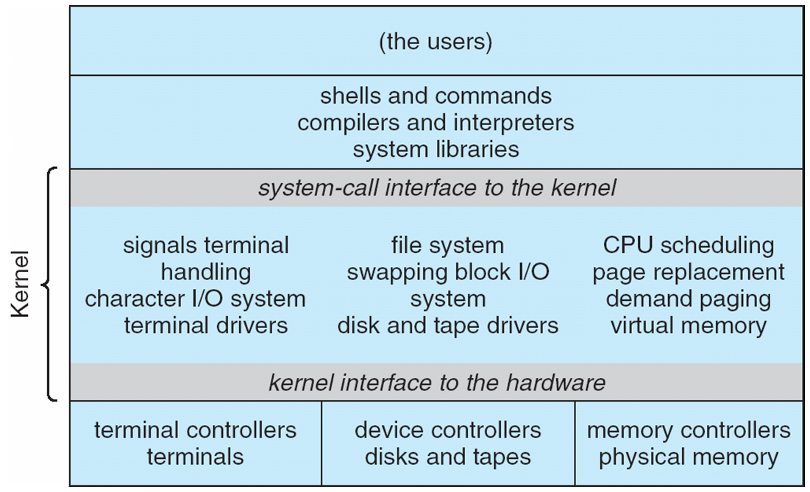
Traditional UNIX System Structure

Slide 36
Layered Approach
The OS is divided into a number of layers (levels), each built on top of lower layers
The bottom layer (layer 0) is the hardware
The highest (layer N) is the user interface
With modularity, layers are selected such that each uses functions (operations) and services of only lower-level layers
Advantage: simple to construct and debug
Difficulty: hard to appropriately define the layers; tend to be less efficient with more layers

Slide 37
Microkernel System Structure
Moves as much from the kernel into “user” space
Communication takes place between user modules using message passing
Benefits:
Easier to extend a microkernel
Easier to port the operating system to new architectures
More reliable (less code is running in kernel mode)
More secure
Detriments:
Performance overhead of user space to kernel space communication
Windows NT → Windows XP

Slide 38
Modules
Most modern OSes implement kernel modules
Uses object-oriented approach
Each core component is separate
Each talks to the others over known interfaces
Each is loadable as needed within the kernel
Allows kernel to provide core services and modules to implement certain features dynamically
Examples: Solaris, Linux, Mac OS X
Similar to layered approach but more flexible
Each module has defined, protected interfaces
Any module can call any other one
Similar to microkernel approach but more efficient
The primary module has only core functions
Modules do not need to use message passing to communicate

Slide 39
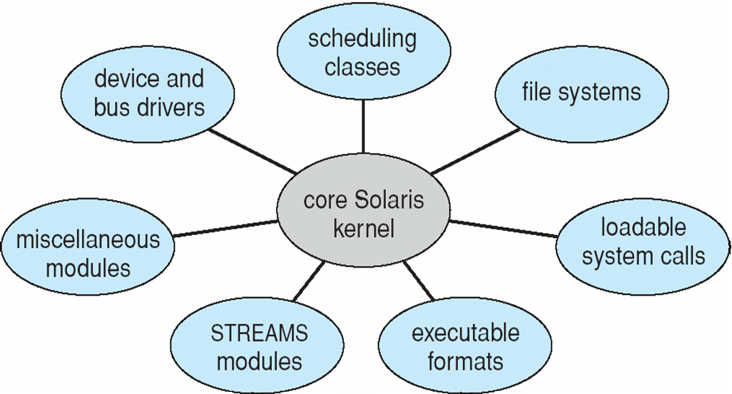
Solaris Modular Approach

Slide 40
Outline
Operating-System Services
User Operating-System Interface
System Calls
Types of System Calls
System Programs
OS Design and Implementation
Operating-System Structure
Virtual Machines

Slide 41
Virtual Machines
Logical computers presented by software
Provide an interface identical to the underlying bare hardware
Implemented by virtual machine monitor (VMM, a.k.a., hypervisor)

Slide 42
Virtual Machines
A physical machine
Processor
Misc I/O
User interface
Storage
Network

Slide 43
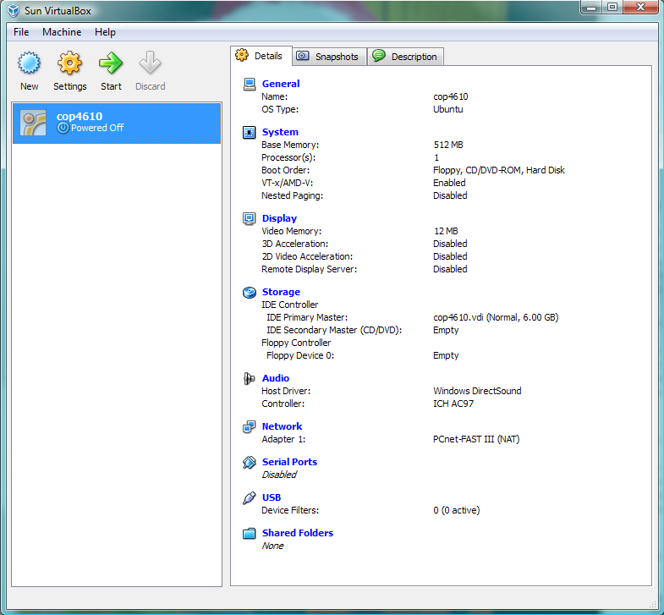
Virtual Machines
A virtual machine

Slide 44
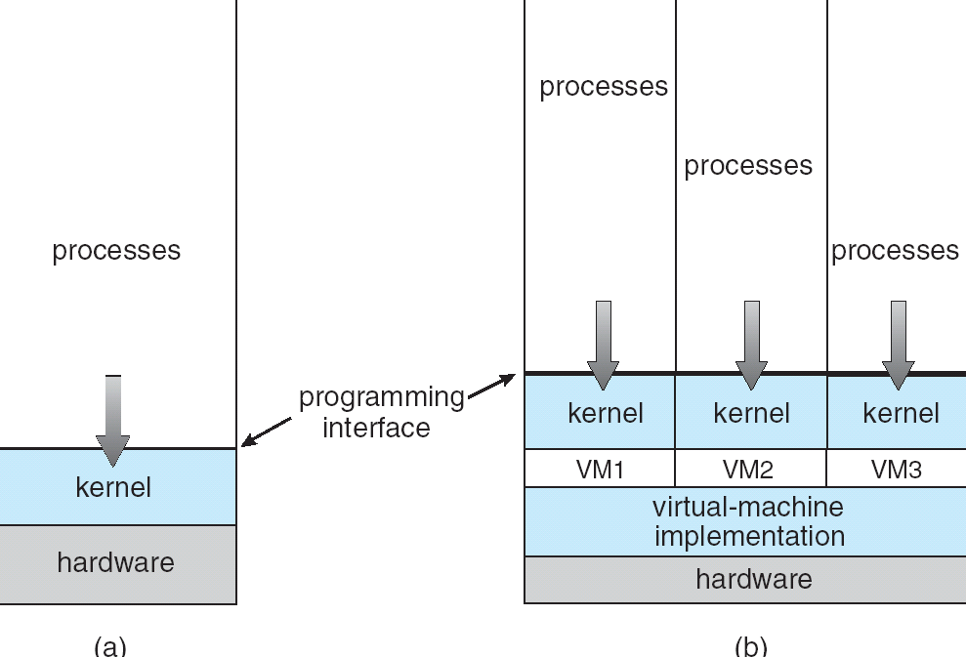
Virtual Machine Structure
(a) Non-virtualized (b) Virtualized
Non-virtual Machine
Virtual Machine
(VMM)

Slide 45
Virtual Machines History and Benefits
First appeared commercially in IBM mainframes in 1972
Revived on x86 in the last ten years: VMware, Xen, VirtualBox, KVM, etc.
Resource sharing with security and isolation
Similar to multi-user/multi-programming
Consolidates many underutilized systems into fewer fully utilized systems
Ease of use and management
Virtual (software) vs. physical (hardware)
Useful for development, testing

Slide 46
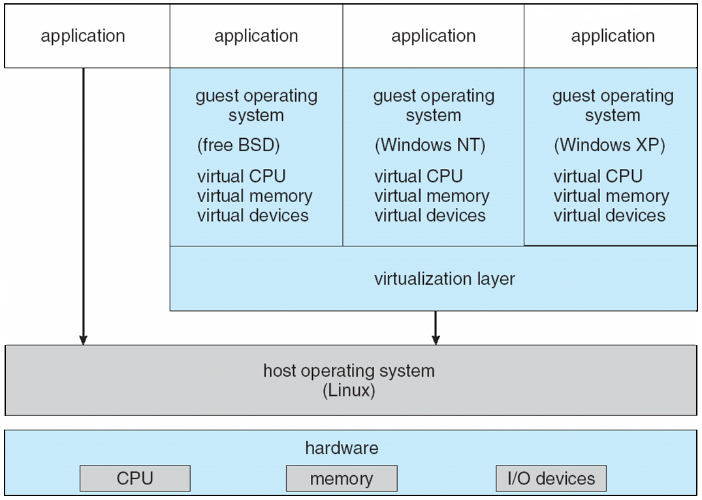
VMware Architecture

Slide 47
Outline
Operating-System Services
User Operating-System Interface
System Calls
Types of System Calls
System Programs
OS Design and Implementation
Operating-System Structure
Virtual Machines

Slide 48
OS Generation
OSes are commonly designed to run on any of a class of machines
To deploy an OS it must be configured or generated for each specific computer site
A process known as SYSGEN
A deployed OS cannot be easily ported to a different computer
SYSGEN program obtains information concerning the specific configuration of the hardware system
Reads from a configuration file (e.g., .config)
Ask the operator of the system (e.g., menuconfig)
Probes the hardware directly to determine the configuration

Slide 49
System Boot
Booting — starting a computer by loading the kernel
How does the hardware start the kernel?
Bootstrap program (bootstrap loader)
Small piece of code that locates the kernel, loads it into memory, and starts it
On CPU reset, execution starts at a fixed memory location where the bootstrap program is stored in ROM or EPROM (firmware)
Some computers (e.g., PCs) use two-step process
Initial bootstrap program executes a more complex boot program from the boot block on the boot disk (GRUB)
The on-disk bootstrap program then loads the OS from disk

Slide 50
OS Debugging
Debugging is finding and fixing errors, or bugs
Failure analysis
OSes generate log files containing error information
Failure of an application can generate core dump file capturing memory of the process
OS failure can generate crash dump file containing kernel memory
Performance tuning
Identifies bottlenecks and optimizes system performance
Kernighan’s Law
“Debugging is twice as hard as writing the code in the ﬁrst place. Therefore, if you write the code as cleverly as possible, you are, by deﬁnition, not smart enough to debug it.”
Notes:
Failure analysis: something does not work
Performance tuning: something does not work well

Slide 51
Homework
2.1, 2.5, 2.7, 2.10
2.13, 2.14, 2.20, 2.21

Slide 52
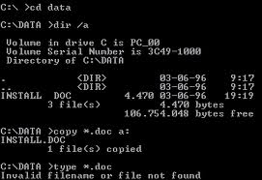
Example CLI: DOS

